Slide 1
Kristiyan Titriyski Opposite Hitter

Slide 2
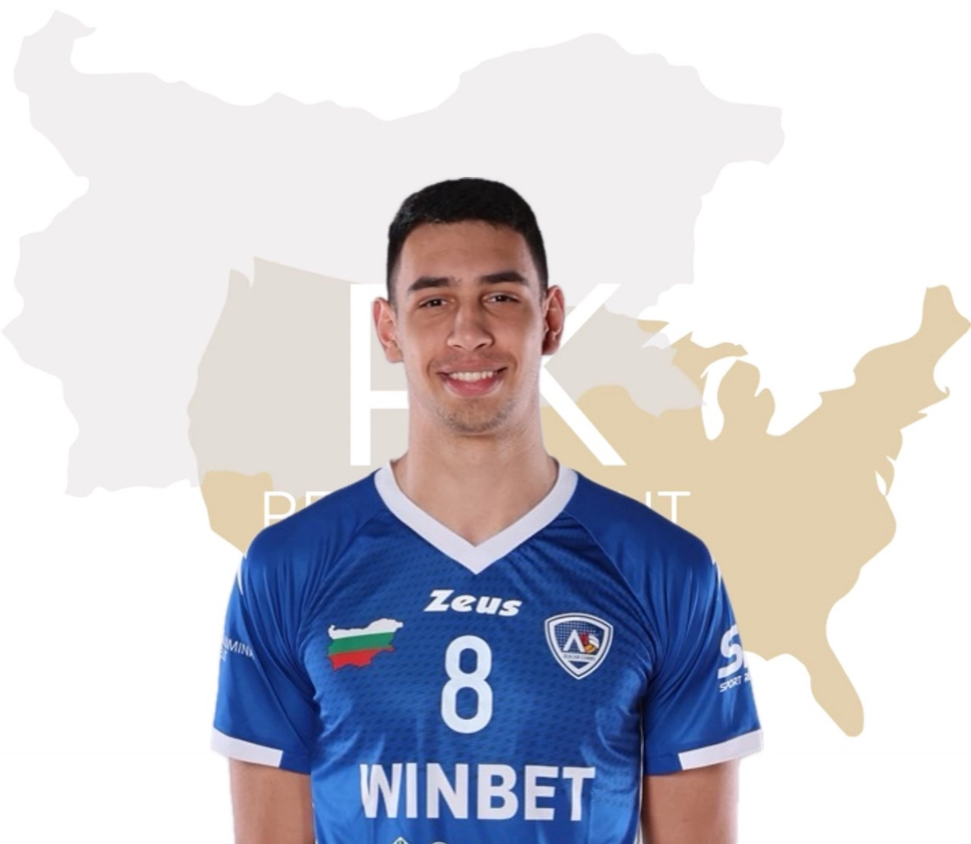
Status: Available
Gender: Male
Position: Opposite Hitter
Date of Birth: 05.06.2005
Graduation date: June, 2024
Club team: VC Levski Sofia

Slide 3
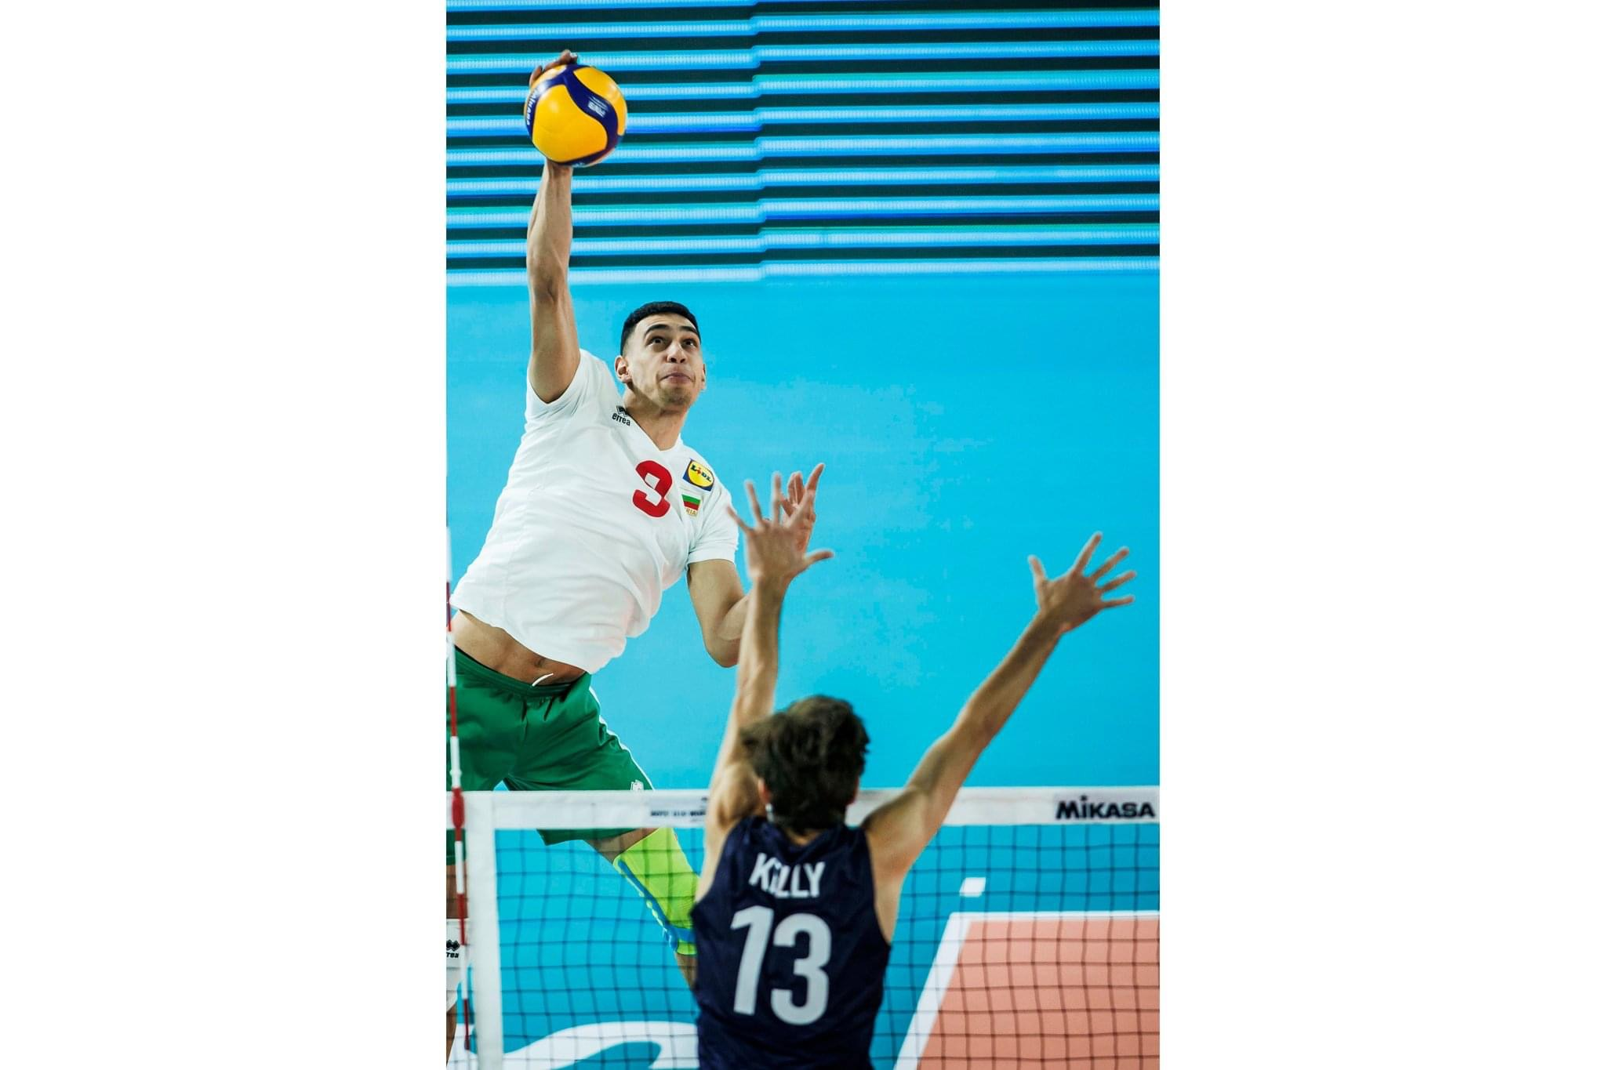

Slide 4
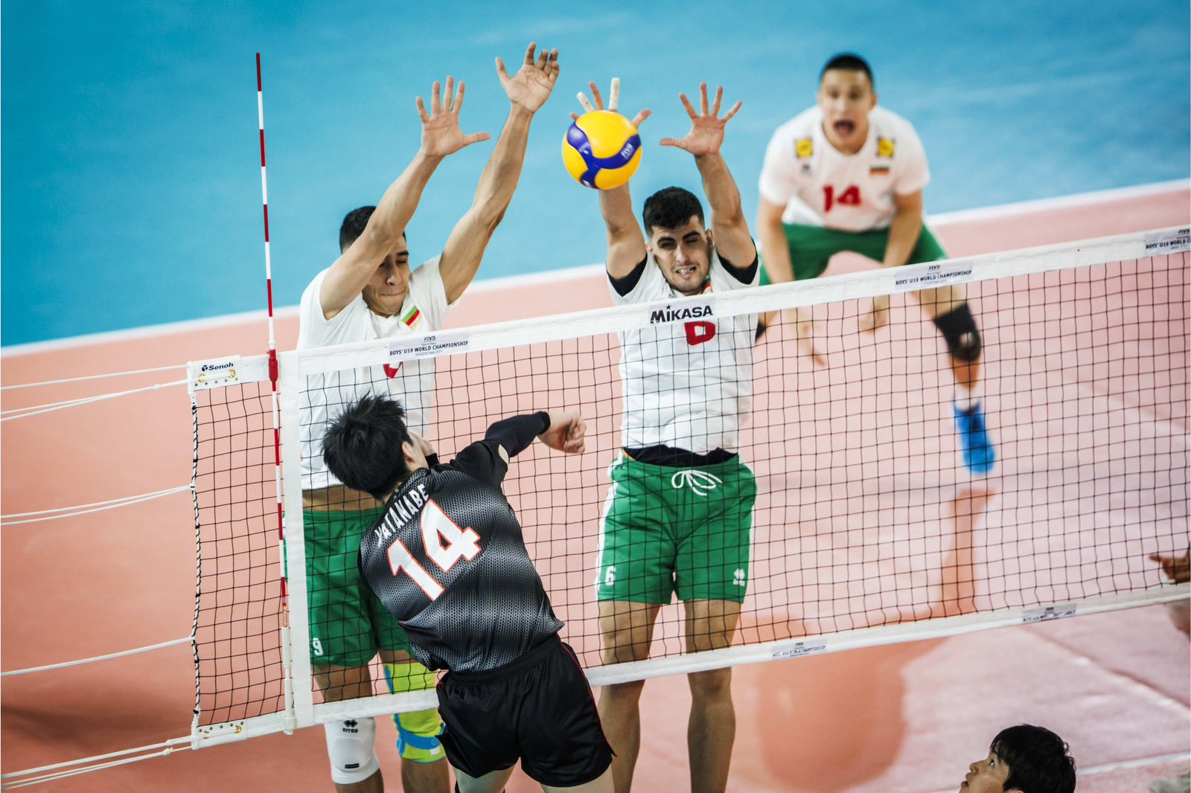

Slide 5
Additional Information
Height: 204 cm.
Weight: 93 kg.
Reach: 267 cm
Standing high jump: 335 cm
Approach high jump: 355 cm
Languages: Bulgarian, English, Russian
Desired degree: TBA
TOEFL grade: TBA

Slide 6
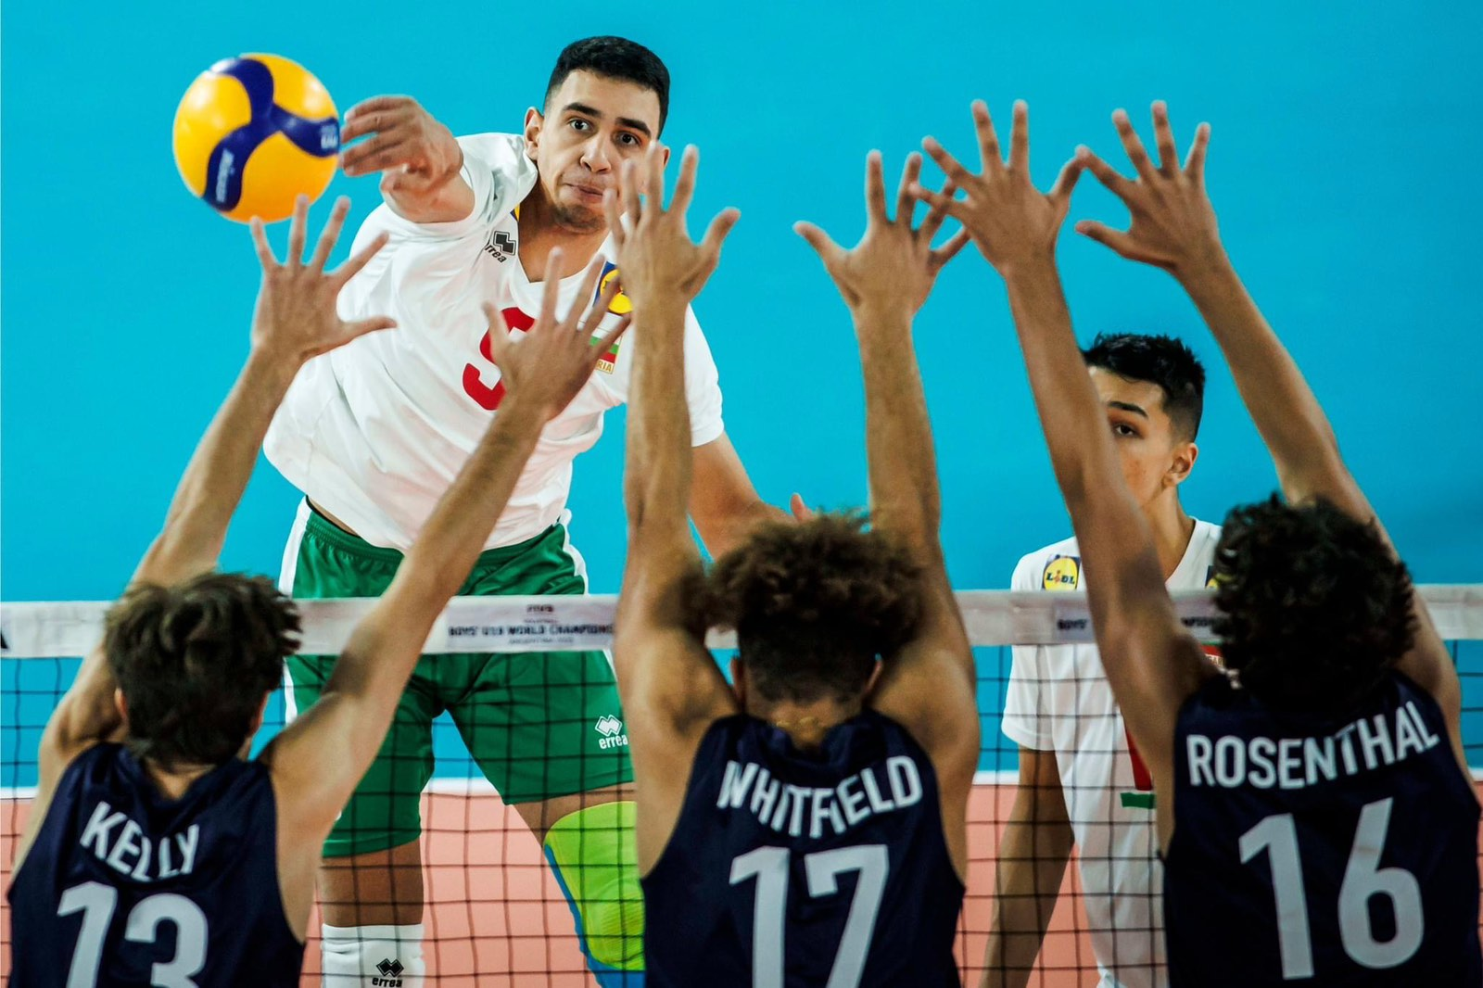

Slide 7
Athletic achievements:
Bulgarian National team:
2023 World championship under 19 - Best scorer
2023 Balkan championship under19 - Best opposite
2023 Tournament in Brazil - MVP
Club team:
2022 Republican championship - Best spiker
2021 Republican championship - Best spiker

Slide 8
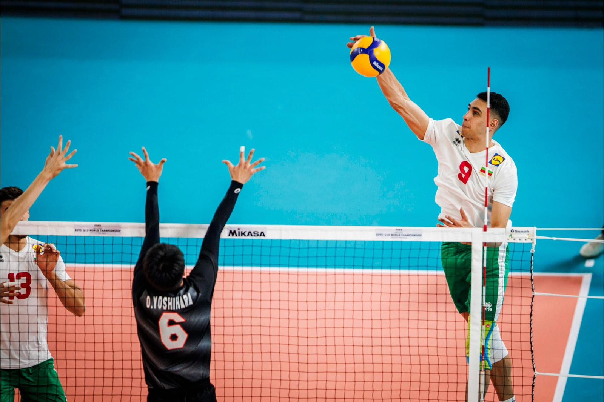

Slide 9
National team:
2021 European championship under 17 - 5th place
2022 European championship under 18 - 3rd place
2023 World championship under 19 - 5th place
2022 Balkan championship - 2nd place
2023 Balkan championship - 2 place
2023 Tournament in Brazil - 2nd place
Club team:
2021 Republican championship 1st place for boys under 19
2021 Republican championship 1st place for boys under 18
2022 Republican championship 1st place for boys under 18
2022 Republican championship 1st place for boys under 19
2023 Republican championship 1st place for boys under 20

Slide 10
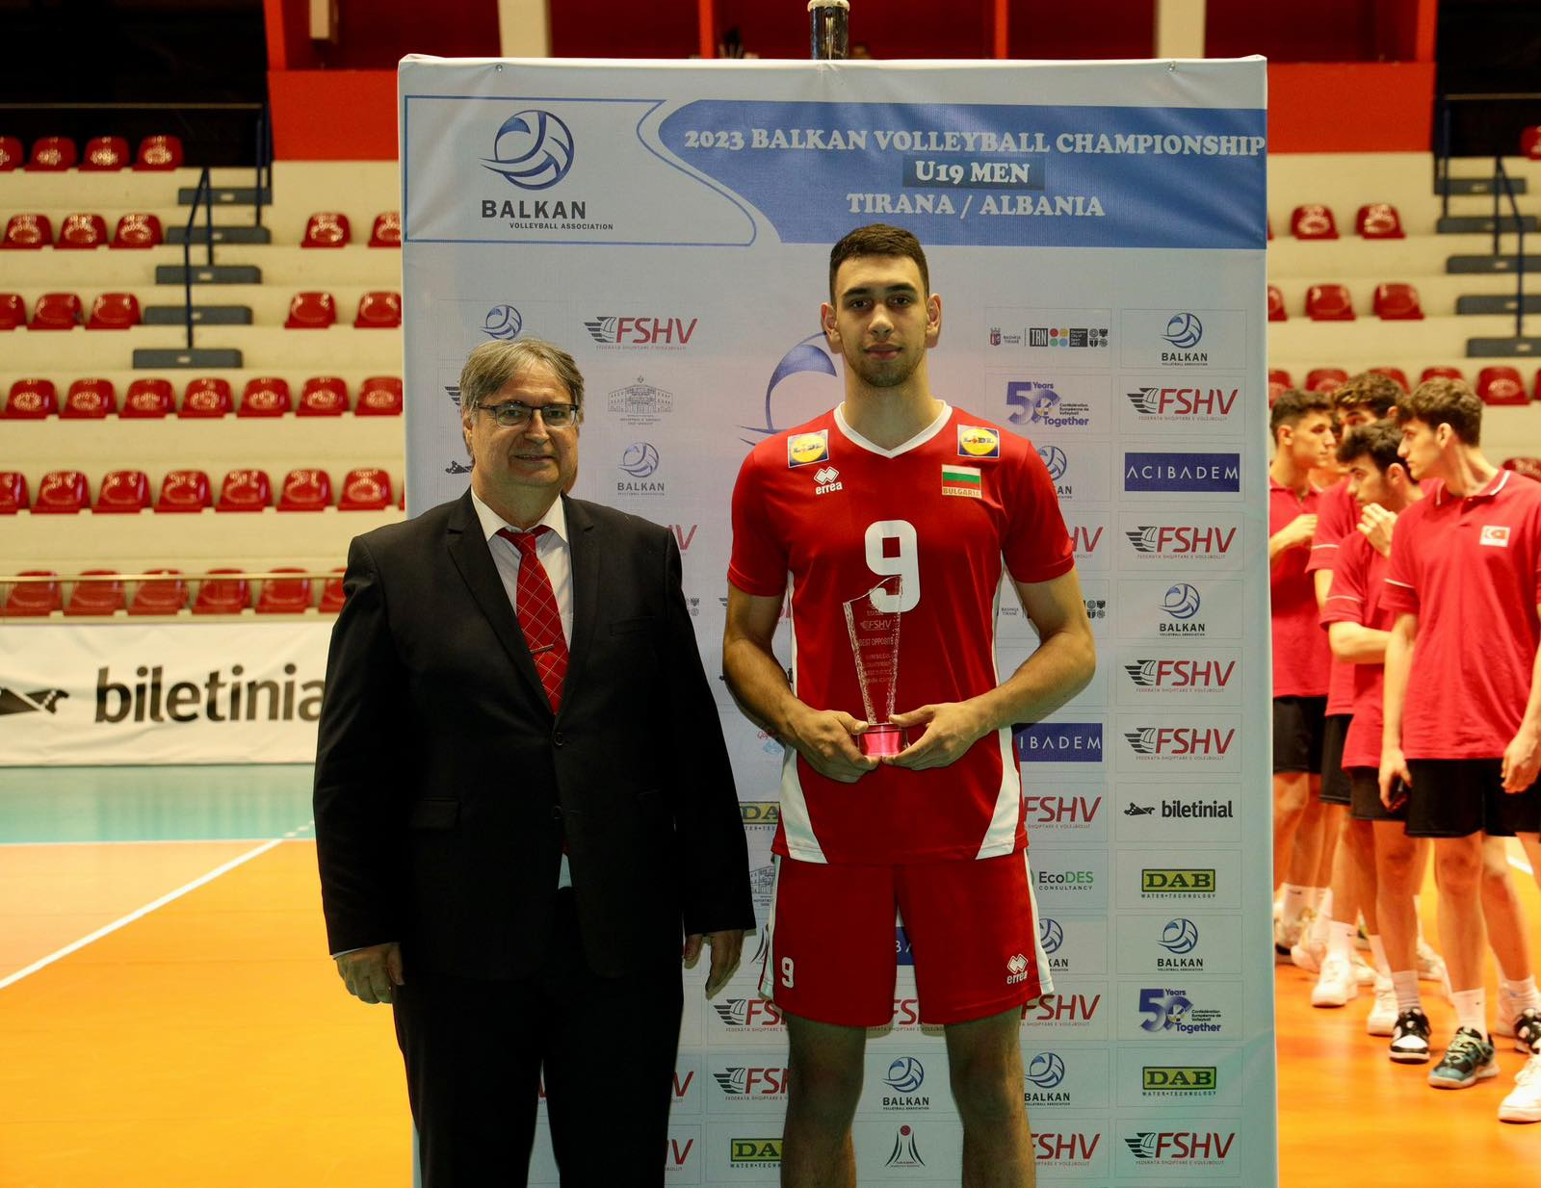

Slide 11
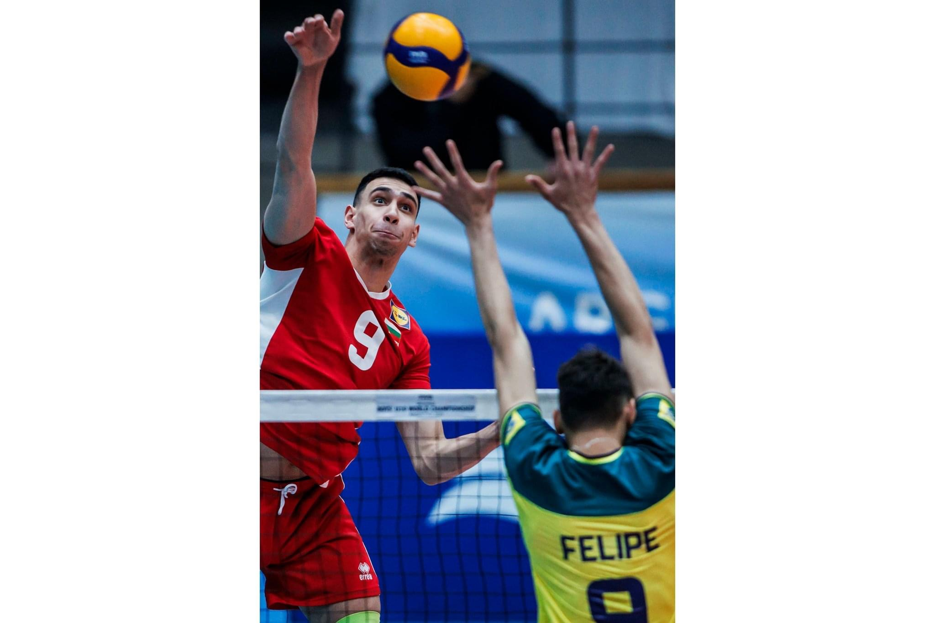

Slide 12
Describe yourself with a few sentences:
I am working hard to achieve my dreams. I consider myself as a
talented player and my ambitions for this sport are high. I love my family and
friends and spending time with them.
What does volleyball mean to you?
Volleyball is my life. I want to be the best in
it so I put a lot of effort while I am practicing. I want to continue with it after
finish studying.
What are your main goals as a student-athlete in the USA?
To play at high level and at the same time to get better grades in college or university. The combination of both may sometimes be hard to release but I am sure soon the whole process would bring me nothing but benefits.

Slide 13
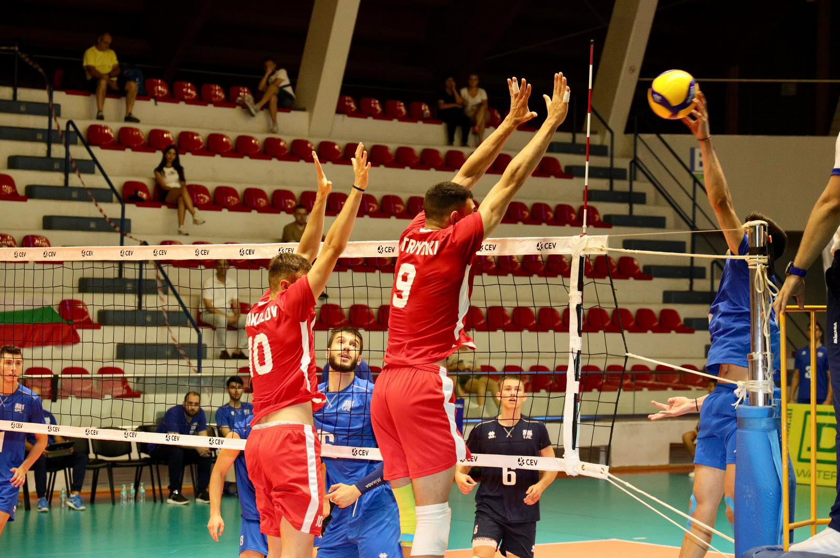

Slide 14
Video Analysis
Highlight video:
https://www.youtube.com/watch?v=nVd6Ujno61I

Slide 15
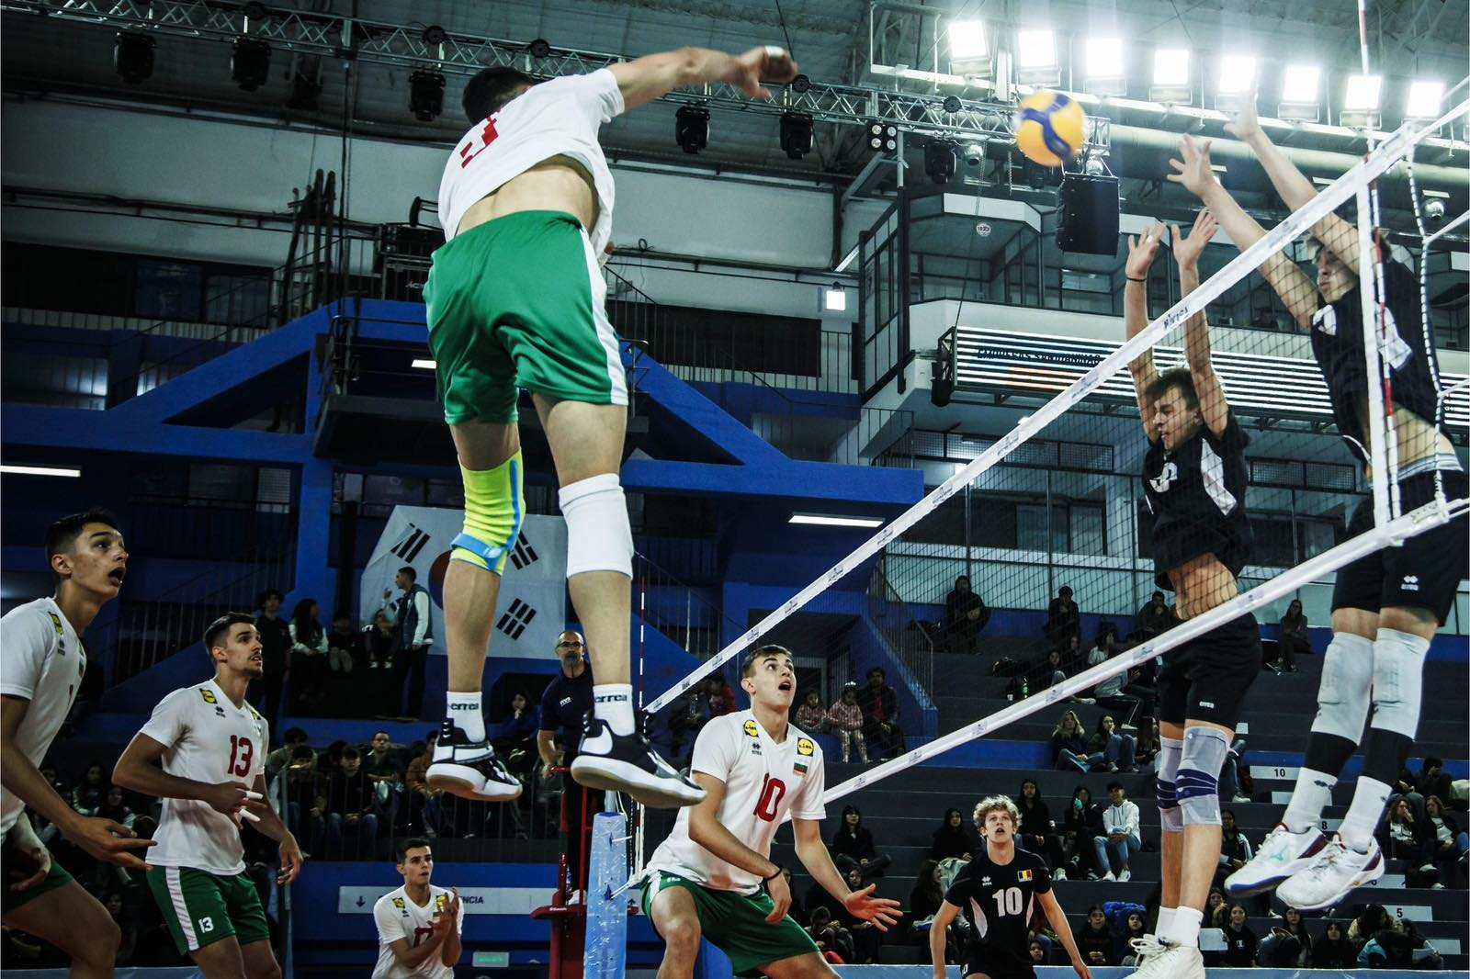

Slide 16
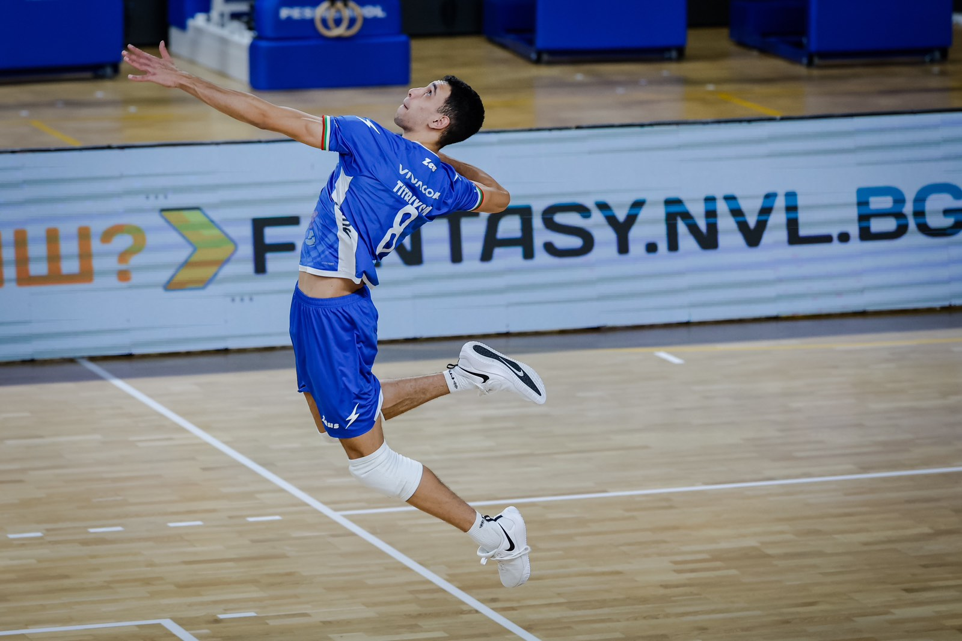

Slide 17
The presentation provides all the basic information for the student-athlete. More details and video can be provided if needed. Contact us.

