Slide 1






Sports with no borders
Participating schools:
Charlemagne College Eijkhagen, Landgraaf (coordinator)
I.E.S. Santa Maria la Real, Aguilar de Campoo
Carolus-Magnus-Gymnasium, Übach Palenberg
Joyce Frankland Academy, Newport

Slide 2


Main goals of the project
social inclusion through sports
gender equality through sports
getting more students involved in sports practising together (mens sana in corpore sano)
acquaintance with sports from other countries (every country brings in one sport)
acquaintance with minority sports
studying the rules and adapting them to own environment to make the sports more equal
broadening collaboration by students
Supported by / inclusion of English and PE
Cross curricular activity on orienteering also by geography and maths!

Slide 3
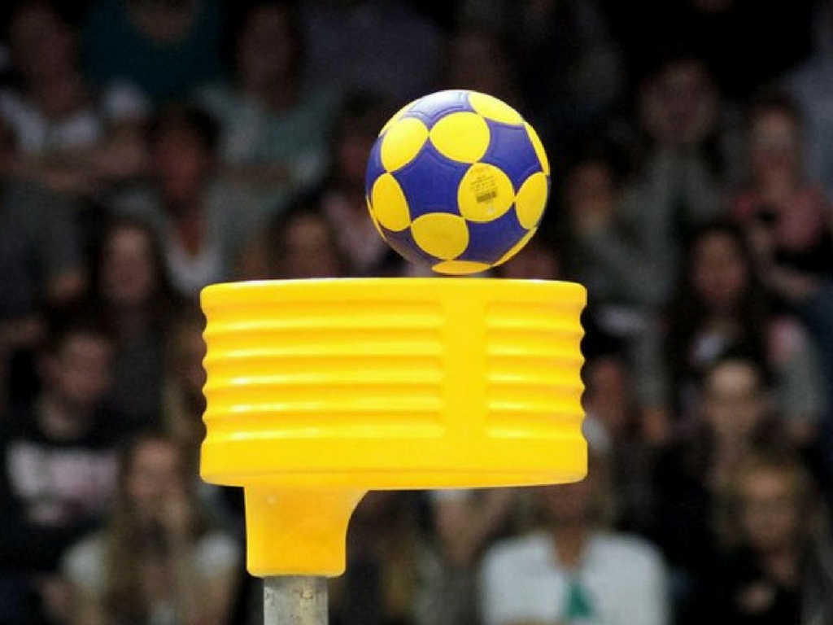

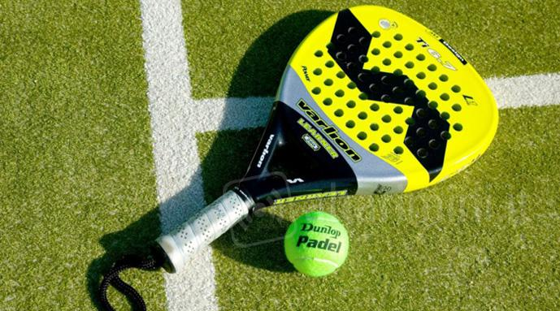
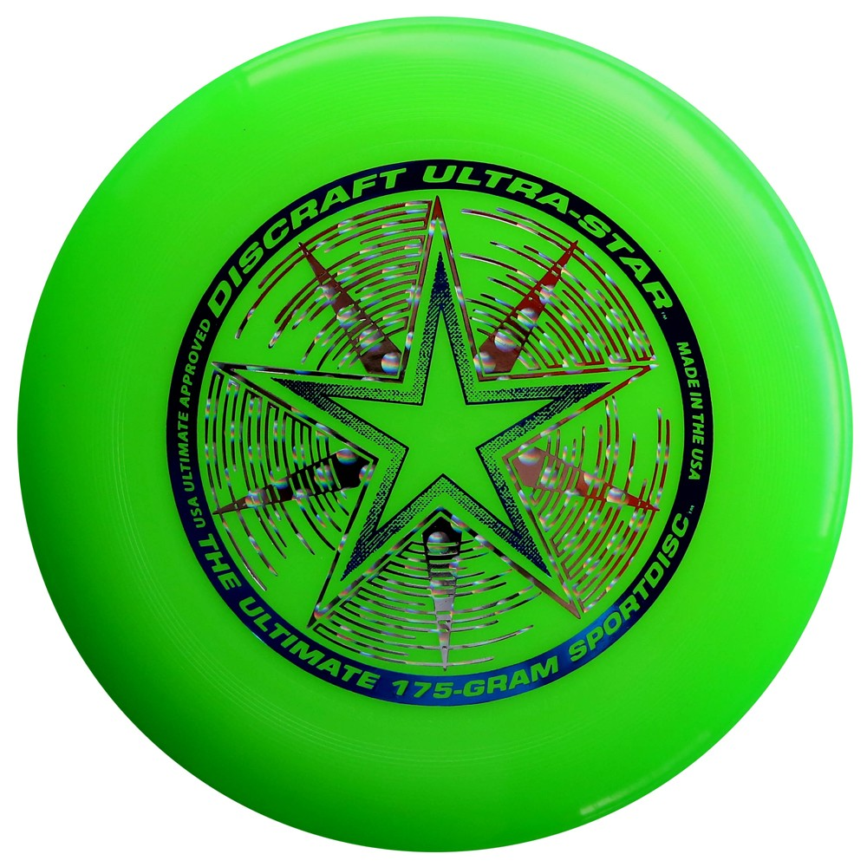
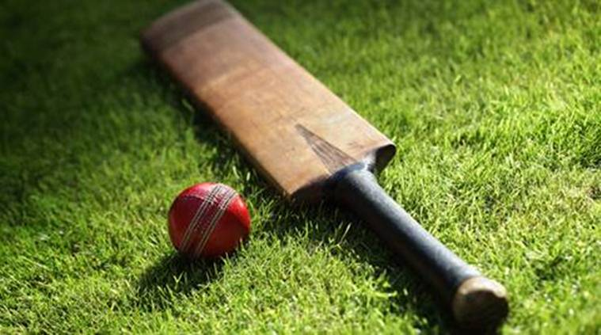
Sports to bring in
Charlemagne College Eijkhagen: KORFBALL →
I.E.S. Santa Maria la Real: PADDLE TENNIS →
Carolus-Magnus-Gymnasium: ULTIMATE FRISBEE →
Joyce Frankland Academy Newport: CRICKET →

Slide 4
Distribution of main tasks
Charlemagne College Eijkhagen: coordination of the project, creating evalution materials and analysing results
I.E.S. Santa Maria la Real: coordination of orienteering materials and collecting all students works of the different sports
Joyce Frankland Academy: making sure that the programs of the short term exchanges fulfill all objectives, correcting the English language of all materials produced by the students
Carolus-Magnus-Gymnasium: coordinator of the website and eTwinning

Slide 5


Joint activities 2018-2019
October 2018:
Introduction and practising of the new sports by the staff, preparing assignments for the students and making further plans together (“introducing new sports in our lives”)
January- March 2019:
Organisation short term exchanges students
(“let’s meet and play 1 and 2”) :
- Charlemagne College Eijkhagen ↔ I.E.S. Santa Maria la Real
- Carolus-Magnus-Gymnasium ↔ Joyce Frankland Academy Newport

Slide 6

Joint activities 2019-2020
October 2019:
Evaluation in Germany by staff: process, activities, materials, etc.
January - March 2020:
Organisation short term exchanges students (“let’s go on 1 and 2”):
- Charlemagne College Eijkhagen ↔ Joyce Frankland Academy Newport
- I.E.S. Santa Maria la Real ↔ Carolus-Magnus-Gymnasium
April 2020:
Evaluation materials by 4 embassadors from each school to realise the final rules for the sports (“let’s evaluate together): Eijkhagen ↔ CMG, Santa Maria la Real ↔ JFAN
May 2020:
Final tournament in Aguilar de Campoo where at least 4 students from each school will take part
(“let’s try and test together”)

Slide 7
Main objectives
We want to:
promote social inclusion (32 students from each school will be involved)
stimulate interaction between our students by using English and through doing sports together
enhance critical thinking through creating and analizing the rules of the different sports
create European cross curricular material that can be used in the curriculum of every participating school (by orienteering as well)
broaden our students horizons and competences to live as European citizens --> improving cultural awareness

Slide 8


