Slide 1
Med High’s Equality and Equity
By: Marilia Teneketzidi and Yali Vaknin

Slide 2
About Med High
In the lively and welcoming environment of our school, all students are equal among each other, and individuals from countries reaching all around the globe socialise, grow and learn together in an adequate surrounding.
The school provides education of the highest standards, ensuring the students’ future success and simultaneously ensuring all students are educated in ways they comprehend; academic support is provided when necessary, hence proving the equity distributed in our school.

Slide 3
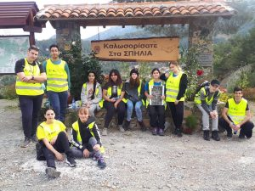
The Duke of Edinburgh
Med High takes part in the prominent Duke of Edinburgh, accompanying individuals from various ages to a challenge of cooperation - The Duke of Edinburgh empowers and supports young people as they learn new skills, overcome obstacles, and build confidence and resilience.
In the students’ journey, our school establishes a path of equality yet equity, instructed to help peers with academic or accustomed struggles and encounter the same challenges and tasks.

Slide 4
The Duke of Edinburgh
Duke of Edinburgh focuses on a variety of different skills and activities including volunteering in civil services, supporting people with disabilities or in need and also physical skills like team sports or individual sports. Thus, it also enhances equity as each individuals’ particular interests, skills, abilities along with difficulties are all taken into consideration to suit everyone equally. A Bronze DofE, for example, has four sections:
Volunteering
Physical
Skills
Expedition
These four unique fields connect our students, as well as other students worldwide, enhancing the activity’s equality.

Slide 5
Thank you for your attention!
☺️☺️☺️

