Slide 1







Sports with no borders
Update….
Participating schools:
Charlemagne College Eijkhagen, Landgraaf (coordinator)
I.E.S. Santa Maria la Real, Aguilar de Campoo
Carolus-Magnus-Gymnasium, Übach Palenberg
Joyce Frankland Academy, Newport

Slide 2

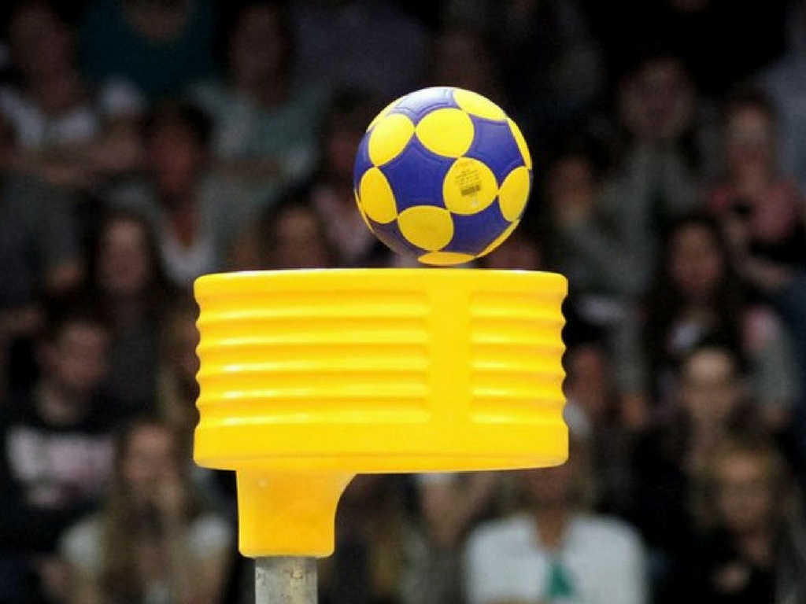
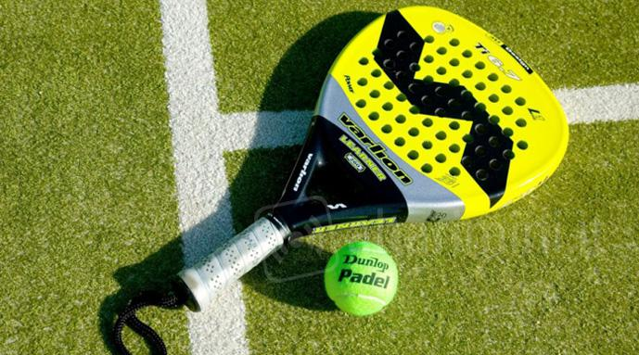

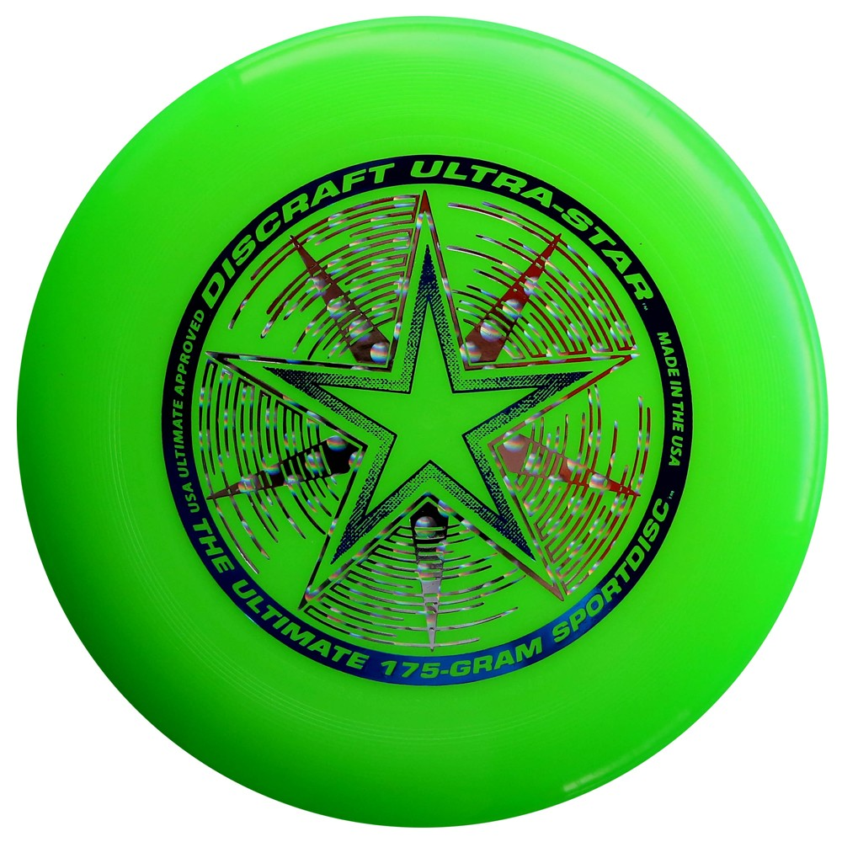
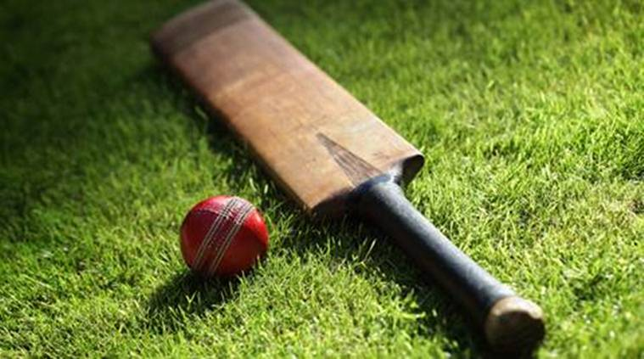
Sports brought in
Charlemagne College Eijkhagen: KORFBALL →
I.E.S. Santa Maria la Real: PADDLE TENNIS →
Carolus-Magnus-Gymnasium: ULTIMATE FRISBEE →
Joyce Frankland Academy Newport: CRICKET →
ORIENTEERING

Slide 3

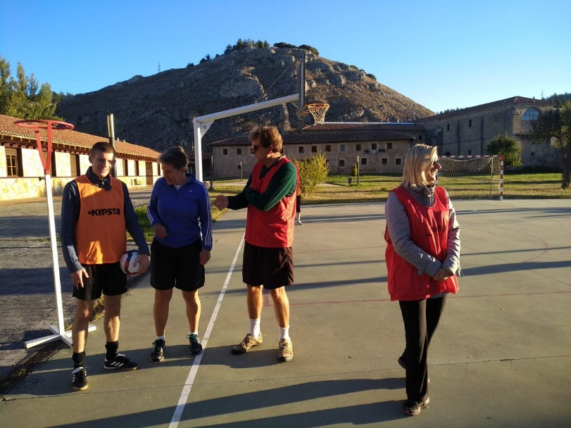
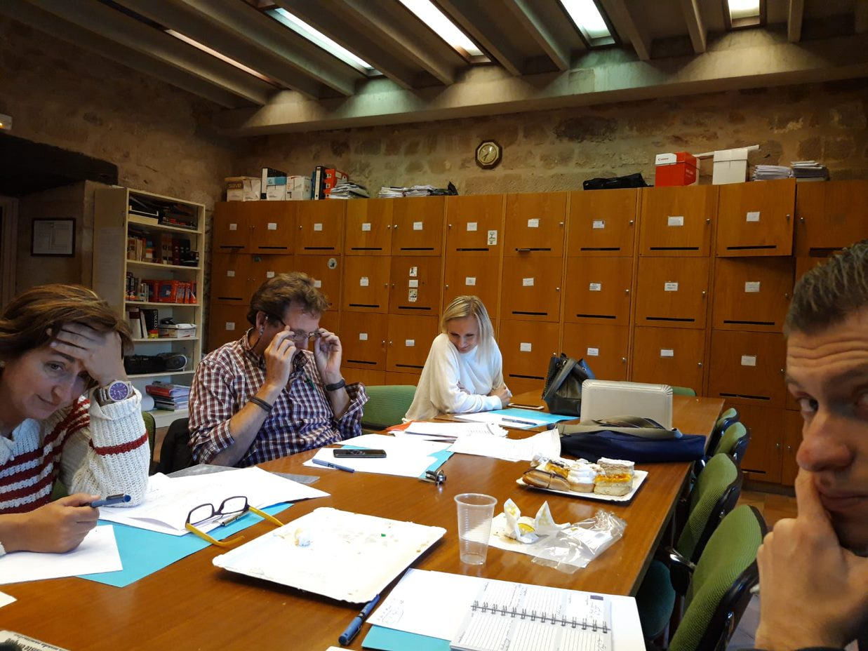
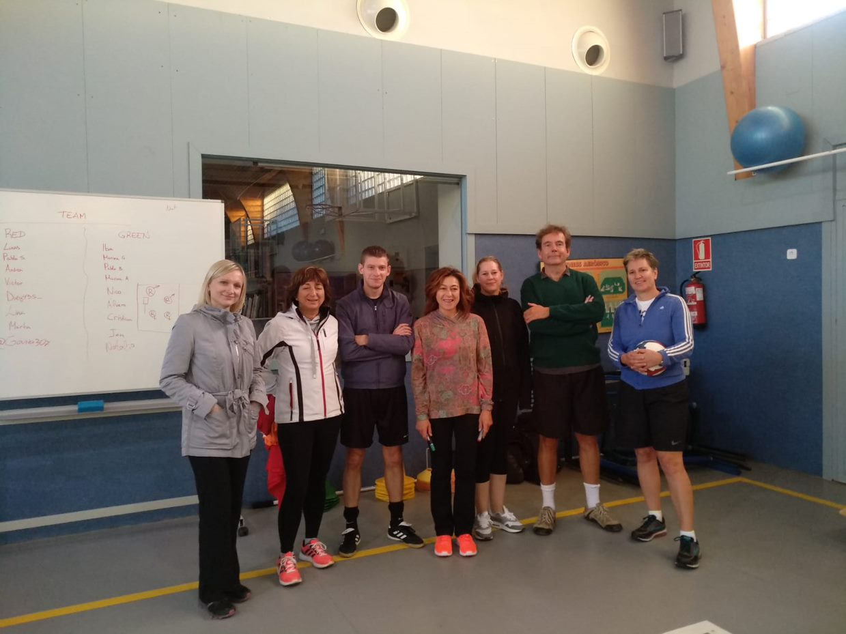

Staff event 2018-2019
Aguilar de Campoo, October 2018:
Preparing assignments for the students and making further plans together, introduction and practising of the new sports by the staff.

Slide 4
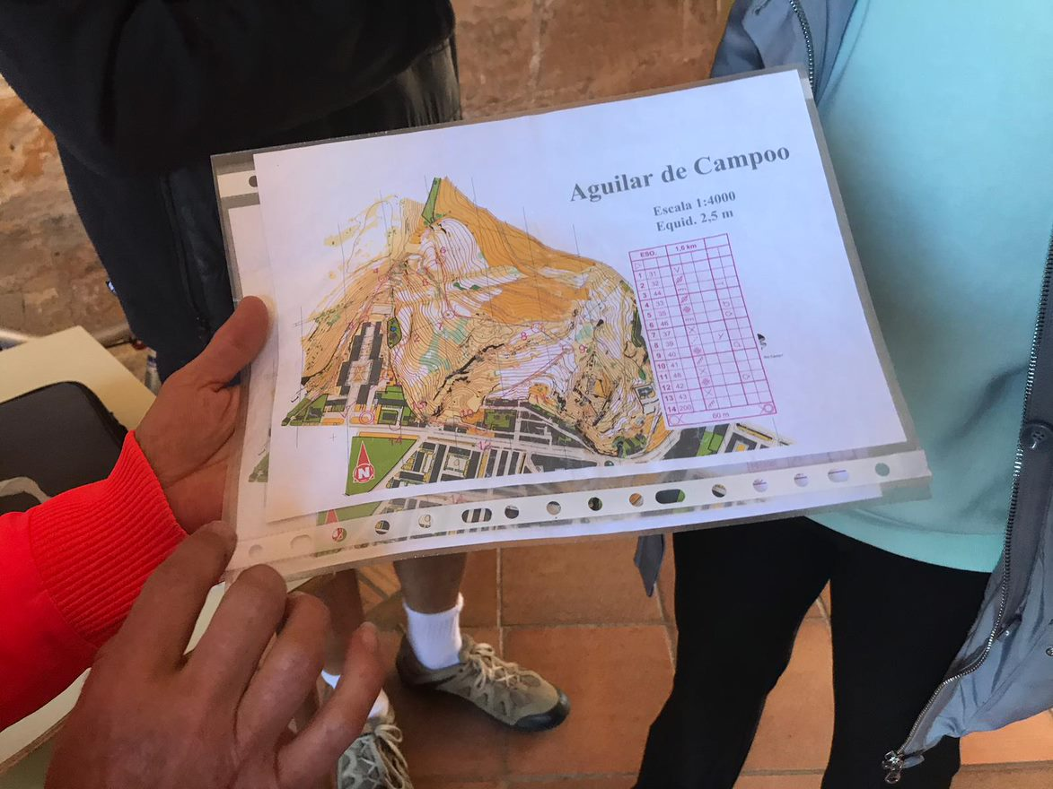
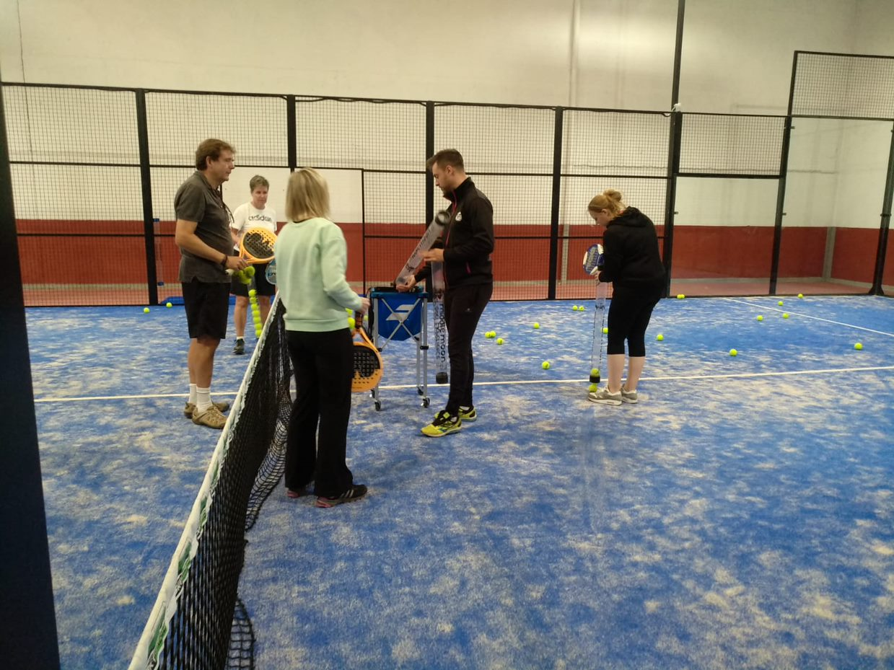
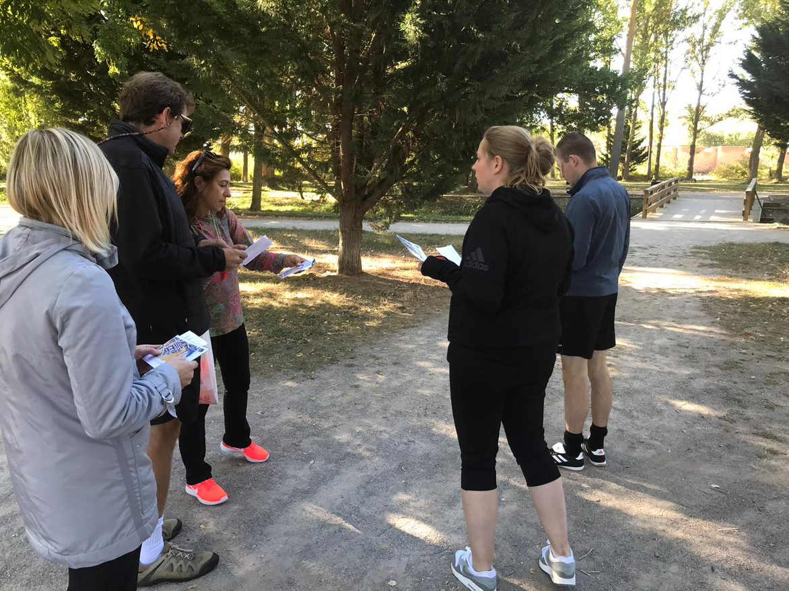
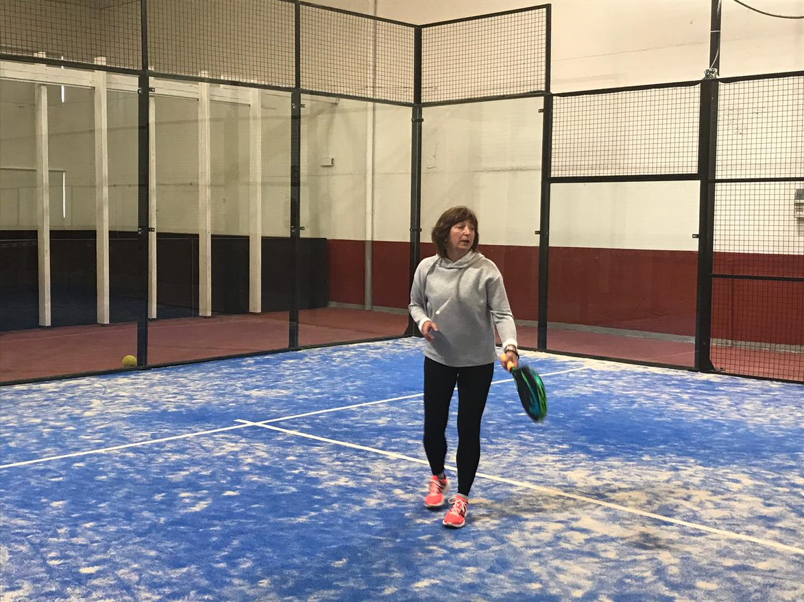
Practising, practising, practising….

Slide 5


Exchanges in 2018-2019
- Charlemagne College Eijkhagen <--> I.E.S. Santa Maria la Real
- Carolus-Magnus-Gymnasium <--> Joyce Frankland Academy Newport
Main goals:
SOCIAL INCLUSION
GENDER EQUALITY
BROADENING COLLABORATION BY STUDENTS
ACQUAINTANCE WITH MINORITY SPORTS
How to realise….?

Slide 6
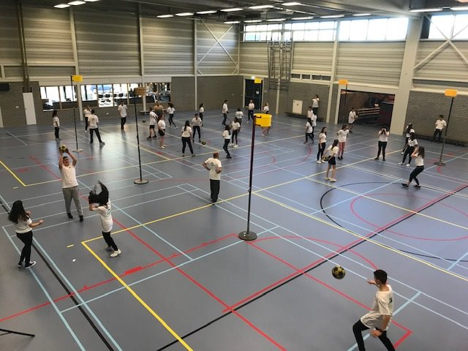
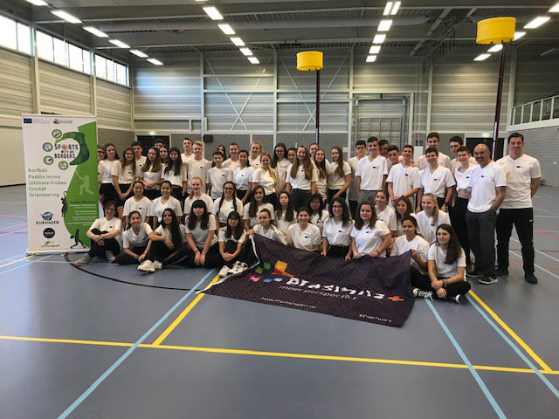
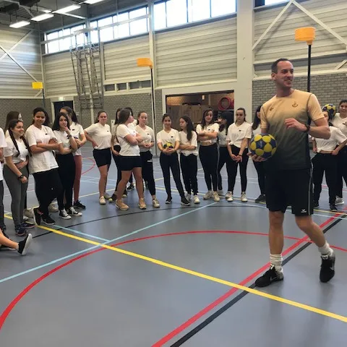
Korfball clinic NL-SP in Vaals, the Netherlands

Slide 7
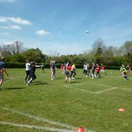
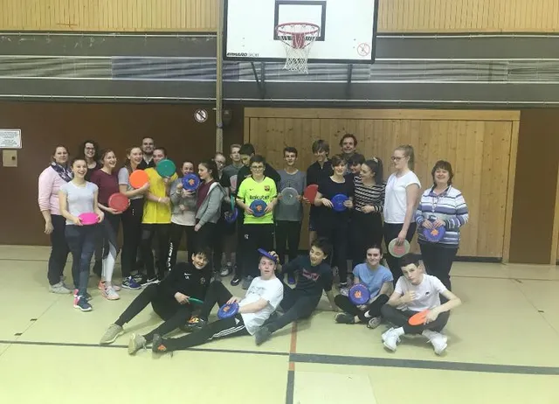
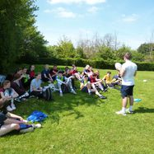

Frisbee in Germany

Slide 8
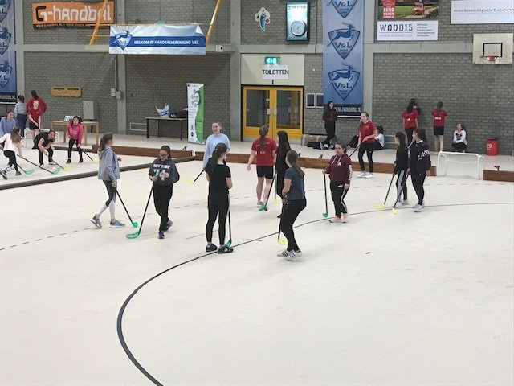
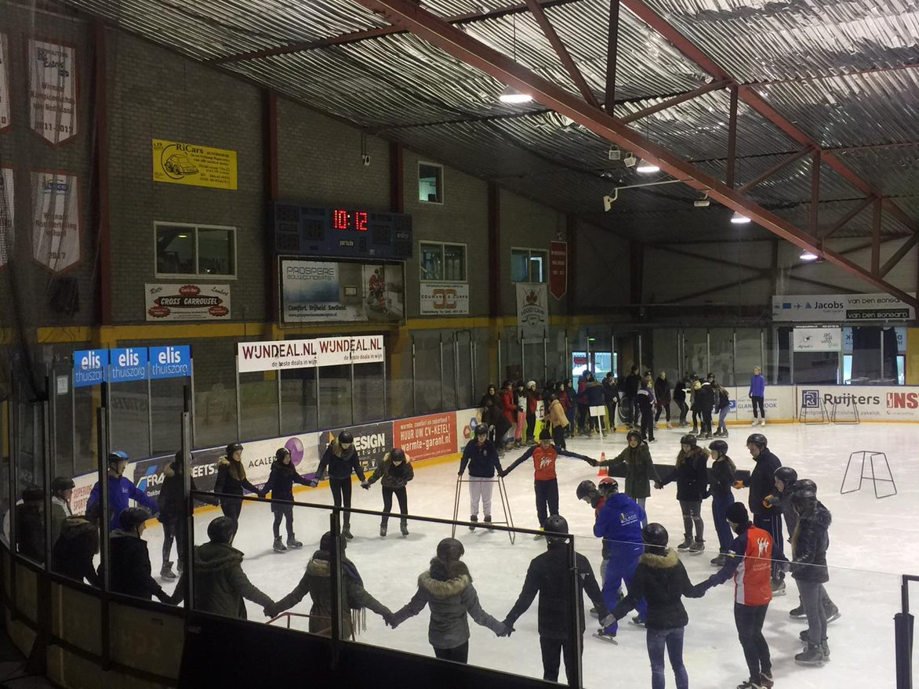
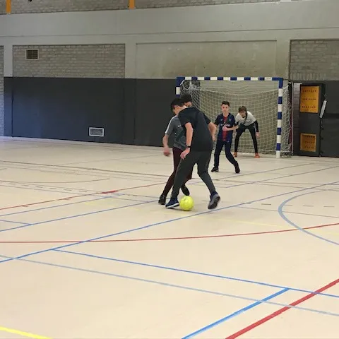
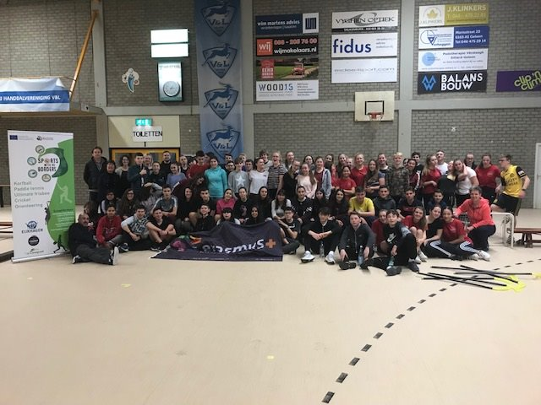
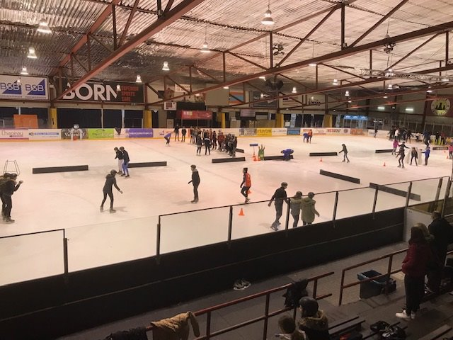
Sports day for all included schools in Geleen

Slide 9
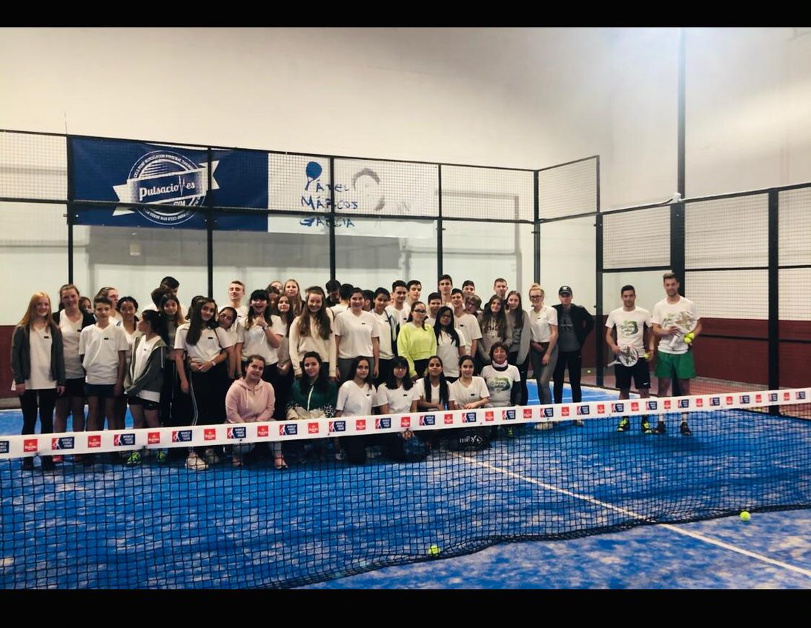
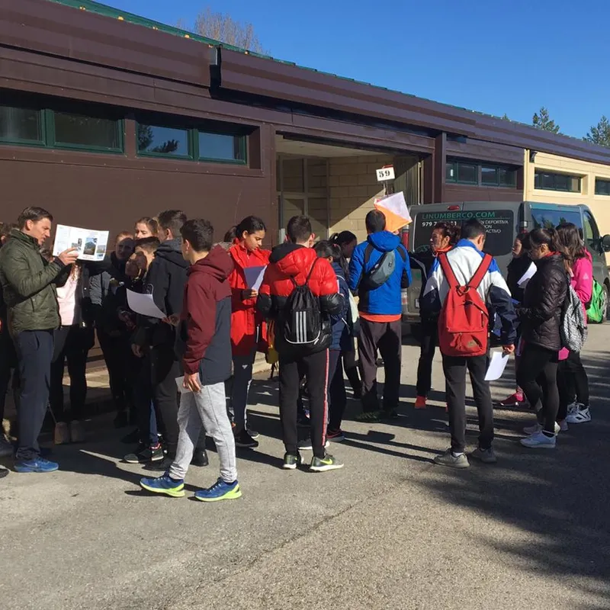
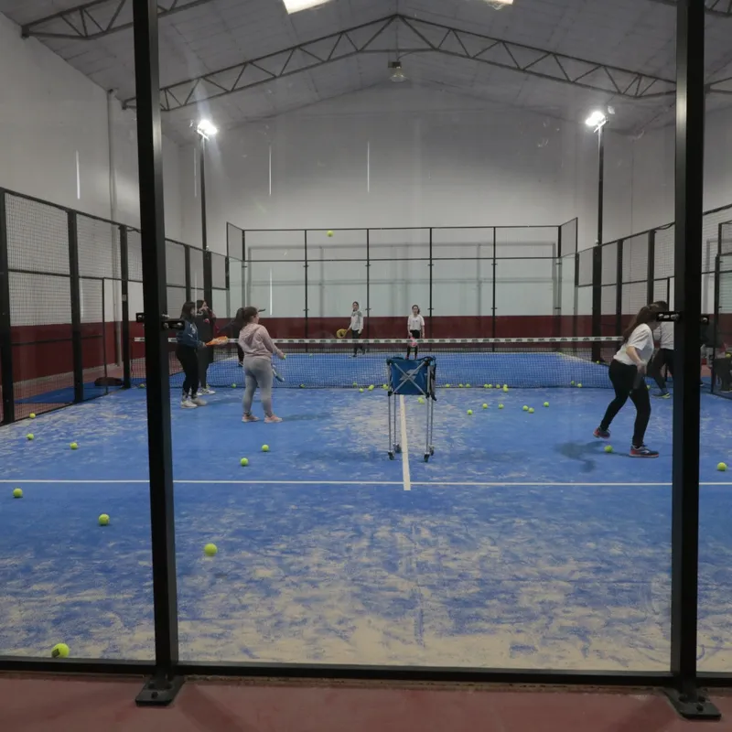
Paddle tennis and orienteering in Spain

Slide 10
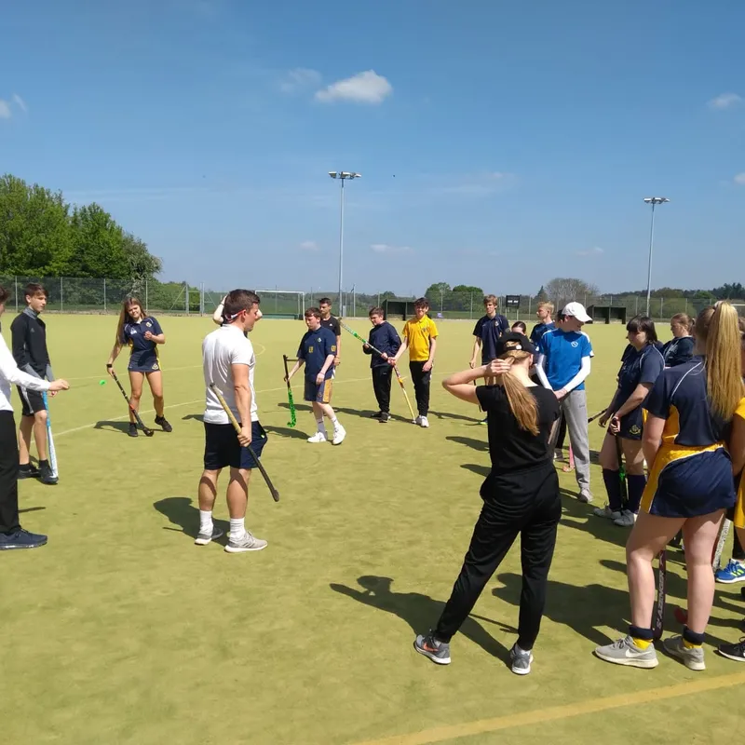
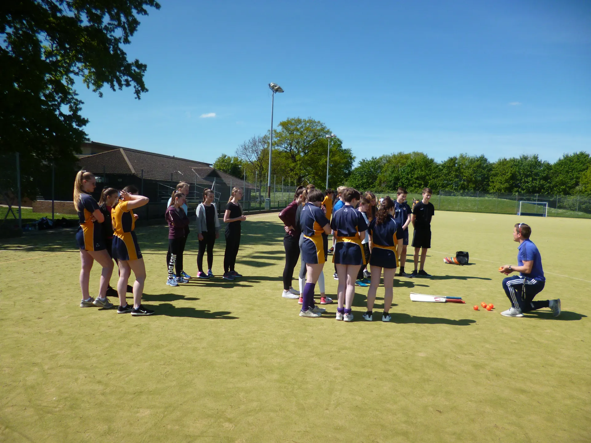
Cricket in UK

Slide 11
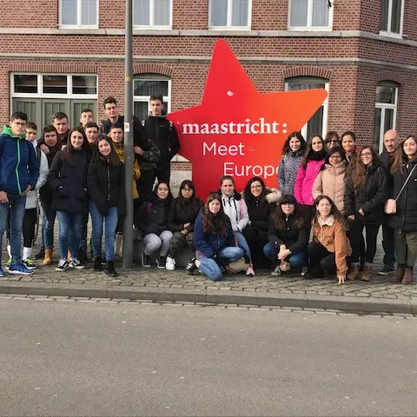
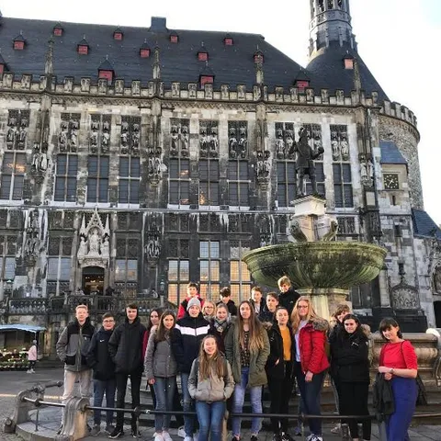
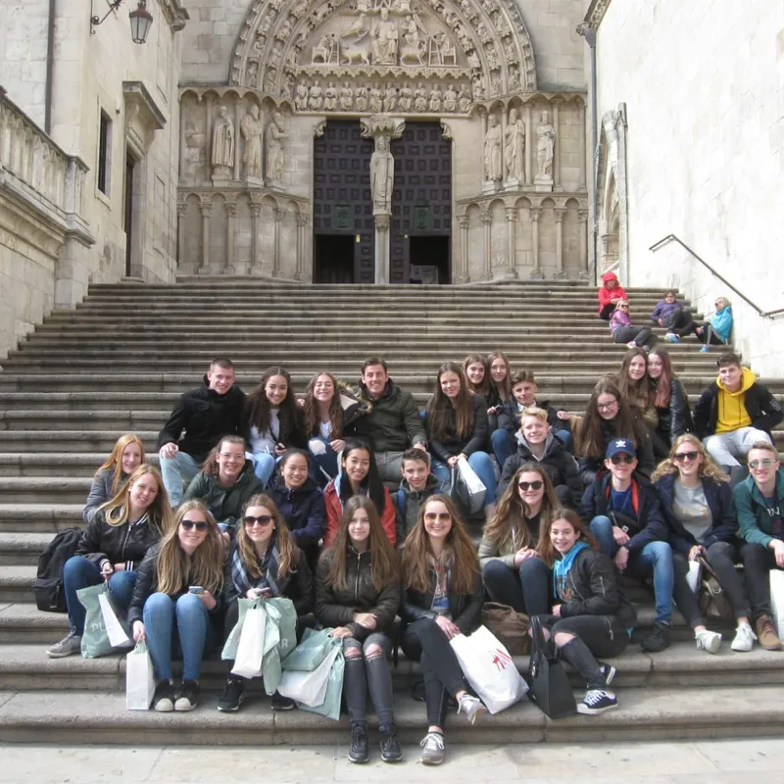
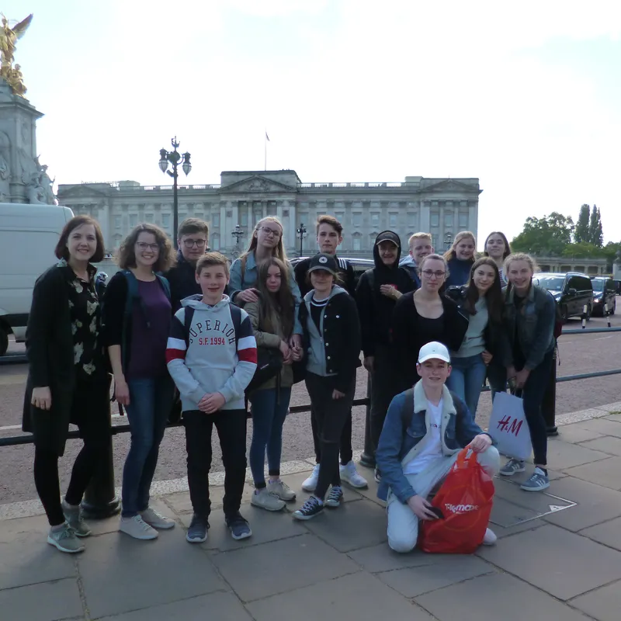
Cultural activities, visiting cities

Slide 12
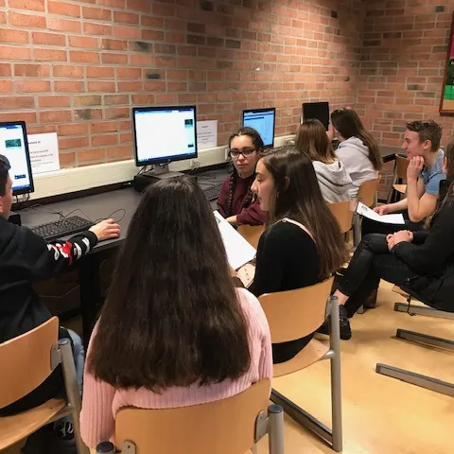
Assignments for students
Before the exchanges:
  research by students in each school (origin, history, impact, equipment, social/economical value, rules, etc.)
  making students familiar with orienteering by using Google Earth
During the exchanges:
  in mixed groups working on “how to make the sport more gender inclusive” (rules, equipment, technical, tactical way)
After the exchanges:
  Gathering results by each school to come to a final product

Slide 13

HOW TO CONTINUE IN 2019-2020?
Exchanges:
Charlemagne College Eijkhagen < --> Joyce Frankland Academy Newport
I.E.S. Santa Maria la Real < --> Carolus-Magnus-Gymnasium
April 2020:
Evaluation materials by 4 embassadors from each school to realise the final rules for the sports: Eijkhagen ↔ CMG, Santa Maria la Real ↔ JFAN
May 2020:
Final tournament in Aguilar de Campoo where at least 4 students from each school will take part, modified rules will be tested.

