Slide 1
Alex Ivanov
Centre Forward

Slide 2
Status: Available Gender: Male Position: Centre Forward Date of Birth: 05 .06. 2006 Graduation Date: June 2025 Club Team: Hockey Club CSKA Sofia

Slide 3
Height: 185cm. Weight: 80 kg. Languages: Bulgarian, English Desired Degree: TBA TOEFL: TBA CAE certificate - C1 level
ADDITIONAL INFORMATION

Slide 4
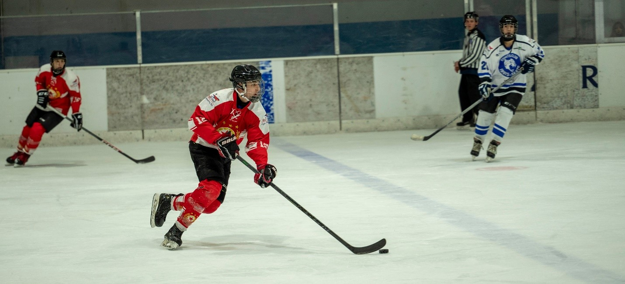

Slide 5
Athletic Achievements:
club and National Team :
3rd place - World Championship 2024 D2B;
1st place - Bulgarian U20 League 23/24;
3rd place - Bulgarian Men`s League 21/22, 22/23, 23/24;
1st place - Bulgarian U14 League 17/18,
2nd place - Bulgarian U16 League 19/20,
3rd place EMF Winter Classic Tournament 2018 (Slovakia)

Slide 6
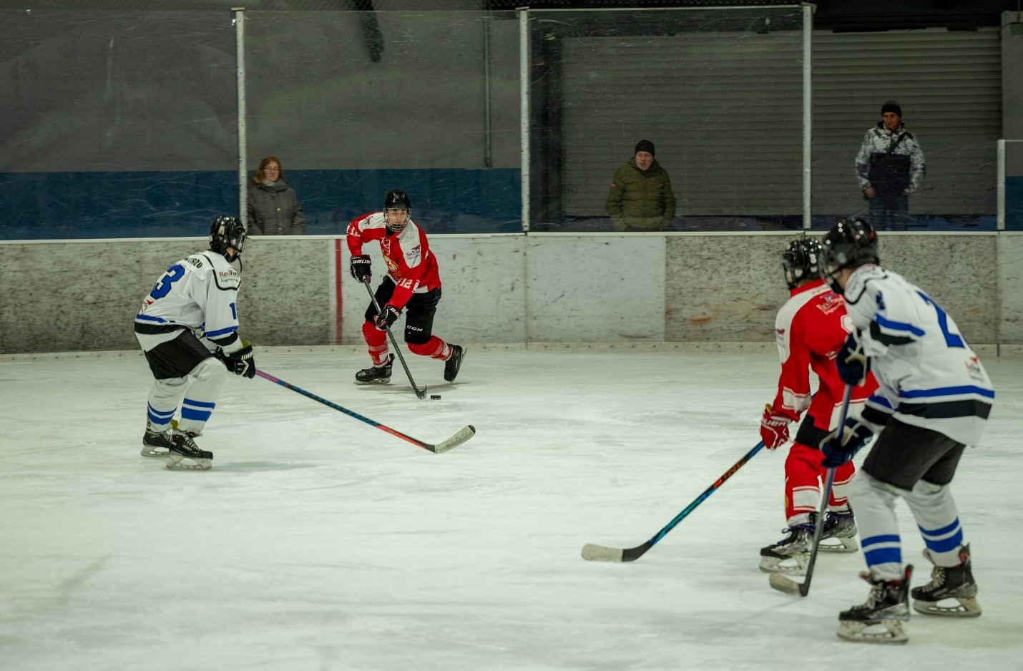

Slide 7
Interview Questions:
Describe yourself with a few sentences.
Hardworking young man, willing to learn and put in the needed work.
What does volleyball mean to you?
Sport is a part of my daily lifestyle. It keeps me active and healthy as well as happy.
What does your education mean to you?
Education is source which will help me build my career.
What are your main goals as a student-athlete in the USA?
My main goal is to get as much as I can from hockey and enjoy as long as I’m able to play it. As a student, I want
to study something that can help me in the future in terms of work.

Slide 8
Video Analysis
Highlight Videos:
https://www.youtube.com/watch?v=UlTPK5e81QY
https://www.youtube.com/watch?v=nHAWjBwC-UM

