Slide 1
ERASMUS SPAIN-THE NETHERLANDS

Slide 2
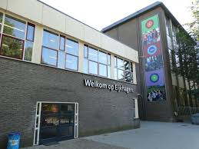
MONDAY
THIS DAY WE GO TO THE HOST SCHOOL AND WE MEET SOME TEACHERS.
LATER WE GO TO THE TOWN HALL IN LANDGRAAF.
AND WE DO AN ORIENTATION ACTIVITY.
AND AT THE NIGHT WE GO TO A BOWLING ALLEY WITH SOME PEOPLE THAT WAS REALLY FUNNY.

Slide 3
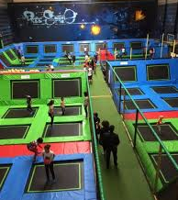
TUESDAY
THIS DAY WE HAD A LESSON OF ICE SKATING AND WE DO A FOOTBALL TOURNAMENT WITH THE ENGLISH AND GERMANS, IT WAS FINE.
AND AT THE NIGHT WE GO TO THE SPACE JUMP WITH A LOT OF PEOPLE IT WAST THE BEST THING WE DO.

Slide 4
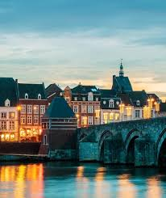
WEDNESDAY
AT THE MORNING WE HAVE A WORKSHOP.
LATER WE GO TO MAASTRICHT TO VISIT IMPORTANT PLACES, AND WE HAD A FREE TIME, WE ( i ) BUY A LOT OF STUPID THINGS.
IT WAS THE BIRTHDAY OF A FRIEND SO I BUY CONFETTI AND A PRESENT FOR HIM

Slide 5
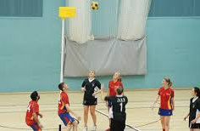
THURSDAY
THIS DAY WE GO TO ANOTHER WORKSHOP.
LATER WE GO TO PLAY KORFBALL, THAT WAS SO BORING AND WE DO BORING ACTIVITIES OF THIS BORING SPORT.
AT THE NIGHT WE GO TO A SMALL PARTY.

Slide 6
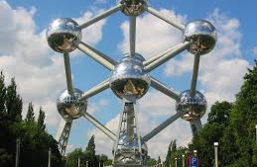
FRIDAY
WE FINISH THE BORING ACTIVITIES OF KORFBALL.
WE CATCH A BUS TO BRUSSELS TO SEE THE ATOMIUM AND LATER WE HAVE SOME FREE TIME AFTER CATCH THE PLANE AND RETURN HOME.

Slide 7
FOOD
 | MONDAY | TUESDAY | WEDNWSDAY | THURSDAY | FRIDAY
BRECKFAST | MILK AND TOAST | MILK AND TOAST | MILK AND TOAST | MILK AND TOAST | MILK AND TOAST
PRELUNCH | WATER AND CHOCOLATE | WATER AND CHOCOLATE | WATER AND CHOCOLATE | WATER AND CHOCOLATE | WATER AND CHOCOLATE
LUNCH | DONT REMEMBER | MEAT AND FRITES | BURGER KING | DONT REMEMBER | BURGER KING
DINNER | MEAT AND FRITES | PIZZA | LASAGNA OF VEGETABLES | CREPES | SPAIN

