Slide 1
Young people, Risk, Social media and Dating apps: Methodological innovations for the study of violence and sexual violence online.
Jorge Ramiro Pérez Suárez, Raquel Rebeca Cordero Verdugo, Antonio Silva Esquinas, Julio Díaz Galán, Stefanía Donnet Hermida, Carmen Sanz García, Mario Muñoz Anguita, Adán Arsuaga Méndez, David Pavón Herradón, Aida Fonseca Díaz, Laura Gómez Cuesta .
4th April 2023

Slide 2
Grupo Conocimiento-Investigación en Problemáticas Sociales
https://criminologia.hypotheses.org/

Slide 3
Contents
Introduction: Dramaturgy and the transaesthetic. 05
Methodology: Researching Young People online. 06
Results I: The cannibal self(ie). 12
Results II: Happycracia & Pain Porn. 14
Results III: The adulthood fetish. 16
Results IV: The Impact on mental health. 19
Results V: The parents’ perspective. 20
Conclusions 23

Slide 4
Dr. Rebeca Cordero Verdugo
Reader in Applied Sociology UEM
PI. GCIPS
Dr. David Pavón Herradón
Lecturer in Criminal Law UEM
Dr. Gino Ríos Patio
Director of Instituto de Investigación Jurídica en Universidad de San Martín de Porres
PHILOSOPHY
LAW
CRIMINOLOGY
Dr. Jorge Ramiro Pérez Suárez
Reader in Applied Criminology in Digital Environments UEM
Prof. Antonio Silva Esquinas
Lecturer in Criminology UEM
Prof. Mario Muñoz Anguita
Lecturer in Criminology UEM
Dr. Julio Díaz Galán
Reader in Anthropology UEM
Dra. Laura Gómez Cuesta
Lecturer in Fine Arts UEM
Prof. Adán Arsuaga Méndez
Lecturer in Philosophy UEM
Profª. Aida Fonseca Díaz.
Lecturer in Law UEM
Counsel

Slide 5
Dramaturgy and the transaesthetic
Hypermodernity
Cyborg
Dramaturgy
According to Lipovetsky:
Lightness and constant movement.
Hypernarcissism.
Worship of fashion and beauty.
Marketing of oneself.
Hyperconsumption.
The banaility of social media..
According to Goffman:
Belief in the part.
Front.
Dramatic realization.
Idealization.
Maintenance of expressive control.
Misrepresentation.
Mystification.
Reality and contrivance.

Slide 6
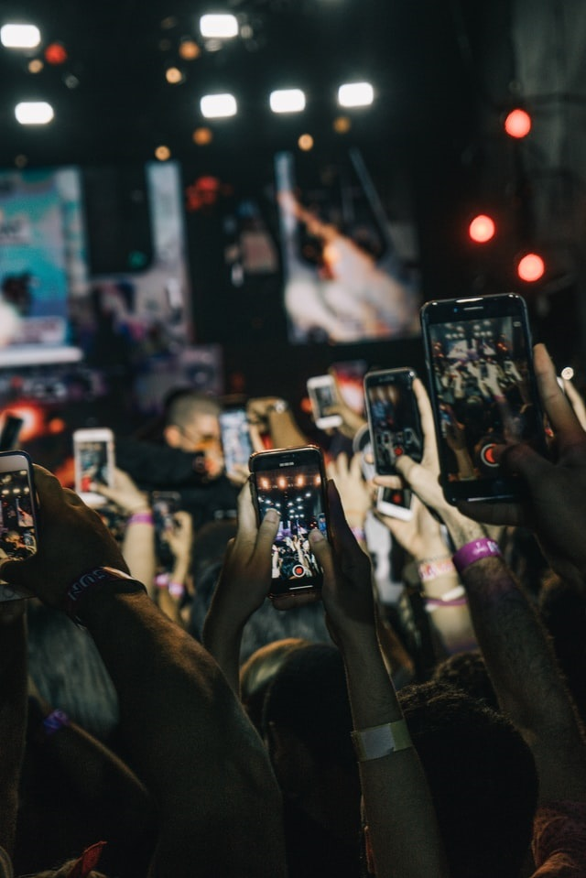
Researching Young People online (I)
CONFIDOMINA2.NET (CIPI/20/171 and Banco Santander)
G.O. Identify and define new forms of domination and social relationships between users aged 13-18 on social networks.
QUAL |  | QUAN
Focus Groups (Phase 1) | Digital Ethnography (Phase 2) | Survey (Phase 3)
N= 2 | N=15, N₁=10.000 Tik Tok, Twitch, Instagram | N= 474
Parents, psychologists, teachers, orientators and legal professionals. | Open digital ethnography. Multisite and non-participant.

Slide 7
Researching Young People online (II)
A.I.DRIANA (CIPI/213006.48)
G.O. Demonstrate the benefits of story-telling in the construction of effective communication channels between parents and children, in order to identify and prevent the risks associated to the use of digital environments.
Phase 1 | Phase 2 | Phase 3 | Phase 4
First round of interviews with parents (structured) N =9 | Second round of interviews with parents (semi-structured) N=9 | Delphi with professionals N=5 | Guide for families (in preparation)
Online storytelling workshop (Instagram & Tik Tok) N= 9 children, 13-15

Slide 8
Researching Young People online (III)
ENROLLA2 (CIPI 2018/UEM34)
G.O. Study the perception of security of individuals aged 18-35 using dating apps and its impact on their levels of victimisation and public health risks.
QUAL | QUAN | QUAL
Phase 1 | Phase 2 | Phase 3
Ethnography on dating apps. N= 6 apps, 9 profiles. N= 800 interactions, 310 direct contacts. | Online questionnaire N=527 | Focus Groups N=2
In-depth interviews with users N= 37

Slide 9
Researching Young People online (IV)
COVID LOVE (CIPI 20/159)
G.O. Understand the motivations that led individuals to the use of dating apps during lockdown, what types of practices where carried out and their impact on the spread of SARS-CoV-2.
QUAN
Phase 2
Online questionnaire N=393, n1= 141
Information combined with: interviews and ethnography Enrolla2 Generation-X.

Slide 10
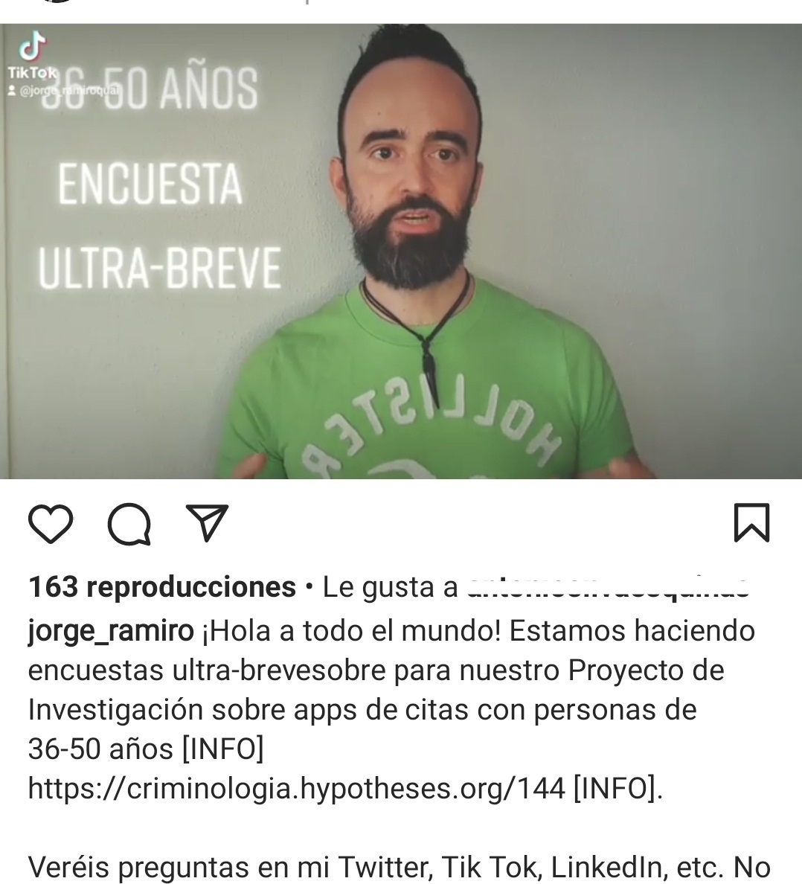
Researching Young People online (V)
Digital Ethnography (Pink et al., 2016)
PRINCIPLES
Multiplicity
Non-digital-centric-ness
Openness
Unorthodox
Reflexivity

Slide 11
Researching Young People online (VI)
Digital Ethnography (Pink et al., 2016)
EXPERIENCES
EMBODIMENT
SENSORIUM
PRACTICES
NON-HUMAN ACTORS
DAILY LIVES
RELATIONSHIPS WITH TECHNOLOGY

Slide 12
The cannibal self(ie) (I)
I am tired of People treating me like a pice of meat [Respondent 208]
Aegon says he is not affected by the aesthetic pressures of social media, but many people do suffer because of that and feel inferior because they do not have what appears on social media. Rhaenyra recognises that she has, sometimes, felt insecure for these matters like seeing a girl with a very thin waistline, etc. Then she thinks and assumes she is ok and healthy, and it goes away. [Jorge R. Pérez’s meeting noes]
Aegon thinks that sexualised videos of boys and girls do not receive the same treatment, why is that a boy without a t-shirt is hot and everyone follows him and the girl without the t-shirt is looking for a boyfriend? All of them think that there are plenty double standards in relation to gender. [Jorge R. Pérez’s meeting notes]
Beauty
Pornography, sexuality and gender
Fat phobia
Self-esteem.

Slide 13
The cannibal self(ie) (II)
EMPTY v. ACCOMPANIED

Slide 14
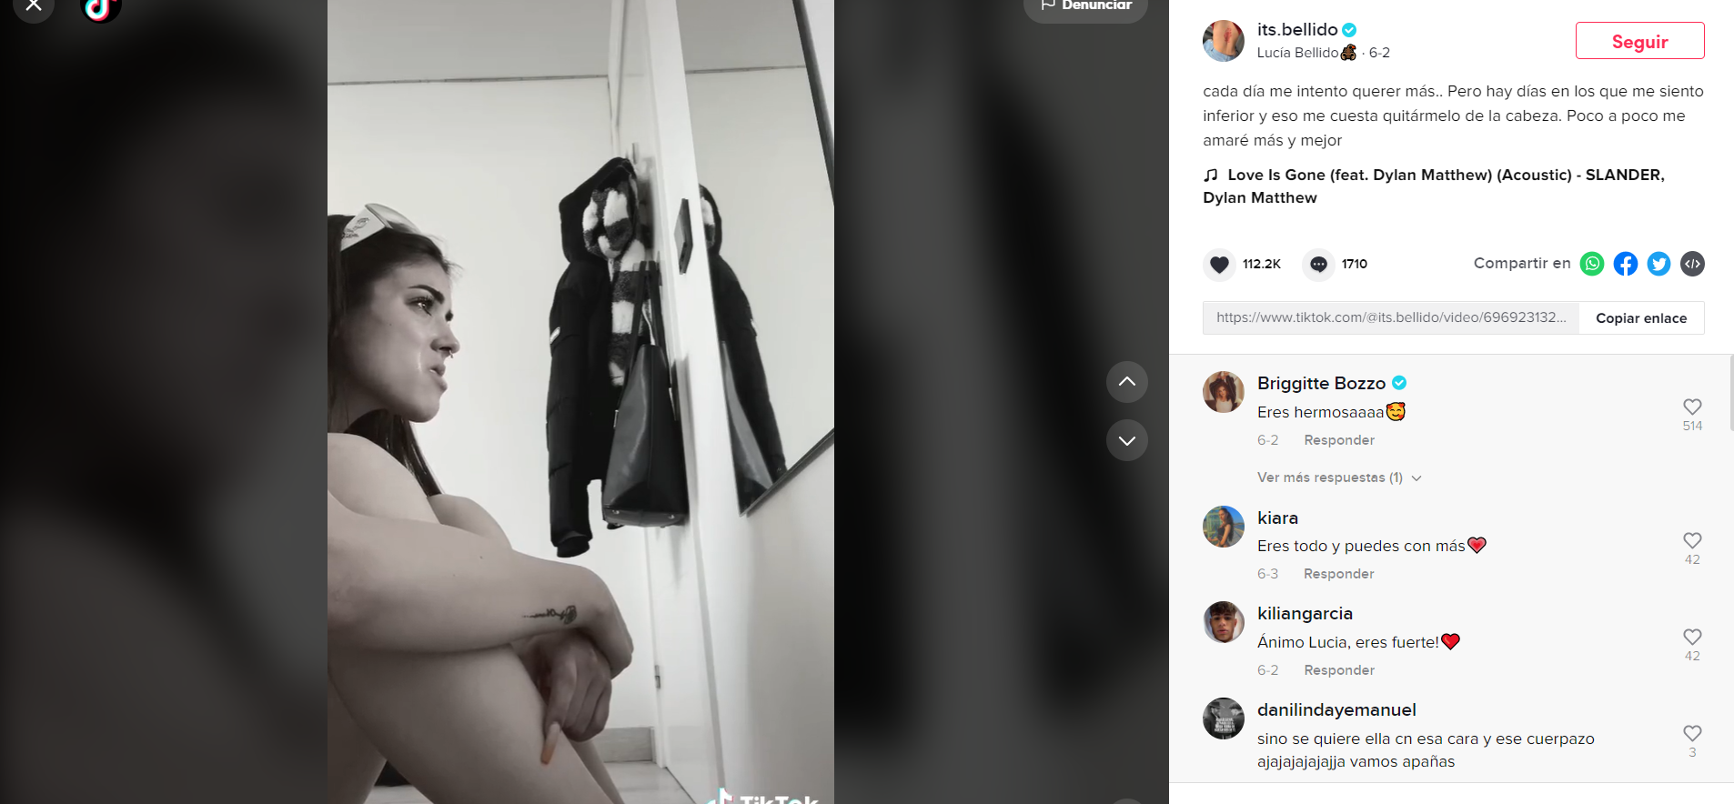
Happycracy & Pain Porn (I)
why does it seem you do not care anymore about anything?
Loneliness
Psychodrama and techno-therapy
Emotional lability
Beauty and narcissism

Slide 15
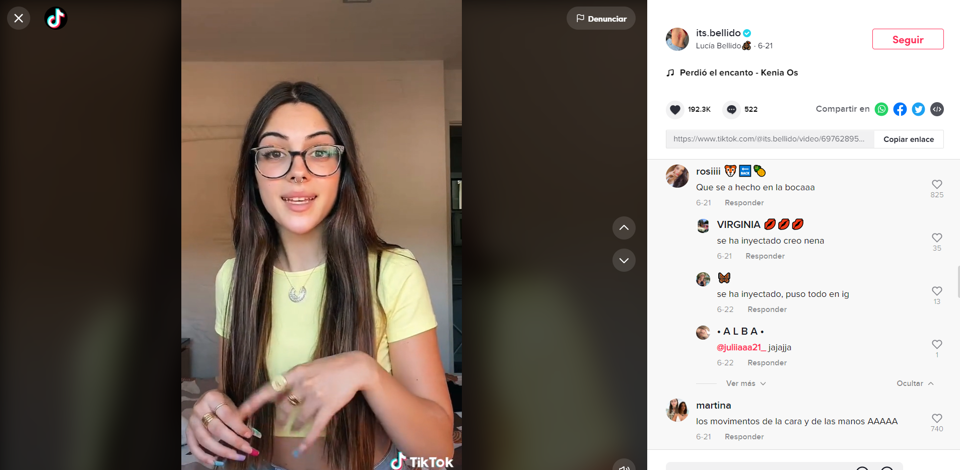
Happycracy & Pain Porn (II)
[Anonymous] got angry because they say that Tik Tok has evolved from a democratic platform where people did whatever they wanted and none criticised it to an arena of hate used to attack for whatever reason. They insist that if hatred is towards them, they have a strong self-esteem and they don’t really care, but if it is directed against friends, family members or random people it is not acceptable. [Antonio Silva’s field diary, emphasis added]

Slide 16
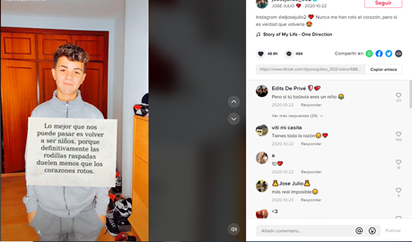
The adulthood fetish (I)
The best than can happen to us is becoming children again
The generating of a fake reality through fake models, because a lot of things are retouched on social media and kids believe that life works in a certain way. [Focus Group 1. Orientator and school teacher. Man, 44]
Laddism (cuñadismo)
Makeup and look
Sexual precociousness and love
Adult experience fetish

Slide 17
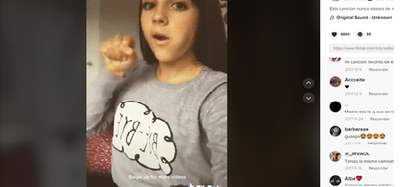
The adulthood fetish (II)

Slide 18
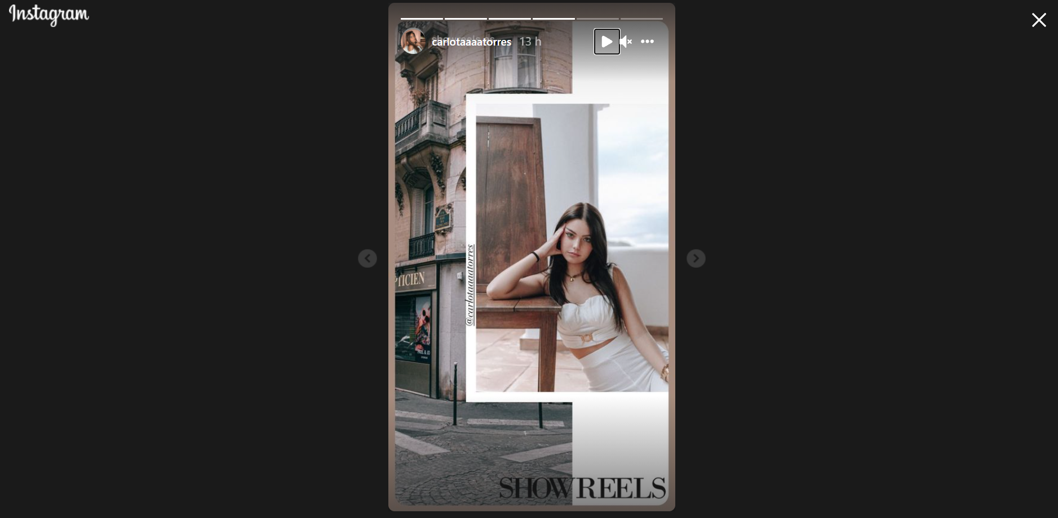
The adulthood fetish (III)

Slide 19
The impact on mental health
Time
Addiction
Violence
Alienation
Confidomina2 Focus Groups and AIDriana’s interviews with parents
It gets them hooked, it becomes addictive. They lose track of time. (Mother, 45)
At the end, the internet, new technologies, social media, I mean, all the network that is becomes a tool for violences, to commit them… but also to get access to them. And in violences I include everything, I include dating violence, I include bullying, cyberbullying, sexting… [Focus Group 2. Lawyer. Woman, 54]
The problem I see is that they are not able to control the time they dedicate to the use of those social networks. [Focus Group 1. Teacher. Woman, 52]
Let’s say it is a competitor for family life and social life with friends. [Focus Group 1. Lecturer. Man, 50]
It has robbed us a lot of time for being with the family and for the ways of socialising they have between them. [Focus Group 1. University personnel. Woman, 47]

Slide 20
The parents’ perspective (I)
I think it affects such relevant aspects like imagination and creativity. (Father, 42).
I am worried about the loss of personal and identity control that the use of the mobile phone is generating. (Father, 42)
Too much exposure of their lives and intimacy. (Mother, 48)
That they meet strange people or get involved in freak communities that I do not like very much. (Father, 54)
Everything, basically that they take advantage of their innocence. (Father, 55)
Worries

Slide 21
The parents’ perspective (II)
Education
Beyond risks and healthy habits, I am interested in the consequences of those risks and unhealthy habits. (Father, 52).
That they had more real examples of internet addiction and other problems related to the digital. (Father, 54).
That they explained them how vulnerable they are on media, the addiction that excessive use causes, and the possible crimes they could be victims of.(Father, 55).
General lack of satisfaction

Slide 22
The parents’ perspective (III)
Perception
Internet knowledge, M=6,71
Perception of safety on the internet, M= 6,14
Perception of your children’s safety on the internet, M= 5,57
Perception of your children’s feeling of safety on the internet, M= 7,57

Slide 23
Conclusions (I)
Critical education
Family and dialogue
Values
Opportunities
High impact on self-esteem.
Lack of family involvement.
Lack of knowledge.
Reality distortion.
Frustration.
Ennui.
Worship of beauty.
Perpetuation of gender roles.
School Failure.
False expectations of personal freedom.
Mental health and suicide.

Slide 24
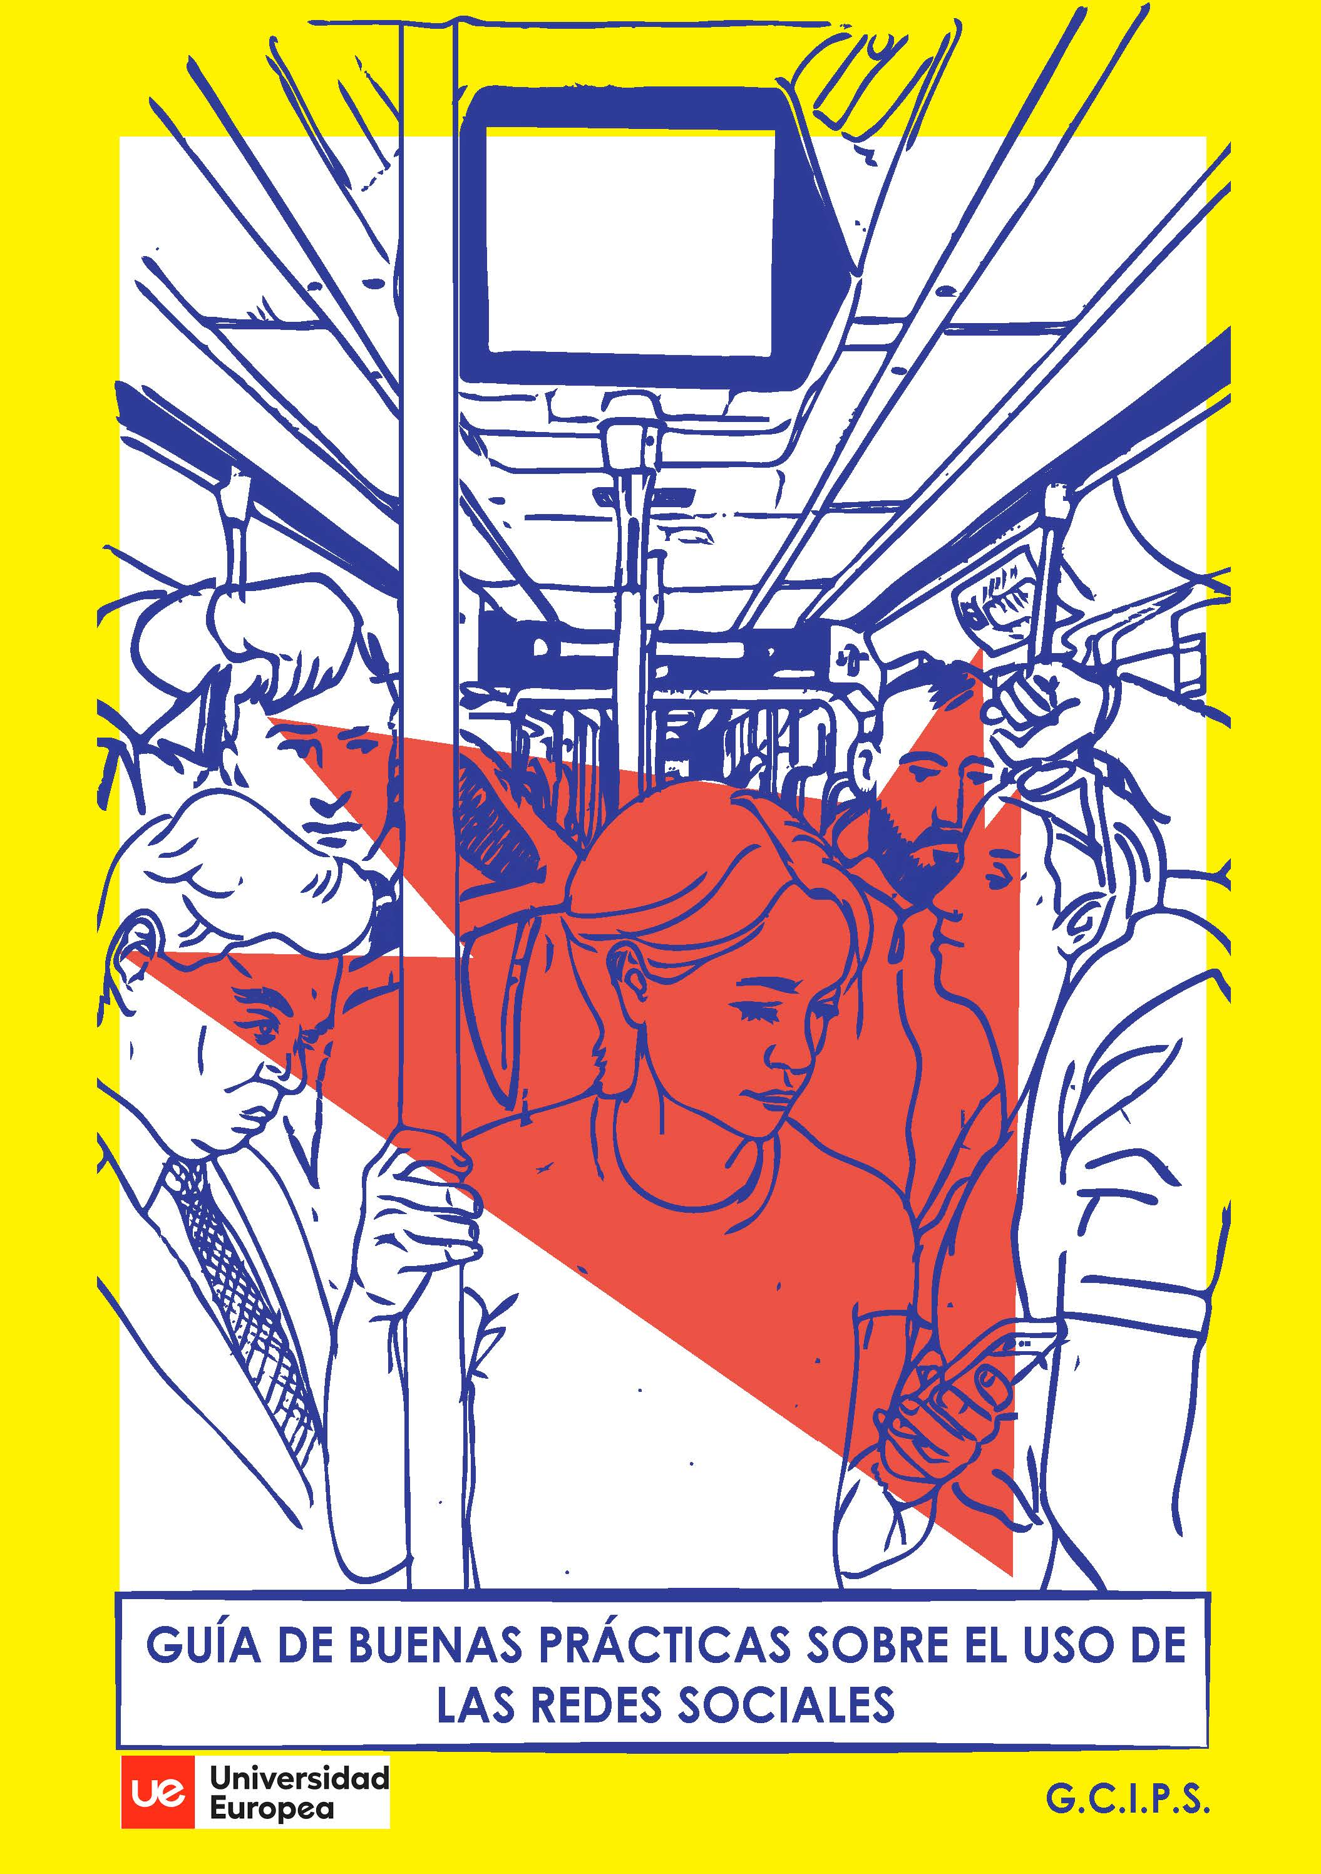
Conclusions (II)
AIDriana’s Guide for Familes
Cover art by Vanessa Abolafio Pérez

Slide 25
References
Goffman, E. (1959). The presentation of self in everyday life. Penguin.
Lipovetsky, G. (2016). La estetización del mundo: Vivir en la época del capitalismo artístico (2nd ed.). [The aesthetisation of the world. Living in the era of artistic capitalism]. Anagrama.
Pink, S., Horst, H., Postill, J., Hjorth, L., Lewis, T. & Tacchi, J. (2016). Digital Ethnography. Principles and Practice. Sage.

Slide 26
Thank you!
Questions?

Slide 27
Contact
Jorge Ramiro Pérez Suárez
GCIPS
Corresponding hours:
8 am-6pm
jorgeramiro.perez@universidadeuropea.es
Twitter: @jramiroperez
Instagram: jorge_ramiro
Facebook: @jramiroperezprofe
Twitter: @GCIPS1
Instagram: gcipsue

