Slide 1
Nikolay Gerganov middle blocker

Slide 2
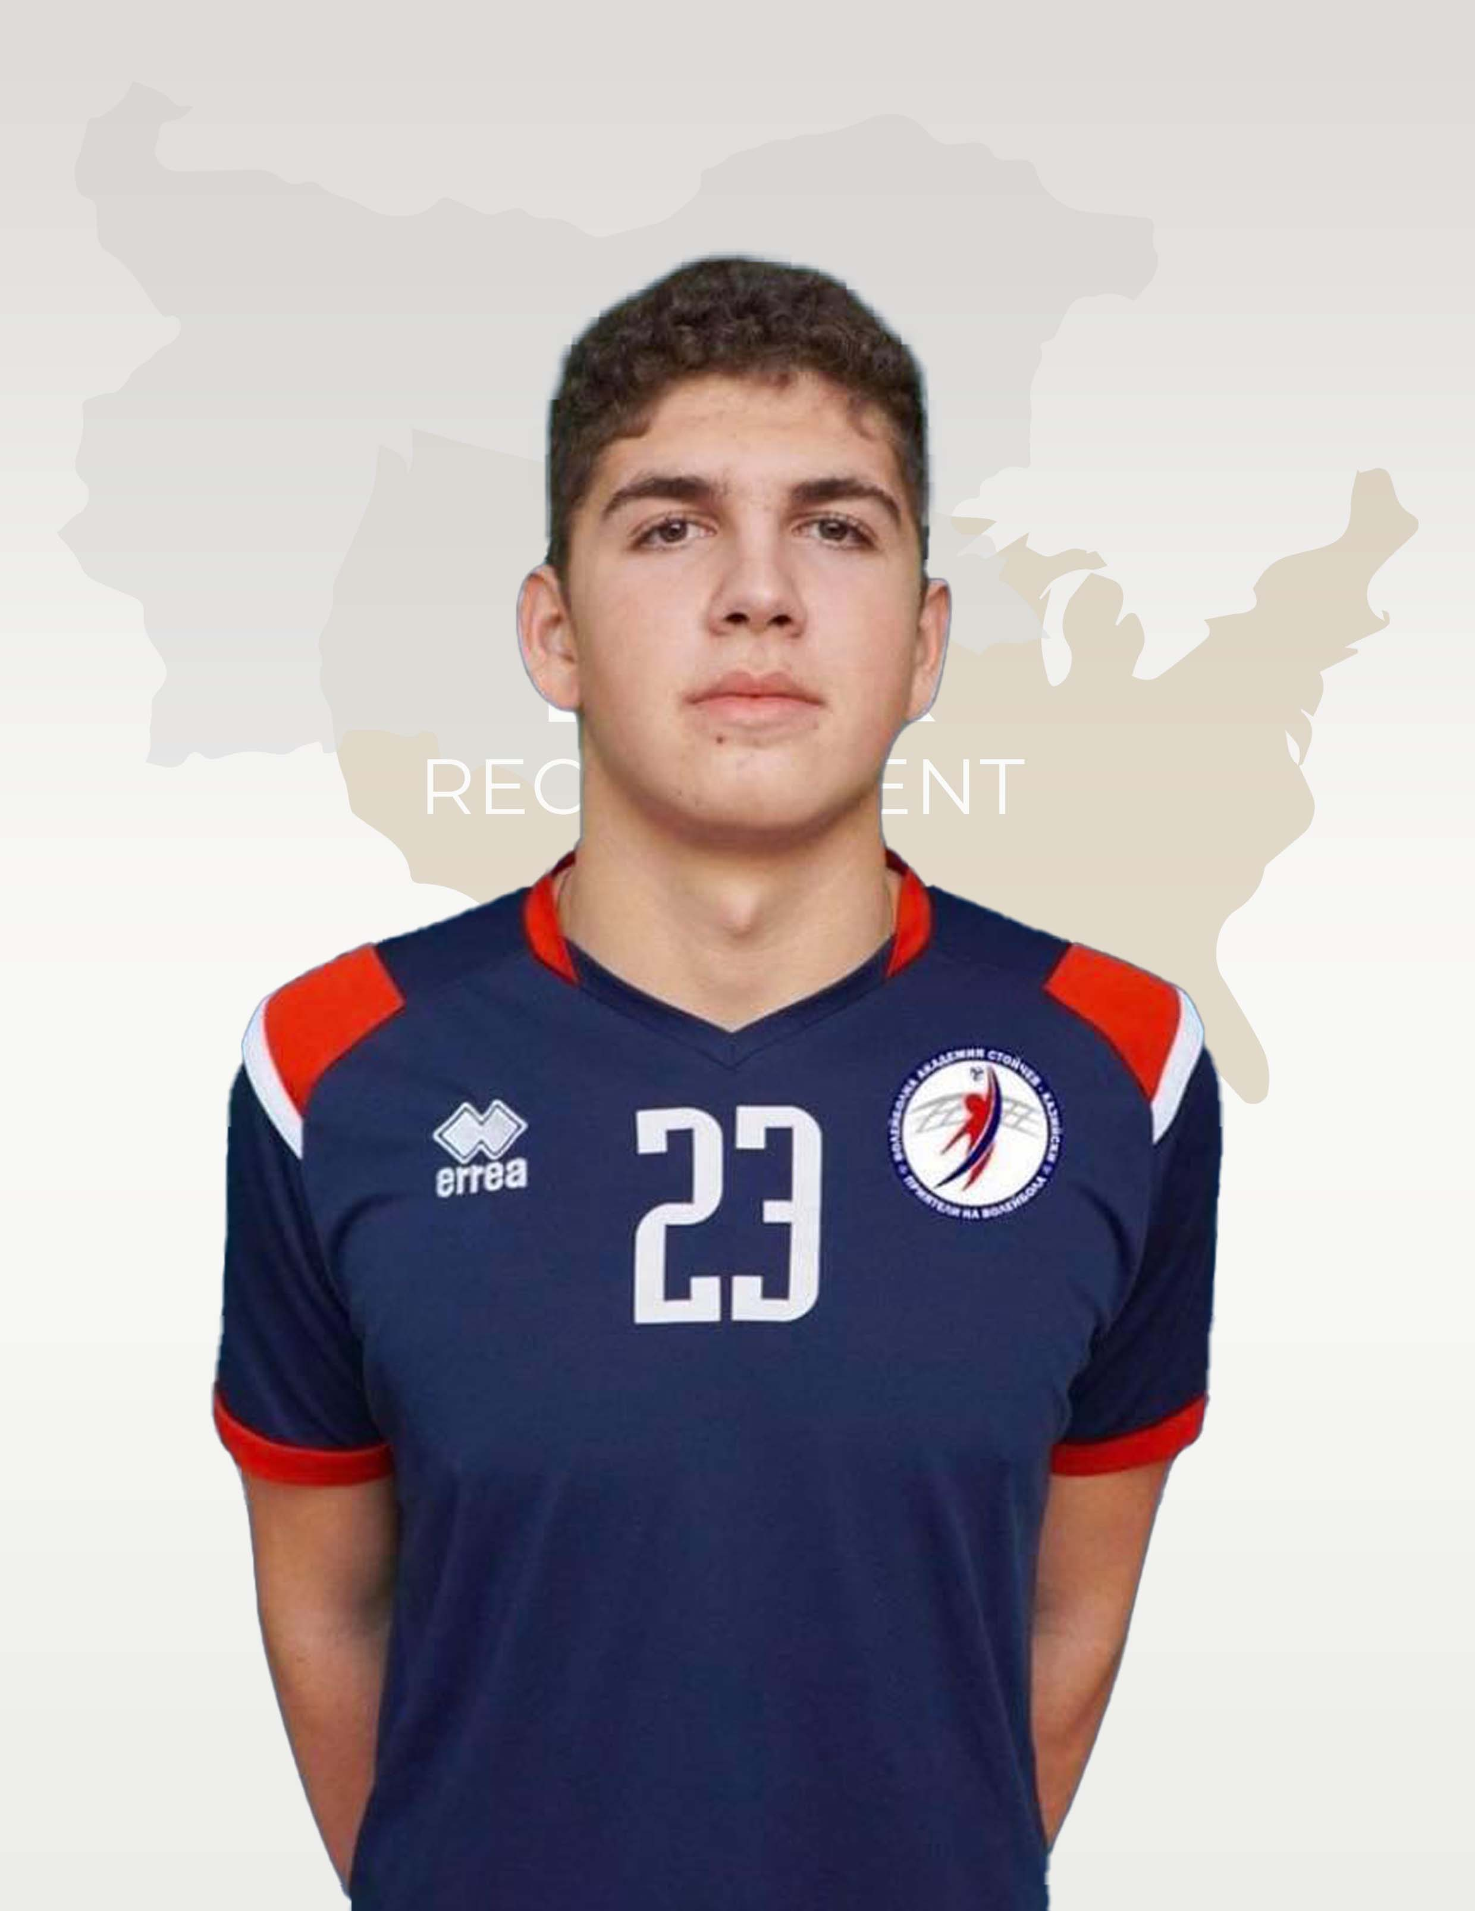
Status: Available
Gender: Male
Position: Middle Blocker
Date of Birth: 08.05.2005
Graduation date: June, 2024
Club team: Volleyball Academy “Stoychev-Kaziyski”
Bulgarian Youth National Team U17

Slide 3
Additional information
Height: 195 cm.
Weight: 90 kg.
Reach: 256 cm.
Approach high jump: 340 cm.
Standing block jump: 330 cm.
High school: 119 High School “Michael Arnaudov” Sofia
Languages: Bulgarian and English
Desired degree: TBA
SAT grade/date: TBA
TOEFL grade/date: TBA

Slide 4
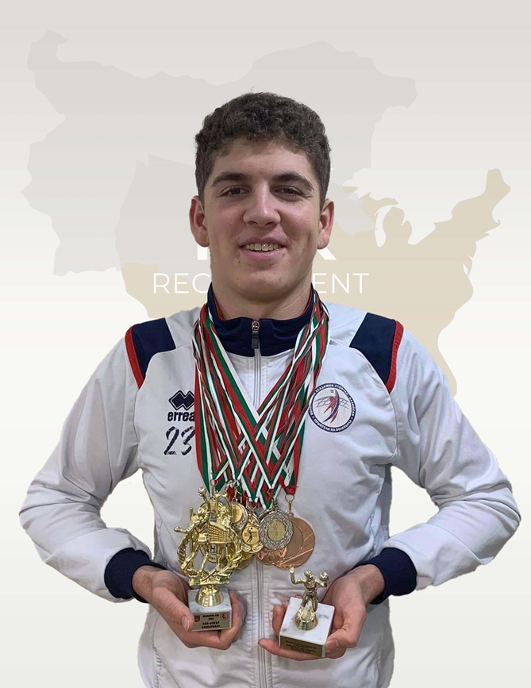
Volleyball Achievements
Republican Champion of Bulgaria – 2019
7 gold medals
4 silver medals
5 bronze medals
List of participation in athletic events:
4 Republican competitions
12 Friendly tournaments
2 participations in the Bulgarian youth national team U17

Slide 5
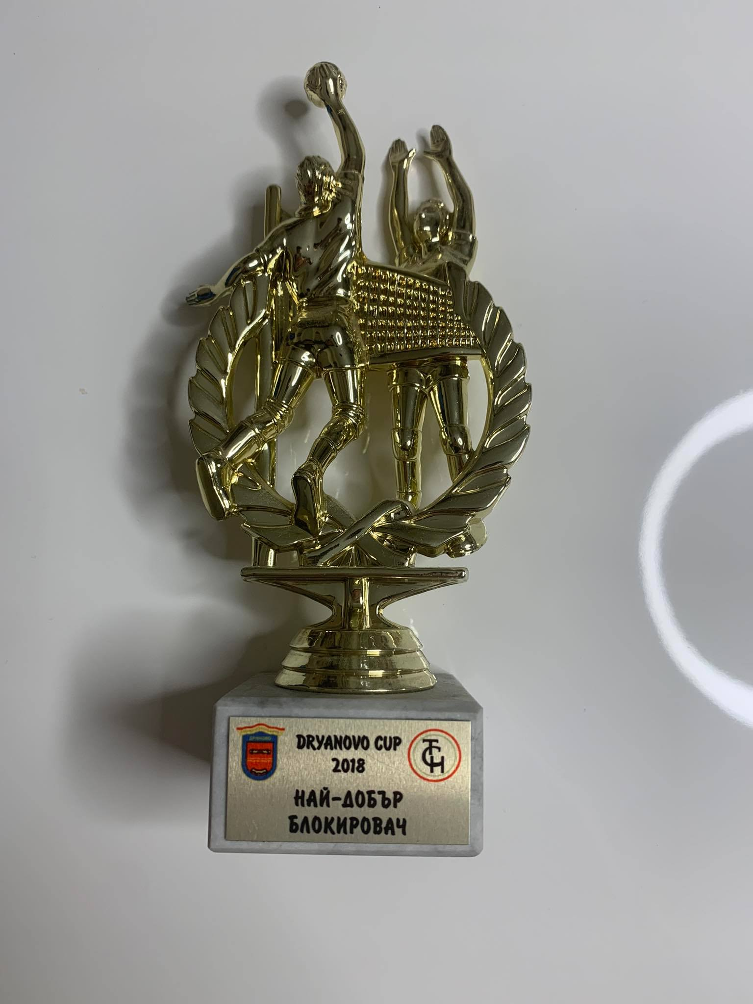
Dryanovo Cup 2018, Bulgaria
Best Middle Blocker

Slide 6
Interview questions
Describe yourself with a few sentences.
I am very disciplined, positive and coachable. I work hard and I do not give up.
What does volleyball mean to you?
Volleyball is very important for me and my life. I am completely committed in this sport. It took hard work and dedication but it is worth it.
What does your education mean to you?
I love volleyball but education is important for me too. I have good grades, I try to be better every day and to learn new things.
What are your main goals as a student-athlete in the USA?
My main goal is to combine education and sport and to develop my skills.

Slide 7
Video Analysis
Highlight Video:
https://youtu.be/_ck_RmyzVN0
https://www.youtube.com/watch?v=AQZIQFzrtFY NEW
https://youtu.be/jmCfAyGtf0Q
Two full matches:
https://www.youtube.com/watch?v=YQcUG_n_S4Q
https://www.youtube.com/watch?v=yHnr8wmzzkc
Middle Blocker with shirt number- 23

Slide 8
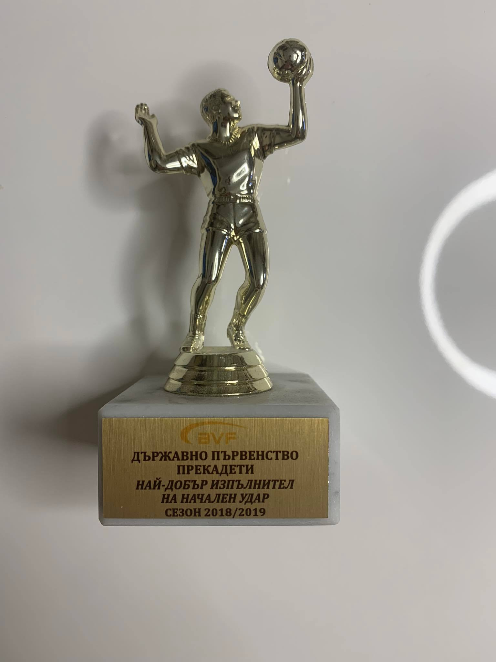
Bulgarian Republican Championship 2018/2019
BEST SERVER

Slide 9
The presentation provides all the basic information for the student-athlete. More details and video can be provided if needed. Contact us.

