Slide 1
Violeta Bachvarova Outside/opposite hitter

Slide 2
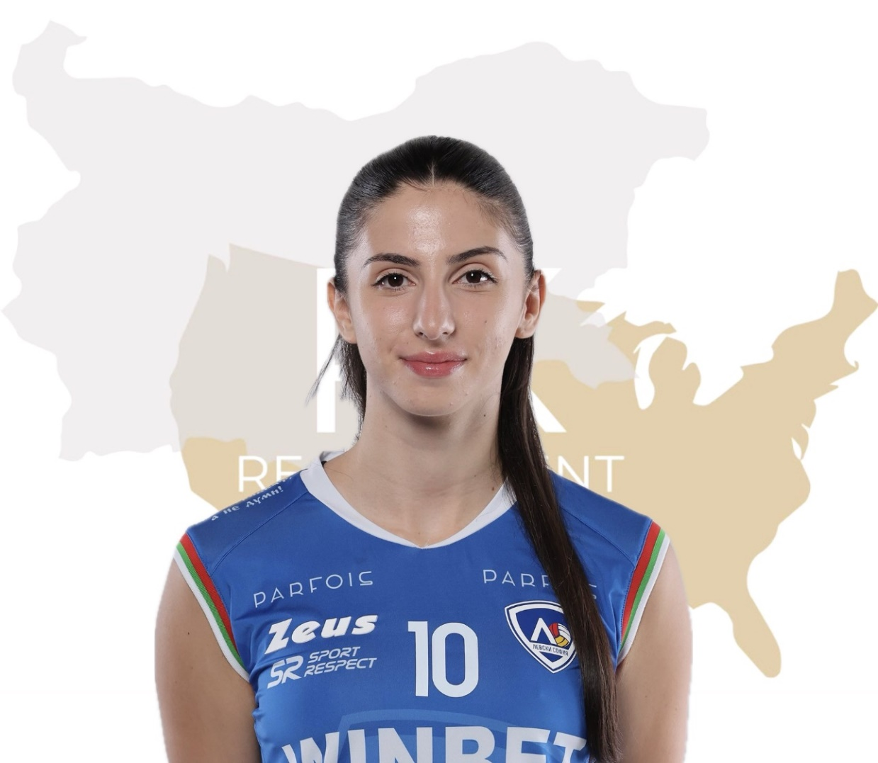
Status: Available
Gender: Female
Position: Outside/Opposite Hitter
Date of Birth: 16.05.2005
Graduation date: June, 2024
Club team: Volleyball Club Levski, Sofia

Slide 3
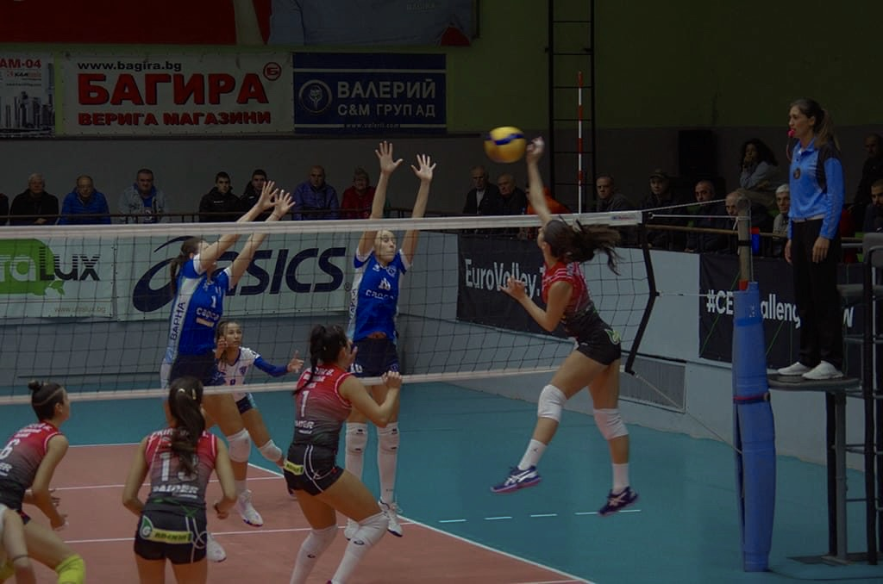

Slide 4
Additional information
Height: 179 cm.
Weight: 63 kg.
Reach: 226 cm.
Approach high jump: 296 cm.
Standing block jump: 276 cm.
High school: “ Ekzarh Antim 1st”Sofia
Languages: Bulgarian, English, German
Desired degree: TBA
SAT grade/date: TBA TOEFL grade/date: TBA

Slide 5
Video Analysis
Highlight Video: https://youtu.be/vbFRYvRGrBU

Slide 6
Interview questions
Describe yourself with a few sentences:
I am ambitious, purposeful and honest. I like to face challenges. I am sociable and always ready to help someone in need. I always give my best in whatever I do.
What does volleyball mean to you?
Volleyball is a way of life for me. For 8 years I sleep, eat and live with volleyball. He taught me discipline and responsibility, teamwork and when I want something not to give up no matter what happens.

Slide 7
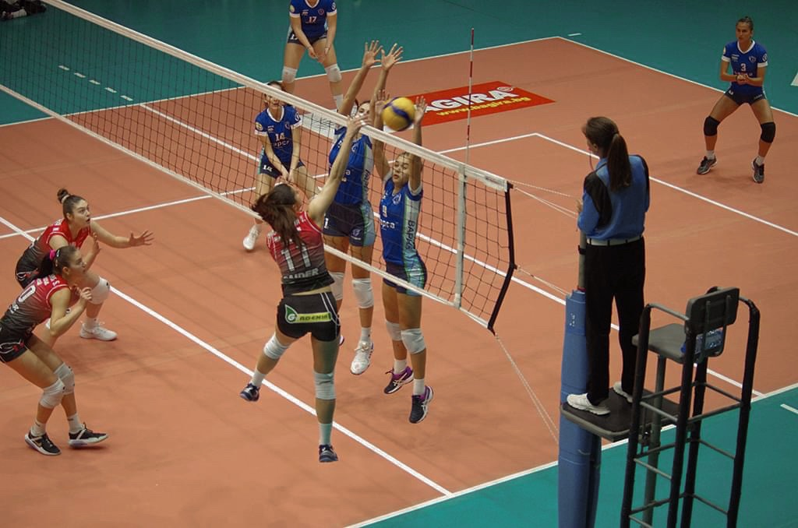

Slide 8
What does your education mean to you?
Education is very important to me. I always demand the best results from myself. I try to balance sports and school. I grew up thinking that I wanted to become a professional volleyball player, but also, I know that when something depends on your body and your physical condition, it can't be a reliable profession. That's why education is important to me.
What are your main goals as a student-athlete in the USA?
As I said, for me sports and education are equally important. In the USA, these two things are combined perfectly. My goal in going to the US is to successfully complete my higher education while actively practicing volleyball. I think this is my best option for development.

Slide 9
The presentation provides all the basic information for the student-athlete. More details and video can be provided if needed. Contact us.

