Slide 1
Daniel Yordanov Mitsin

Slide 2
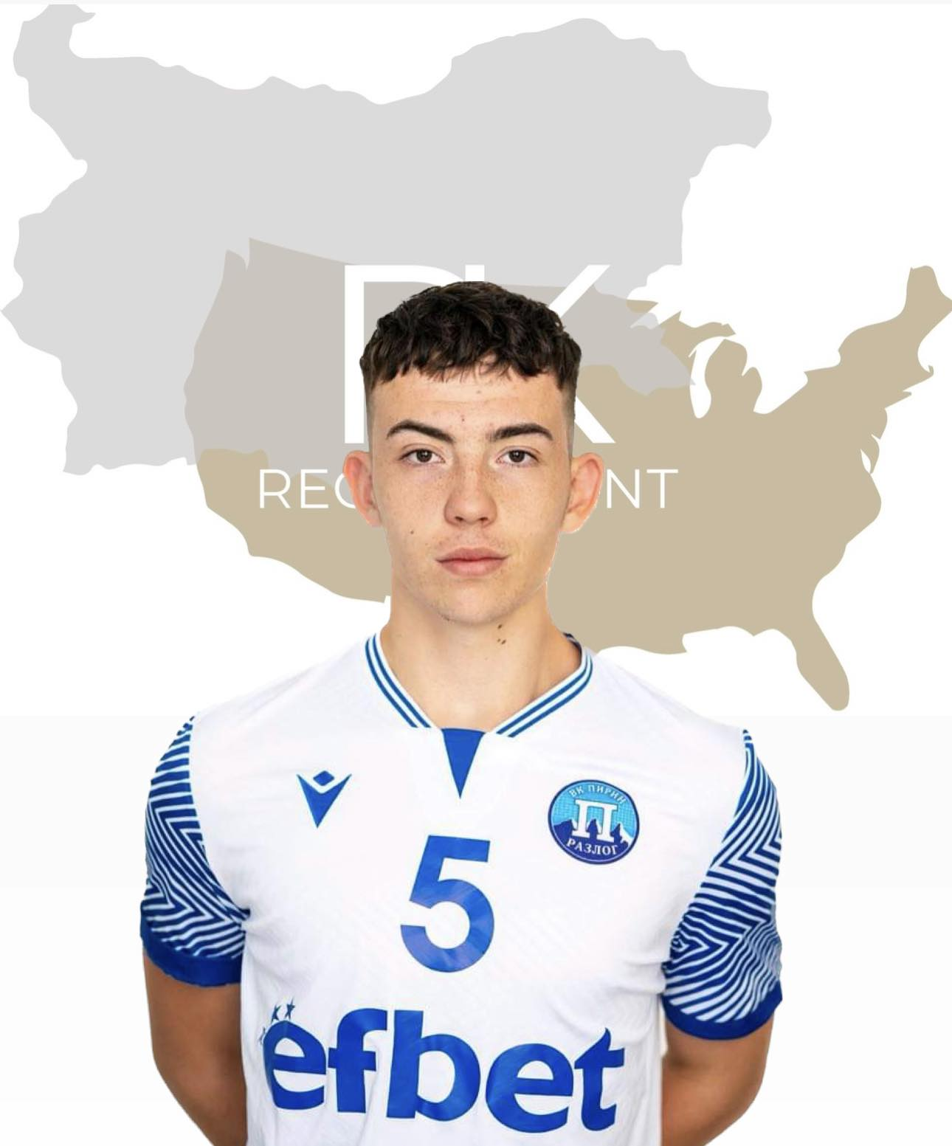
Status: Available
Gender: Male
Position: Setter
Date of Birth: 18.05.2005
Graduation date: June, 2024
Club team: Pirin Razlog
Bulgarian Youth National Team

Slide 3
Additional information
Height: 194 cm.
Weight: 80 kg.
Reach: 248 cm.
Approach high jump: 325 cm.
Standing block jump: 295 cm.
High school: Secondary Peter and Ivan Kanazirevi High School
Languages: Bulgarian and English
Desired degree: TBA
SAT grade/date: TBA
TOEFL grade/date: TBA

Slide 4
Volleyball Achievements
1. Bulgarian Youth National Volleyball Championship 2017- 1st place
2. Bulgarian Youth National Volleyball Championship 2018- 1st place
3. Bulgarian Youth National Volleyball Championship
2019- 2nd place
4. Bulgarian Youth National Volleyball Championship
2020- 3rd place

Slide 5
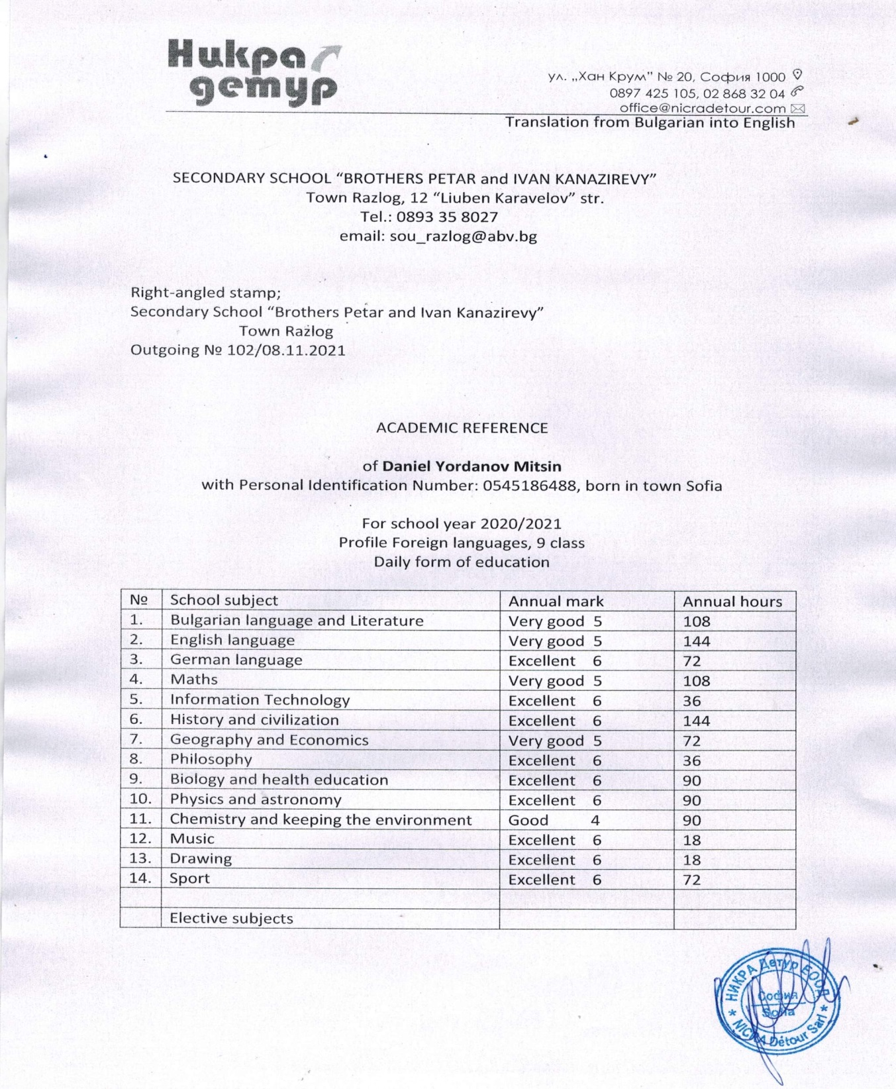

Slide 6
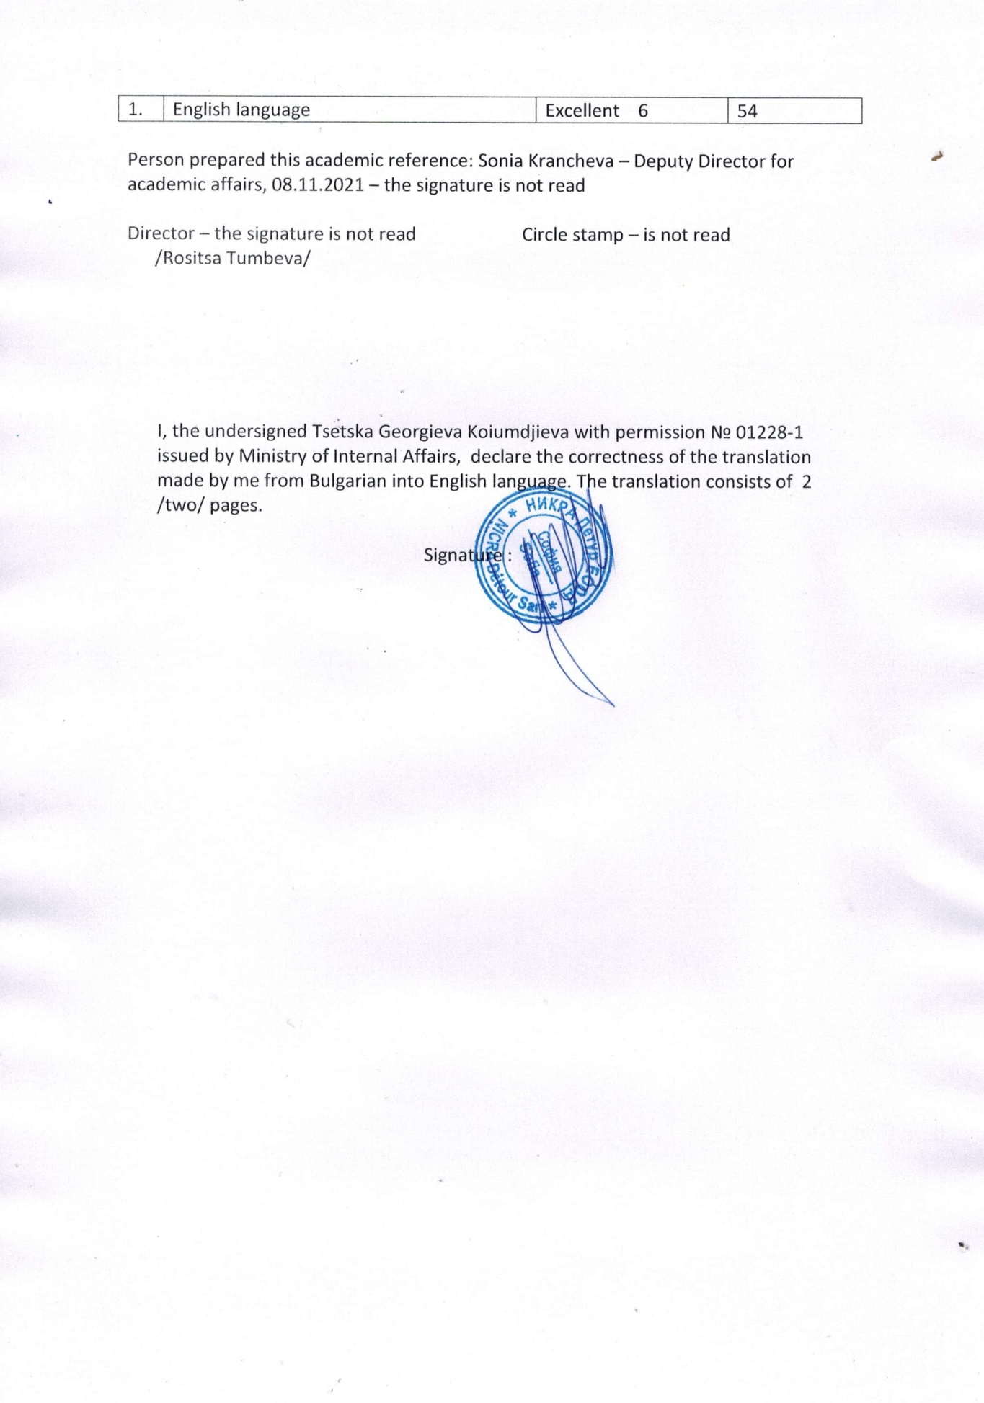

Slide 7
Interview questions
Describe yourself with a few sentences:
Hi my name is Daniel! I’m From Bulgaria and love to play volleyball. I can describe myself with a few words and adjectives. I’m emotional, funny but after all I’m serious and responsible. I can say I'm a team player and for me my team is like a second family.
What does volleyball mean to you?
For me volleyball is not just a hobby. It is a way to live. Volleyball is like one of my primary instincts, I can’t live without it!

Slide 8
What does your education mean to you?
About my education I can say it is more important than my athletic life because volleyball is up to date but knowledge is forever. I want to learn and I try to do it at any possible moment.
What are your main goals as a student-athlete in the USA?
First of all I see chances to study and play on a high level and I think that’s super, because the USA is the country where I can be a good student with good education and become a high level profiled player at the same time.
Second, I can continue my volleyball career after I graduate or I can go on with the profession I choose in the university.
The last reason is because after my volleyball career I will have a good education and good education is important nowadays.

Slide 9
Video Analysis
Highlight Video:
https://www.youtube.com/watch?v=NXqywMCsH-g
https://www.youtube.com/watch?v=FzUAqe0ulys
https://www.youtube.com/watch?v=TXKULJf4XGM
Two full matches:
https://www.youtube.com/watch?v=UkSv2ADQli0
https://www.youtube.com/watch?v=gWkc0bsFAKo

Slide 10
The presentation provides all the basic information for the student-athlete. More details and video can be provided if needed. Contact us.

