Slide 1
Veronika Petrova Opposite/outside hitter

Slide 2
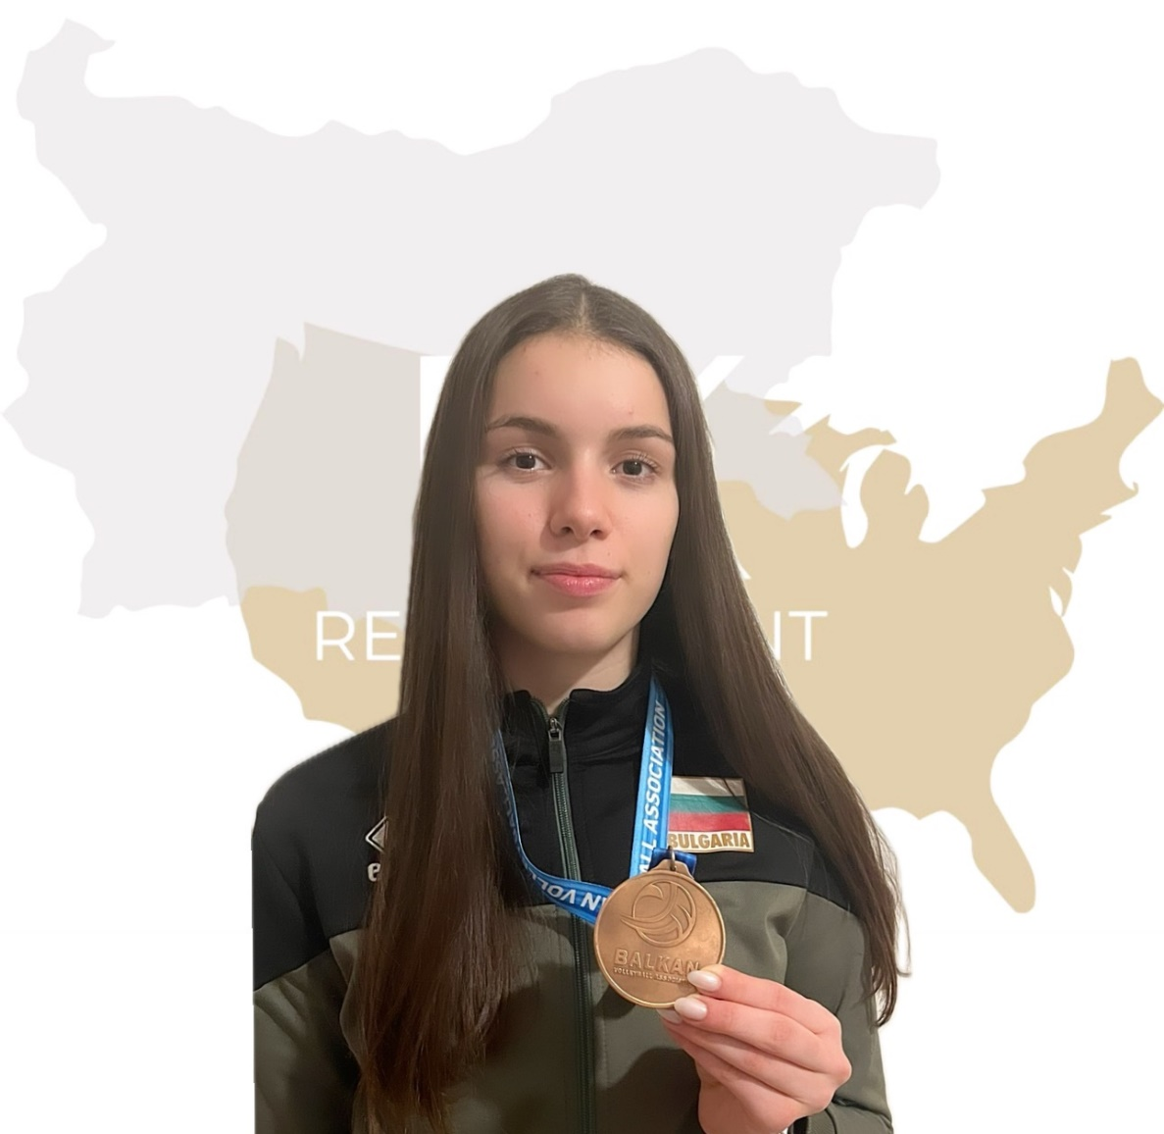
Status: Available
Gender: Female
Position: Opposite/Outside Hitter
Date of Birth: 14.02.2007
Graduation date: June, 2025
Club team: CPVC (Central Police Volleyball Club)

Slide 3
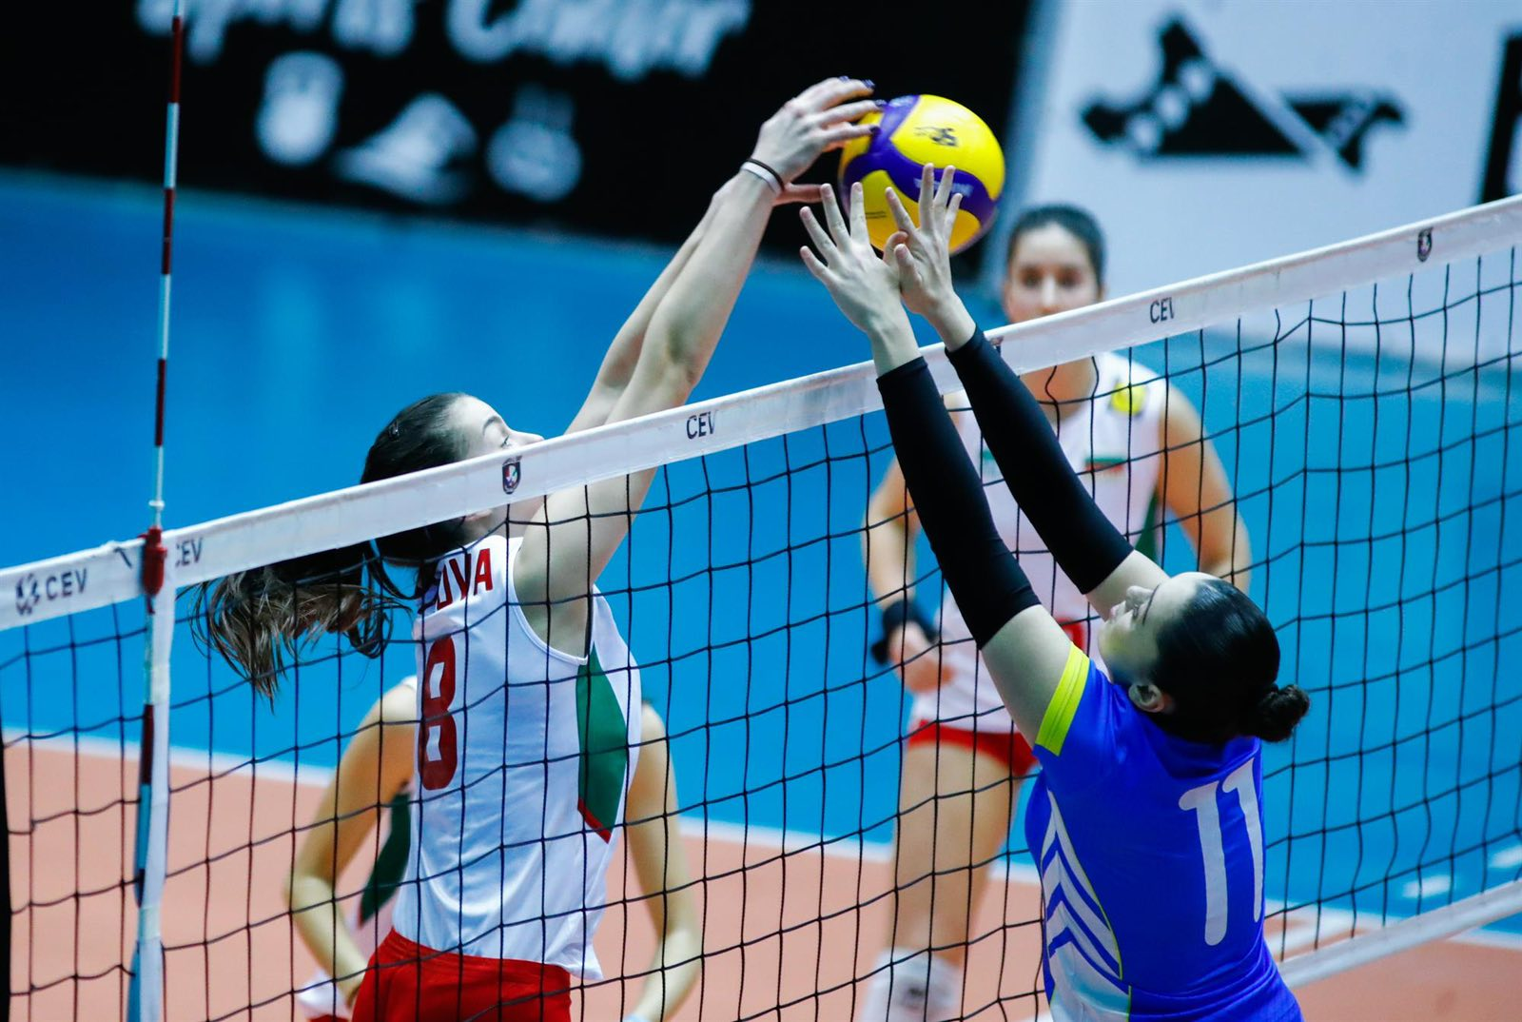

Slide 4
Additional information
Height: 186 cm.
Weight: 70 kg.
Reach: 240 cm.
Approach high jump: 305 cm.
Standing block jump: 280 cm.
High school: English School T. Jefferson, Sofia
Languages: Bulgarian, English, Spanish
Desired degree: TBA
SAT grade/date: TBA TOEFL grade/date: TBA

Slide 5
Volleyball Achievements
Club team:
MVP – season 2019/2020, 2nd place – 2021/2022
1st place(Future stars) -2021/2022
Part of the ideal team (Future stars)-2021/2022
1st place (cup of Bulgaria)-2021/2022, second place – 2022/2023
National team :
2nd place in qualification for U17 European championship 2023
1st place in qualification for U17 European championship 2023
3rd place in U17 Balkan Championship 2023
Part of the selection for the 2024 European qualification U18

Slide 6
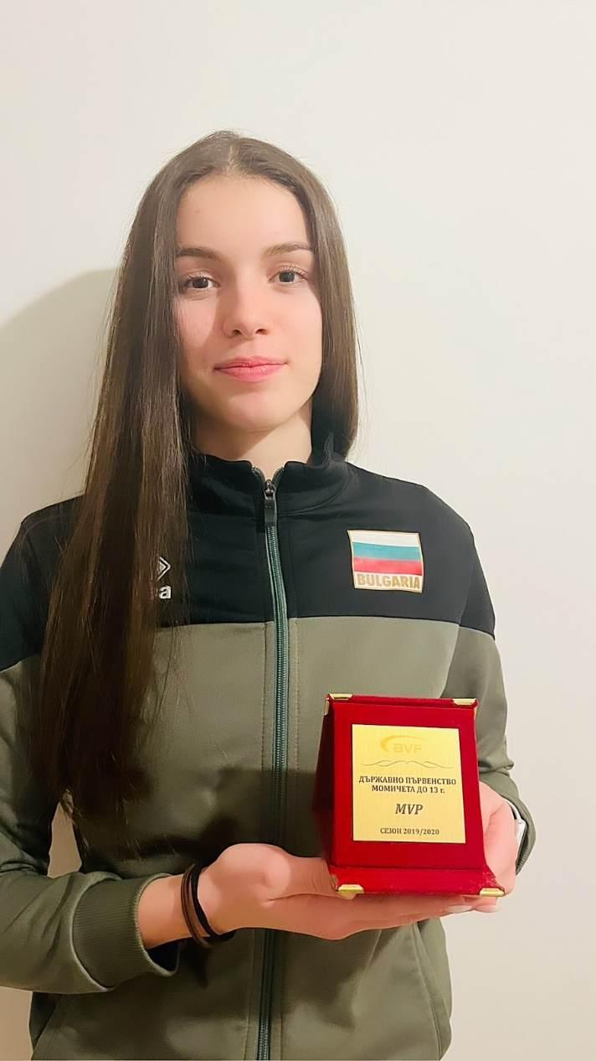
Tournaments Participation
Club team: National championship – 2018/2019; 2019/2020; 2020/2021; 2021/2022; 2022/2023; 2023/2024;Future stars; Cup of Bulgaria(2 times);
National team – 2 Qualifications for U17 European championship 2023; U17 European championship 2023; U17 Balkan Championship 2023; Qualification for U18 European championship 2024

Slide 7
Video Analysis
Highlight video:
https://www.youtube.com/watch?v=TfS0B3LIv_8

Slide 9
Interview questions
Describe yourself with a few sentences:
I consider myself as a highly motivated student and volleyball player. I am a perfectionist. I pay attention to the detail. Everything must be under control. I love my family and my friends- they mean a lot to me. Loyalty and honesty are two of the most vital features which I am looking for.
What does volleyball mean to you?
Volleyball is everything. Playing this sport makes me happy and very joyful. The emotion is hard to believe. The team and the club I am playing for, is small and not very popular, but we have built a magnificent core. I love playing with my team. We are putting much effort to gain the best results for our potential. However, I am the captain, so I should maintain a good communication with the coach.

Slide 10
What does your education mean to you?
To be an educated student is a must. Nowadays when you have a pretty sustainable education, there are lots of opportunities for a development in future.
What are your main goals as a student-athlete in the USA?
To maintain good marks throughout the season and simultaneously to play volleyball at top level. I suppose that the load will be a lot so I should build a healthy routine and try my best to make recoveries frequently.

Slide 11
The presentation provides all the basic information for the student-athlete. More details and video can be provided if needed. Contact us.

