Slide 1
I TechTrading I ETF Investment Strategy
IBD‘s ETF Investment Strategy developed by William o‘ Neil
Dr. Juergen Schwarz
JS-TechTrading
Managing Director
https://www.js-techtrading.com/english/home/
Etoro: https://etoro.tw/3oJ0MTn

Slide 2
I TechTrading I Background
Price movements are a result of supply and demand.
Therefore, trading volume is a critical parameter:
a) high trading volume in combination with increasing prices
-> positive signal
b) high trading volume in combination with decreasing prices
-> negative signal, big institutions might be selling
This strategy can be applied for all market ETF‘s, e.g. SP500, NASDAQ, Russel, DAX, MDAX, SDAX
High liquidity of the relevant instrument is essential

Slide 3
I TechTrading I Distribution Days
Distribution Days
William o' Neil defines a "significant decline" as a drop of more than 0.2%, with no rounding up.
A distribution day indicates unusually heavy selling by institutional investors, the heavyweights who largely set a market's direction.
Four or five distribution days over several weeks nearly always signal that stocks have topped and are heading for a downturn.

Slide 4
I TechTrading I Follow-Through Days
Follow-Through Days after a Market Correction
System developed by William J. O'Neil to identify an important change in general market direction from a definite downtrend to a new uptrend
A follow-through day occurs during a market correction when a major index closes significantly higher than the previous day, and in greater volume. It happens Day 4 or later of an attempted rally.
Leading up to a follow-through day, an attempted rally takes place during a downtrend when a major index closes with a gain. The rally attempt continues intact as long as the index doesn't make a new low.

Slide 5
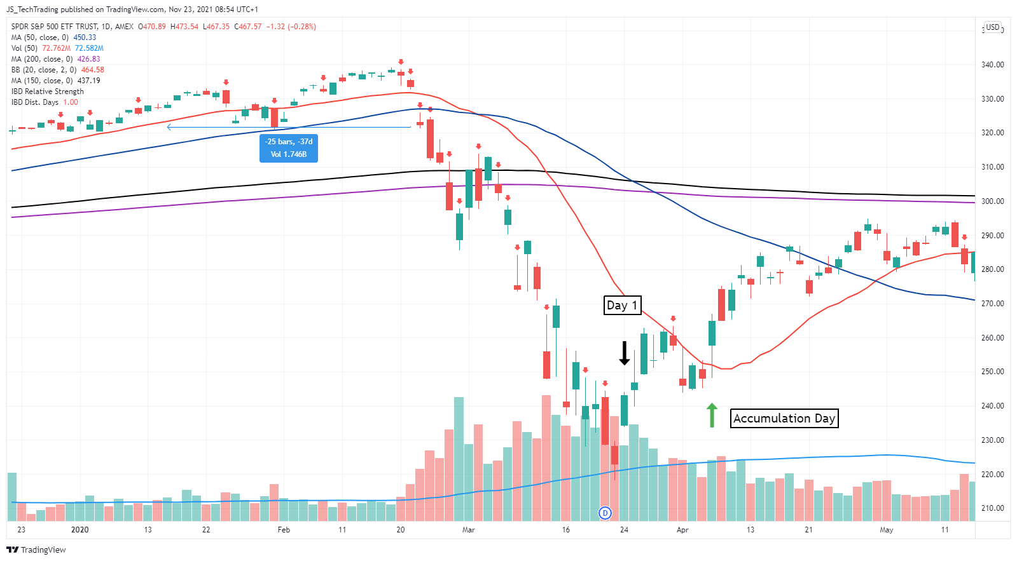
I TechTrading I Example SP500

Slide 6
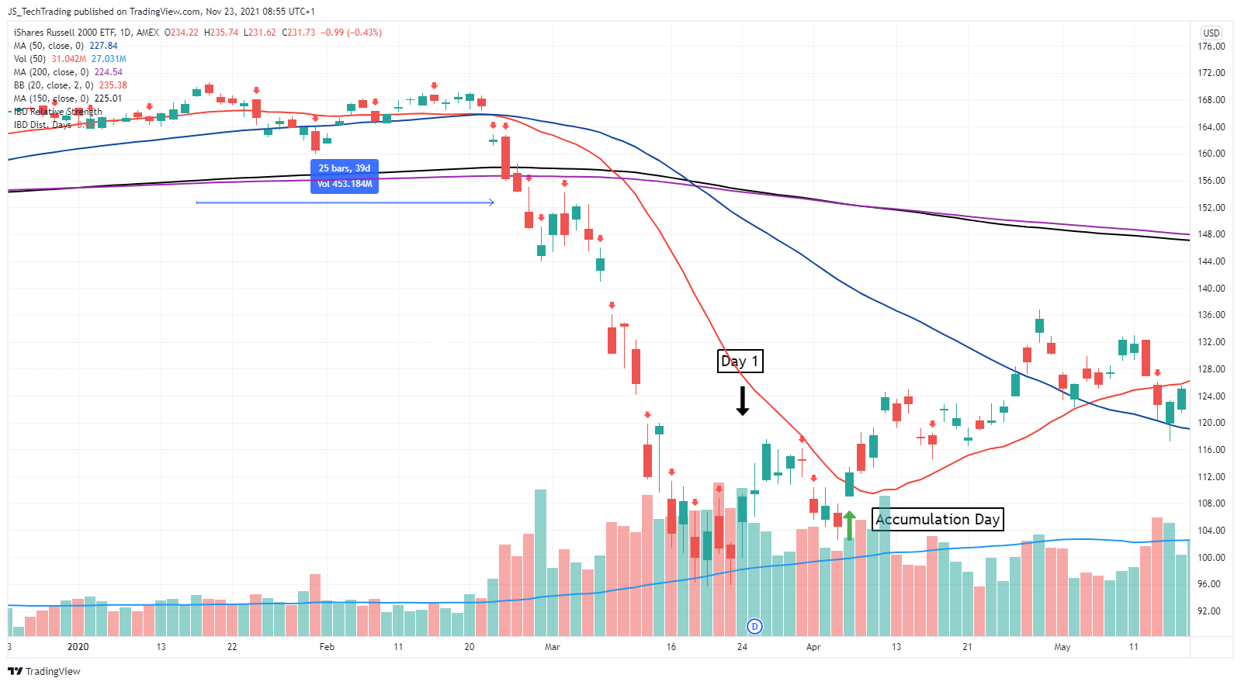
I TechTrading I Example Russel2000

Slide 7
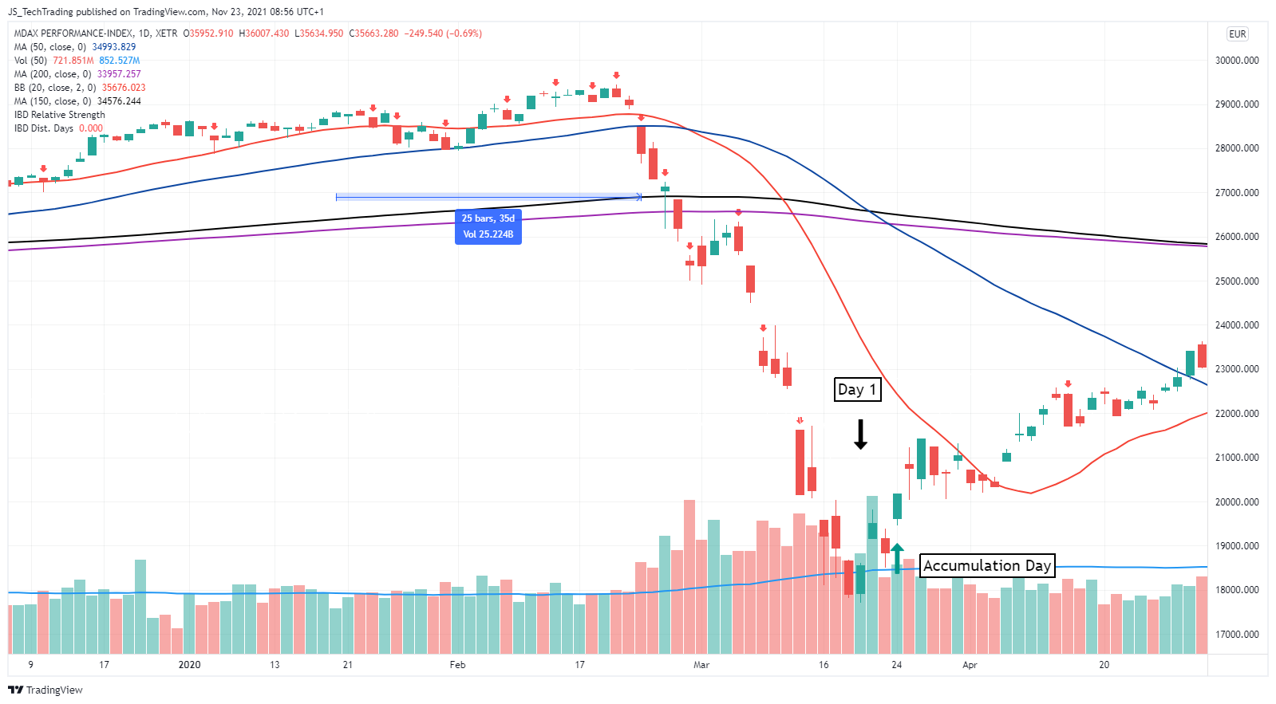
I TechTrading I Example MDAX

Slide 8
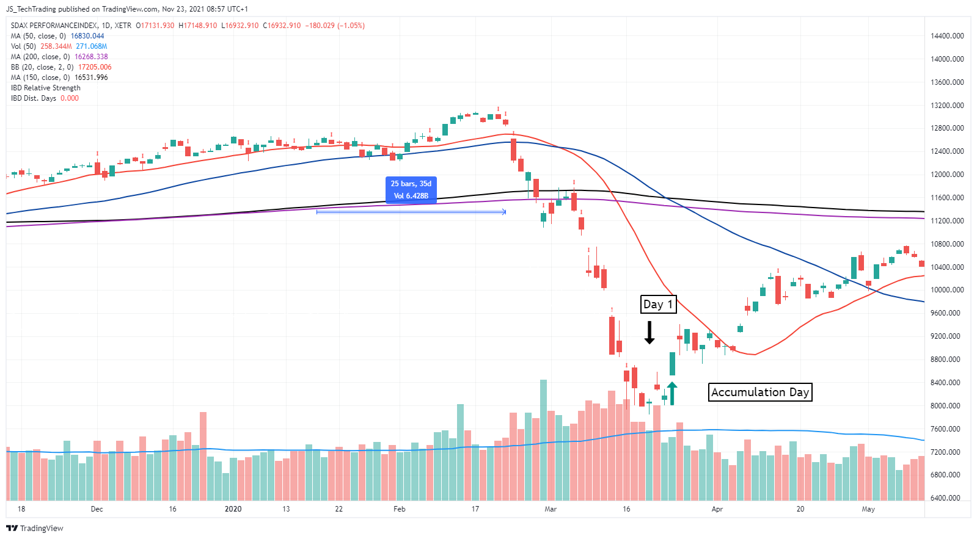
I TechTrading I Example SDAX

Slide 9
I TechTrading I Application
Direct application for ETF investments
Apply this approach to determine your market exposure for swing trading strategies
# Distribution Days | < 4 | 4 - 5 | > 5
% invested | 100% | 50% | 0%

