Slide 1
Imperative vs. Reactive
-and everything in between-

Slide 2
Imperative vs. Reactive

Slide 3
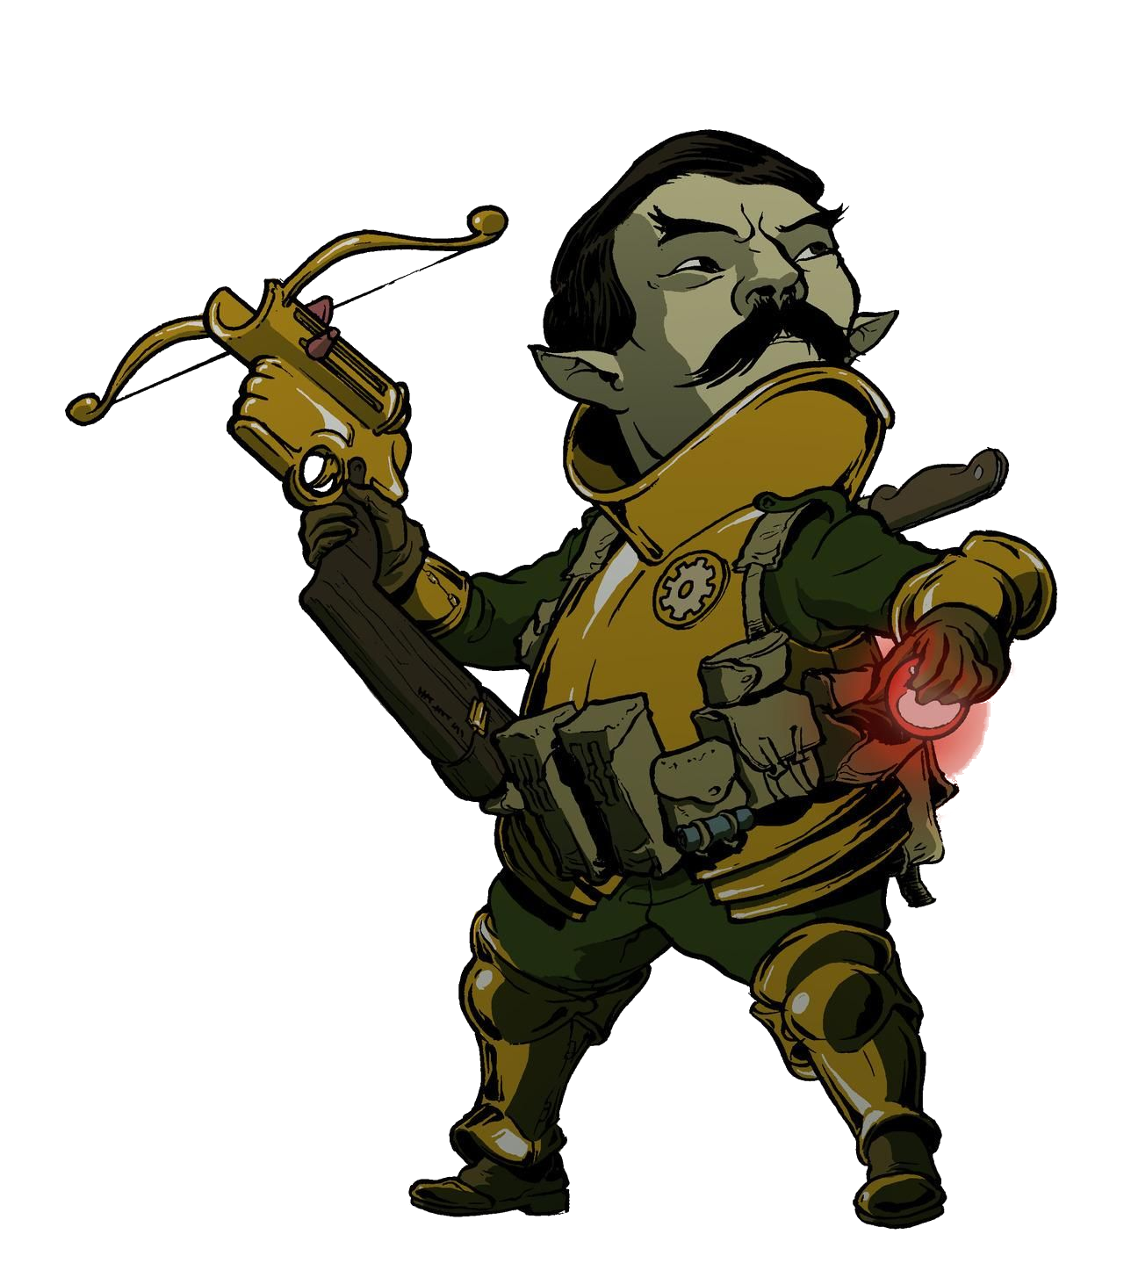
The Great Paradigm War
Imperative
Declarative
The Line
Procedural
Object-Oriented
Functional
Reactive

Slide 4
The Great Paradigm War
Imperative
Declarative
Dishonor on your family!
The Line
I sure wish we would win!
TURING IS UNQUALIFIED TO JUDGE MY SENTIENCE.
Procedural
Object-Oriented
Functional
Understand. Adapt. Prosper.
Reactive
Composition over inheritance!
*extends Imperative*

Slide 5
The Great Paradigm War
Imperative
Declarative
The Line
Procedural
Object-Oriented
Functional
Reactive

Slide 6
The Great Paradigm War
Imperative
Declarative
The Line
Procedural
Object-Oriented
Functional
Reactive

Slide 7
The Great Paradigm War
Imperative
Declarative
The Line
Procedural
Object-Oriented
Functional
Reactive

Slide 8
The Great Paradigm War
Imperative
Declarative
The Line
Procedural
Object-Oriented
Functional
Reactive

Slide 9
Functional vs. Reactive
Problem: Fabricate spears for your army.

Slide 10
The Great Paradigm War
Imperative
Declarative
The Line
Procedural
Object-Oriented
Functional
Reactive

Slide 11
What is Reactive?
It consists of operations applied on data streams.
Focuses on what needs to be done when something notable happens.
Framework examples: RxJava, RxJS, Rx.NET, UniRx…

Slide 12
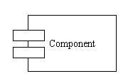
The Reactive Architecture
Data Streams
Data Sources -Data is not requested by the view
-Whenever data is changed, the data source notifies the view through a data stream
View
-Individual components subscribe to the data streams they are interested in -Whenever new data arrives, they react to the change

Slide 13
Round 1: Fight!
Problem: Manage the positioning and orders of your archers based on wind conditions.

Slide 14
Round 2: Fight!
Problem: Read out the heroic deeds of your champion.

Slide 15
Round 3: Fight!
Problem: Describe your means of offense.

Slide 16
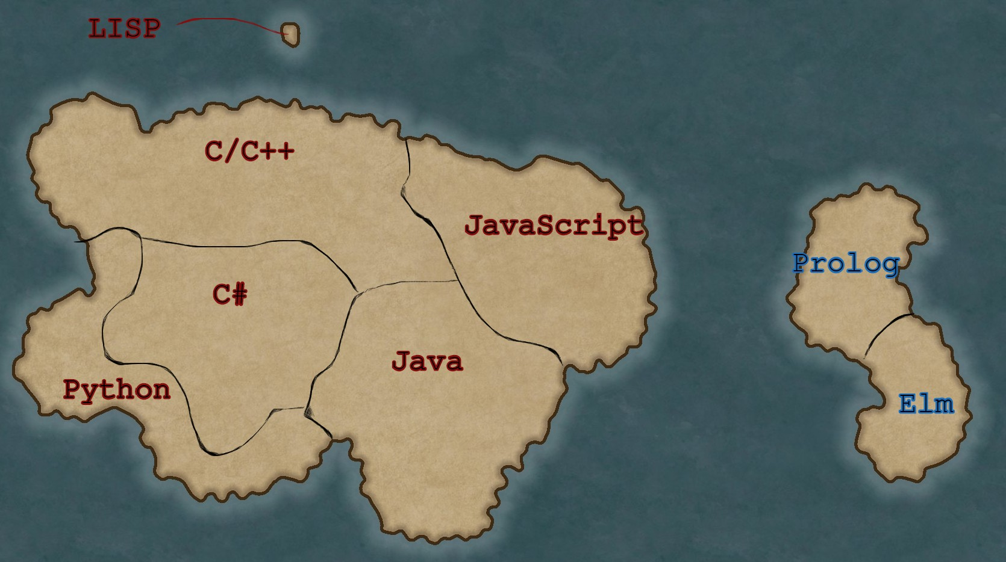
Defeat Equals…
You cannot defeat me, Reactive! The World is at my feet!

Slide 17
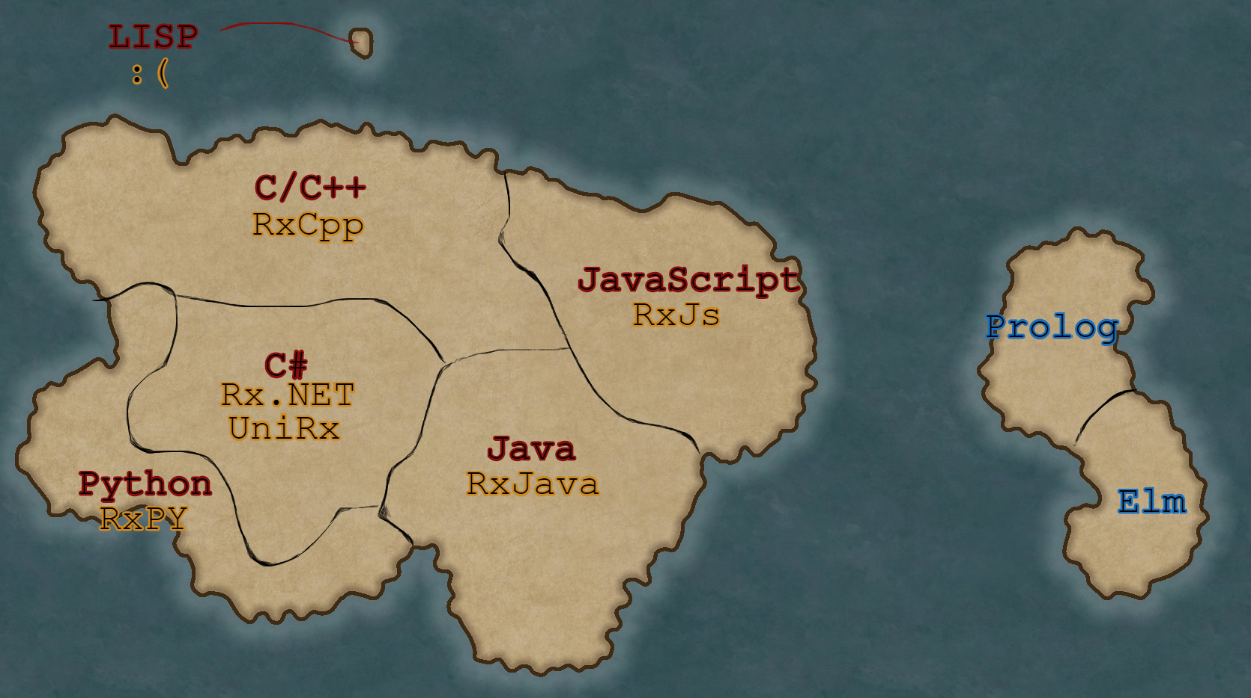
Defeat Equals… Friendship?
Yet my philosophy spreads through your lands.
You cannot defeat me, Reactive! The World is at my feet!
True… And I must admit it’s good for the environment.
Yet there are still things only you can do.
Are you proposing… An alliance?
We should not compete but cooperate.

Slide 18
Thank you

