Slide 1
Stilian Delibosov Middle blocker/Outside hitter

Slide 2
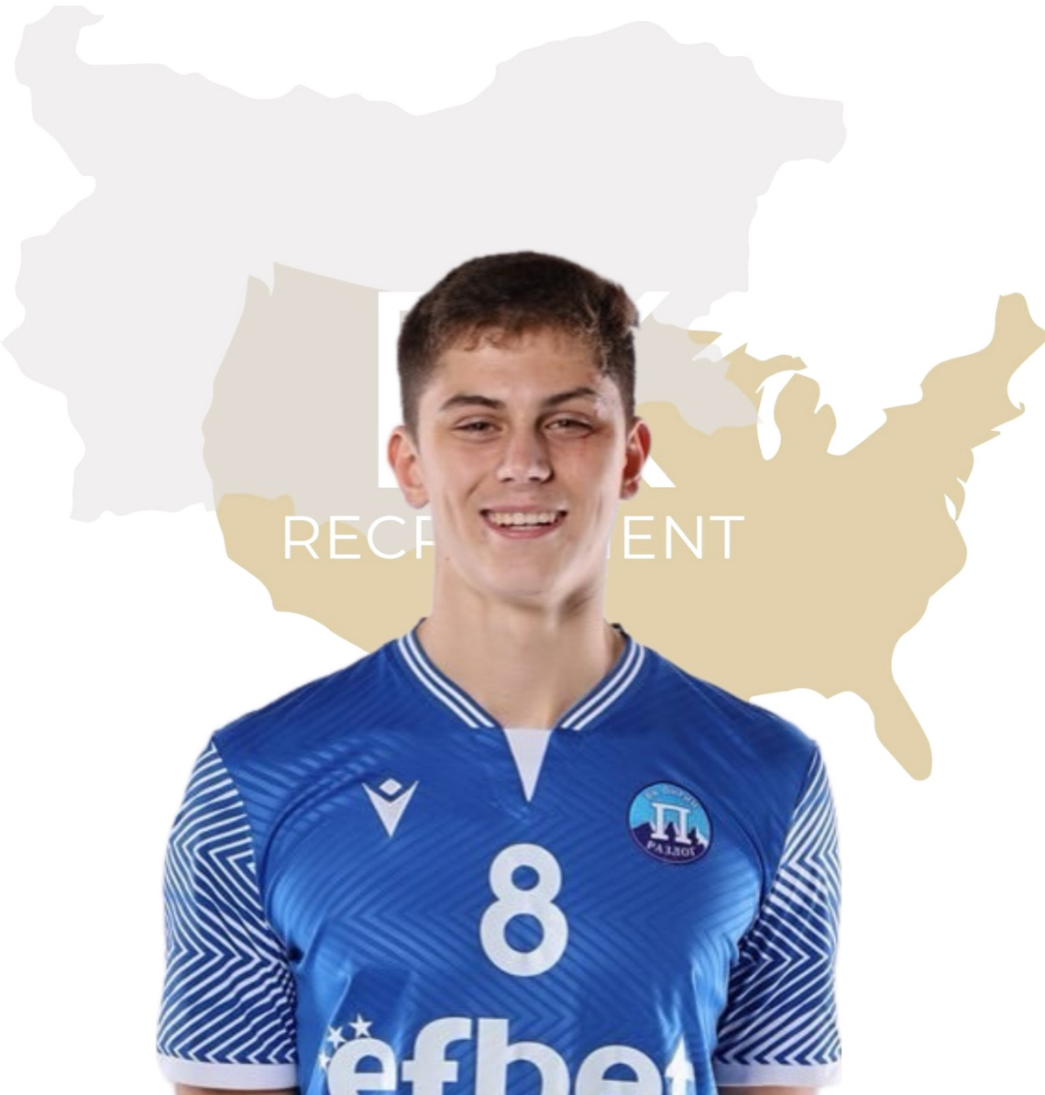
Status: Available
Gender: Male
Position: Middle Blocker/Outside Hitter
Date of Birth: 19.02.2005
Graduation date: June, 2024
Club team: Volleyball Club “Pirin Razlog”

Slide 3
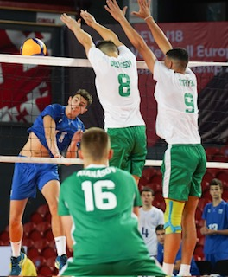
Additional Information
Height: 200 cm.
Weight: 89 kg.
Reach: 257 cm.
Approach high jump: 350 cm.
Standing block jump: 330 cm.
High school: Vocational High School of Transport
Languages: Bulgarian, English
Desired degree:
SAT grade/date: TBA
TOEFL grade/date: TBA

Slide 6
Volleyball Achievements
VC Pirin Razlog- 1st place-National championship season 2016/2017 boys; National Championships season 2017/2018 boys
2nd place- Volleyball school games 2018/2019 boys ; National Championship season 2018/2019 boys and Dryanovo Cup 2019 boys
3rd place- National Championship, season 2021/2022 Boys U18
Bulgarian National Team awards-U17 Balkan Volleyball Championship, Serbia, 3-5 March 2021 - 1st place
U17 European Championship, Albania, 2021 - 5th place
U18 Balkan Championship, Sofia, January 2022 - 1st place
U18 Balkan Championship Serbia 28.06-02.07.2022 - 2nd place
CEV U18 Volleyball European Championship 2022 Georgia - 3rd place
U19 Balkan Championship-Men, Albania, 11-15.07.2023 – 2nd place
World Championship U19, Argentina, 2023 – 5th place

Slide 7
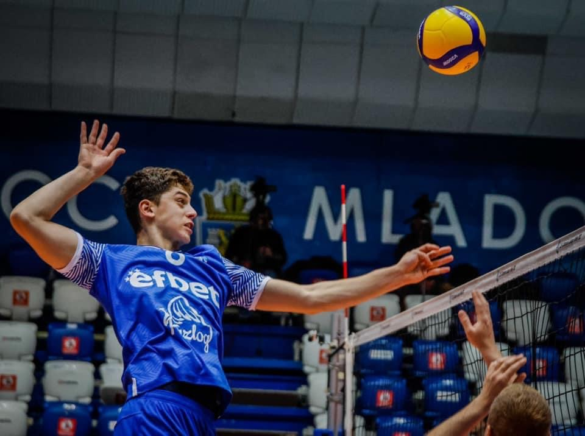

Slide 8
Individual Awards
Individual awards- Dryanovo Cup, 2019 - Best Server
National Championship U16, season 2020/2021 - Best Middle-blocker
The school’s number 1 athlete for 2022
National Championship men’s u17, season 2021/2022 - Best Middle-blocker
National Championship U19, season 2022/2023 - Best Outside hitter
Athlete of the year for 2022 - Razlog Municipality

Slide 9
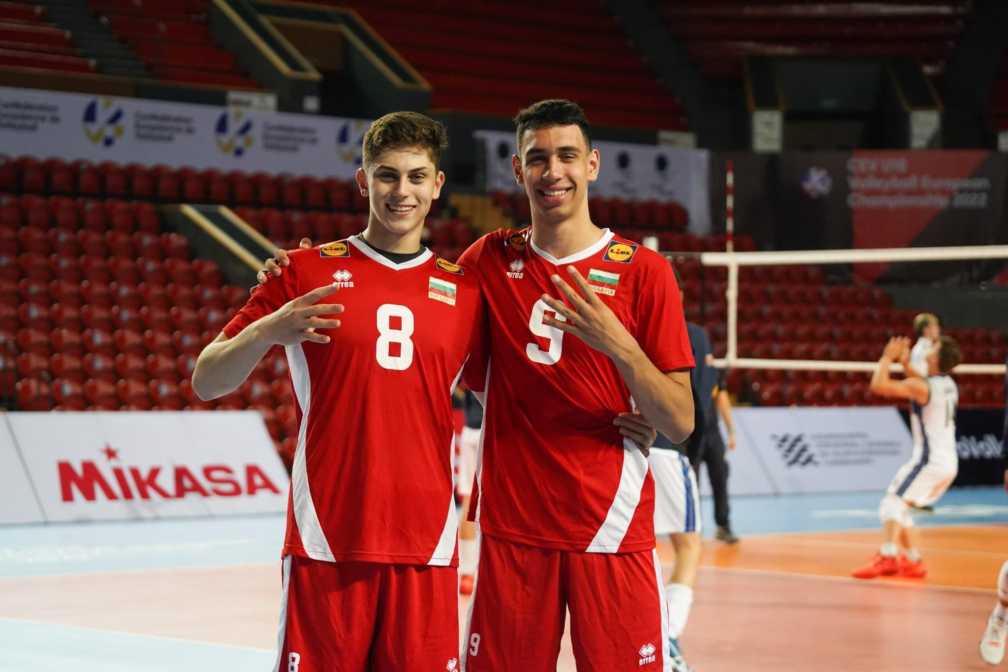

Slide 10
Interview questions
Describe yourself with a few sentences:
I am patient and brave. I have always been a hardworking person and I want to develop as a player in America.
What does volleyball mean to you?
Volleyball means more than just a sport to me. I try to get better because it gives me great pleasure to play.
What does your education mean to you?
Education is very important to me and I want to graduate in America. It gives me another option in life and a way to learn and improve.
What are your main goals as a student-athlete in the USA?
I want to show what I’m capable of and what volleyball skills I have, also I want to become better and better and develop more in this direction.

Slide 12
Video Analysis
Highlight Video:
https://youtu.be/crSGF7uDyMA
https://www.youtube.com/watch?v=UXQUv48VqoU

Slide 13
The presentation provides all the basic information for the student-athlete. More details and video can be provided if needed. Contact us.

