Slide 1
Human rights workshop

Slide 2
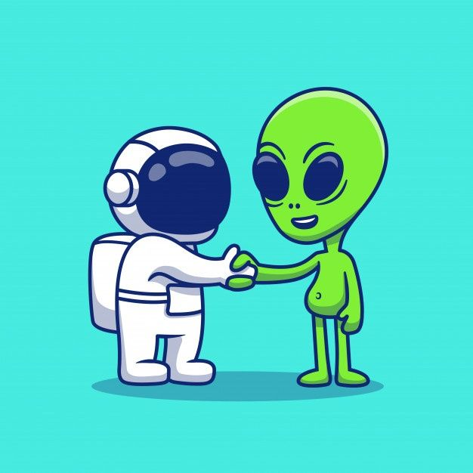
task
Act out a short dialogue in which you describe what human beings need to live and grow to an alien.
For example:
What do human beings need to survive?
What things help us to grow physically?
What things help us to succeed in life?

Slide 3
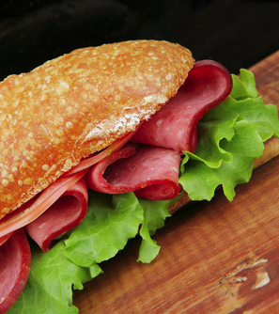
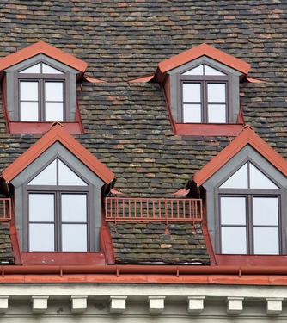
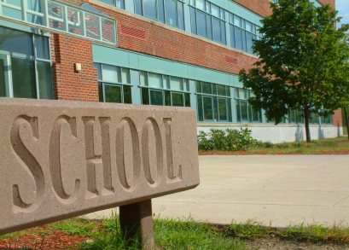
All human beings, have similar basic needs:
nutritious food, health care, shelter, education, protection from harm and more.

Slide 4
Human rights
Human beings need these thing to live and grow and to be human.
Needs are different to wants. Wants are not necessary for a person to survive, grow and develop.
Everyone of us has the right to have these needs fulfilled.
These rights are called human rights.

Slide 5
Your rights, my rights
Human rights support all areas of our lives, for example:
Right to education
Right to have your own thoughts, beliefs and religion
Right to vote in elections once you reach the voting age
Right not to be required to do forced labour and not to be treated as a slave
You can think of human rights as a set of rules that state what we all need to live and grow, and how we should treat each other.

Slide 6
Marketplace activity
Today you are going to be working in a marketplace.
Some students will be ‘human beings’ buying human rights.
Some students will be ‘human rights owners’ selling human rights.

Slide 7
What have you got to do?
Human beings
You need to buy four human rights that you think are most important to your life.
You have a £1,000 budget - and you can’t go over budget!
Have a look at all 16 human rights and decide which ones you definitely want to buy.
Consider that they might not be all on sale.

Slide 8
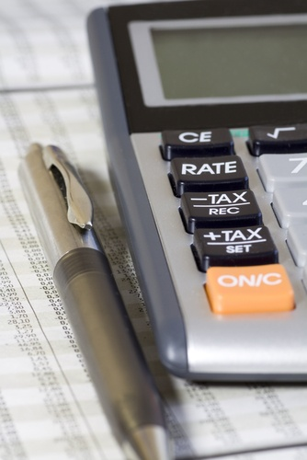
What have you got to do?
Human rights owners
You need to sell more human rights than anyone, and for the highest price.
The price should reflect the importance of the human right – but remember the human beings only have £1,000 budget.
You need to review 8 human rights and choose 4 human rights to sell. You should select the ones that you think are most important.
Create sales posters for your stall, including the name of the human right and the starting price.

Slide 9
Remember
The purpose of this activity is to think about the importance of human rights, not just negotiating money.
Think about:
How will the human rights benefit your / our lives?
What would happen if you / we didn't have them?

Slide 10
How will it work?
Browsing (5mins)
Human beings will browse the different market stalls, finding out which human rights are on sale and talking to the human rights owners to find out why they should buy their human rights and their starting price.
Make notes of the different prices you are discussing on your human rights cards.
Choices (2mins)
Human beings decide which human rights they are going to try and buy and from who.
Human rights owners prepare to negotiate by thinking about the price range of their human rights.

Slide 11
Human beings – ready to go?
Human rights owners – ready to go?

Slide 12
How will it work?
Trading (5mins)
Human beings quickly choose which human rights they will buy, and agree the price with the human rights owner.
Record your purchases and sales in the Trading table on your worksheet.

Slide 13
How will it work?
Independent review
Independently review your work in preparation for class discussion by completing the Review table on your worksheet.

Slide 14
Class discussion
Owners:
Which human rights did you choose to sell and why?
Which was most popular? How did you promote this human right?
Which human right was least popular? How did you promote it?
Who made the highest number of sales? Which human rights did you sell?

Slide 15
Class discussion
Human beings:
Did you find it easy / hard to choose which human rights to buy?
Which human rights did you buy and why?
How would these rights benefit your life?
Which human rights did you not think were important?
What would be the impact of not having these rights?

Slide 16
Important – all human rights are yours
In reality you don’t ever have to choose your human rights.
Human rights belong to everyone from when they are born.
Although they can sometimes be restricted, human rights can never be taken away from you.
There are different laws that protect everyone’s human rights which we will explore in the next lesson.

Slide 17
Important - all human rights are yours
Every human right is important!
Every human right is needed to live and grow – and to be a human being!

Slide 18
What have we learnt?
That human rights belong to everybody.
That every human right is important and needed for human beings to live and grow.

