Slide 1
Eleonora Gicheva SETTER

Slide 2
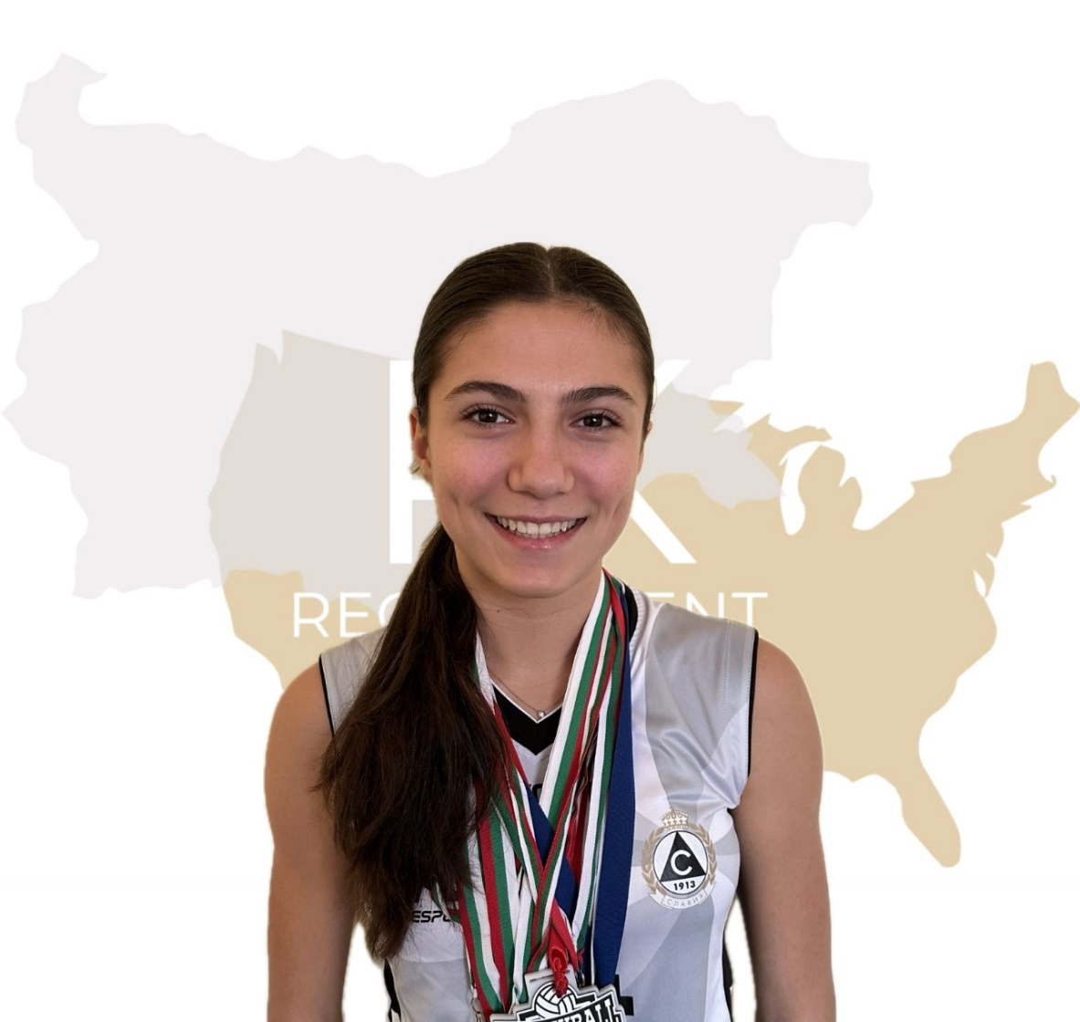
Status: Available
Gender: Female
Position: Setter
Date of Birth: 19.11.2006
Graduation date: June, 2025
Club team: Volleyball Club Slavia, Sofia

Slide 3
Additional information
Height: 175 cm.
Weight: 60 kg.
Reach: 228 cm.
Approach high jump: 295 cm.
Standing block jump: 280 cm.
High school: „57 SU Saint Naum Ohridski“ Sofia
Languages: Bulgarian, English
Desired degree: TBA
SAT grade/date: TBA TOEFL grade/date: TBA

Slide 4
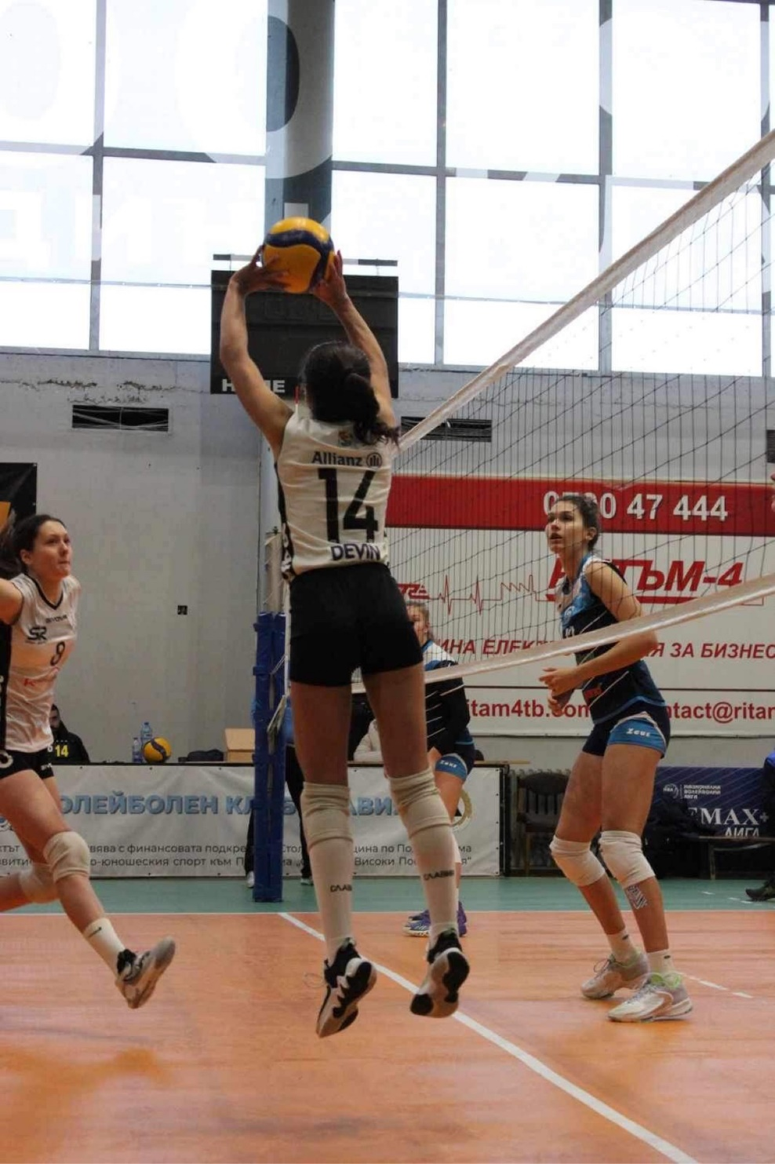
Volleyball Achievements
2019 Christmas Tournament “Ivan Nikolov” -1st place
2019 “Sofia tournament” - 2nd place
2021- Tournament “Play with us”- 2nd place
2022- Serbian friendly tournament- 2nd place
2022- Tournament “Girls of the roses” -3rd place
Bulgarian Republican Championship- 2021/22- 7th place ; 2022/23- 6th place
Bulgarian Demax League 2022/23- 4th place
Bulgarian cup 2022/23- 3rd place
2023 National Beach volleyball Tournament U20- 1st place x5

Slide 5
Individual awards
2022- Serbian friendly tournament- Best setter
2022- Beach volleyball tournament Byala open U18 MVP
2023- Beach volleyball tournament Byala open U20- Best defender
2023- Beach volleyball tournament “Emona cup” U20- MVP
2023- National beach volleyball tournament “Byala open” U20- MVP

Slide 6
Beach Volleyball Participation
European Beach Volleyball Championship U18 2022 Loutraki, Greece
European Beach Volleyball Championship U22 2023 Timisoara, Romania
European Beach Volleyball Championship U20 2023 Riga, Latvia
European Beach Volleyball Championship U18 2023 Madrid, Spain

Slide 7
Video Analysis
Highlight Video:
https://www.youtube.com/watch?v=1RcGi1DESKo NEW! https://www.youtube.com/watch?v=Nybiv1DAUpA

Slide 9
Interview questions
Describe yourself with a few sentences:
I describe myself as a positive and caring person. I am disciplined and very ambitious. I am a fast learner and I always aim for the best. I work hard and giving up is not an option for me.
What does volleyball mean to you?
I started practicing volleyball 8 years ago and when I first entered the gym I didn’t know anything about volleyball and I didn’t think that it would become so important for me, but now I can’t imagine my life without volleyball. It is my passion which I am dedicated to.

Slide 11
What does your education mean to you?
For me education is as important as volleyball. Outside of sports it can provide a lot of skills and knowledge. Education plays an important role in building a career outside of the court.
What are your main goals as a student-athlete in the USA?
My main goals as a student-athlete in the USA are to combine both sports and education. I want to develop my skills on the highest level and become the best version of myself.

Slide 12
The presentation provides all the basic information for the student-athlete. More details and video can be provided if needed. Contact us.

