Slide 1
OUR WEEK IN MARTINIQUE

Slide 2
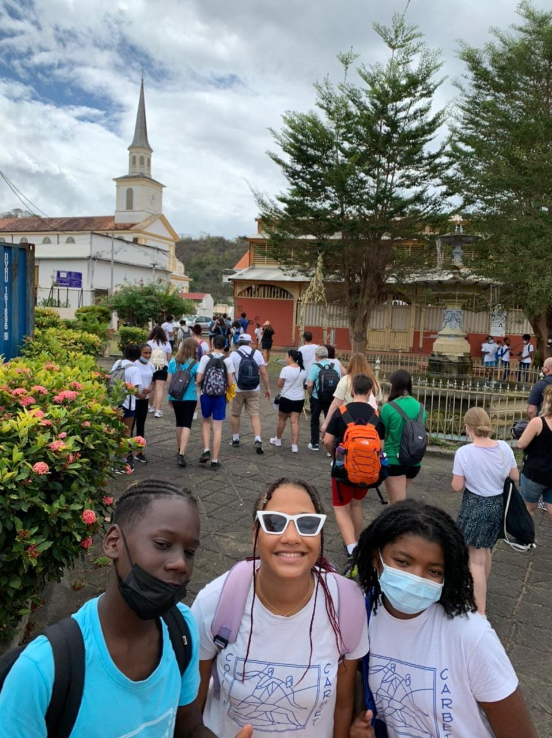
MONDAY
We started with presentations of our countries
After that, we went hiking
During the hike, we swam in a river
Our opinion
It was nice to meet each other and hear about where each one of us comes from.
We saw a lot of nature and some typical Martinican plants.
At the end, we were exhausted and wet after hiking through the river.
tiring

Slide 3
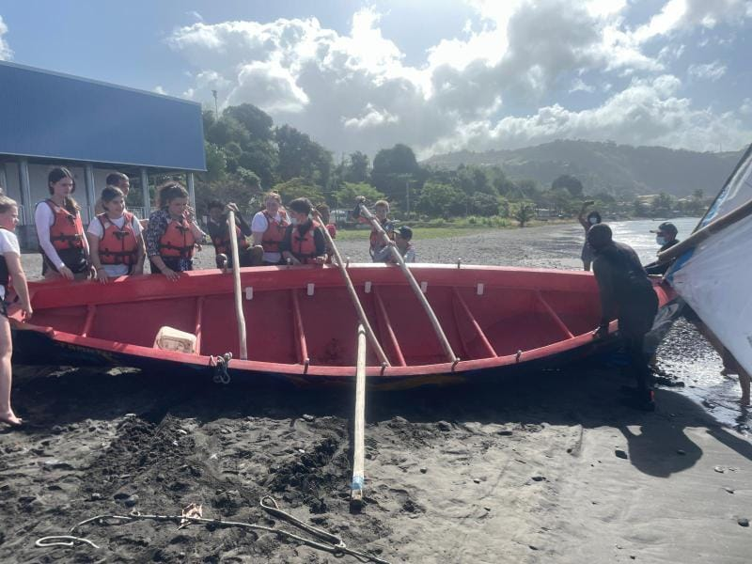
tuesday
Fun
We went to St. Pierre to sail on a yole (traditional Martinican boat)
Meanwhile, some of us went kayaking and swimming
After lunch, we went to the house of Aimé Césaire, a famous local poet
At his house, we wrote a poem about racism and discrimination
Our opinion
It was very exciting to learn new stuff and very funny to see people fall from the yole into the water.
The history of Amié Césaire was interesting but it was too long and we were tired from the water activities.

Slide 4
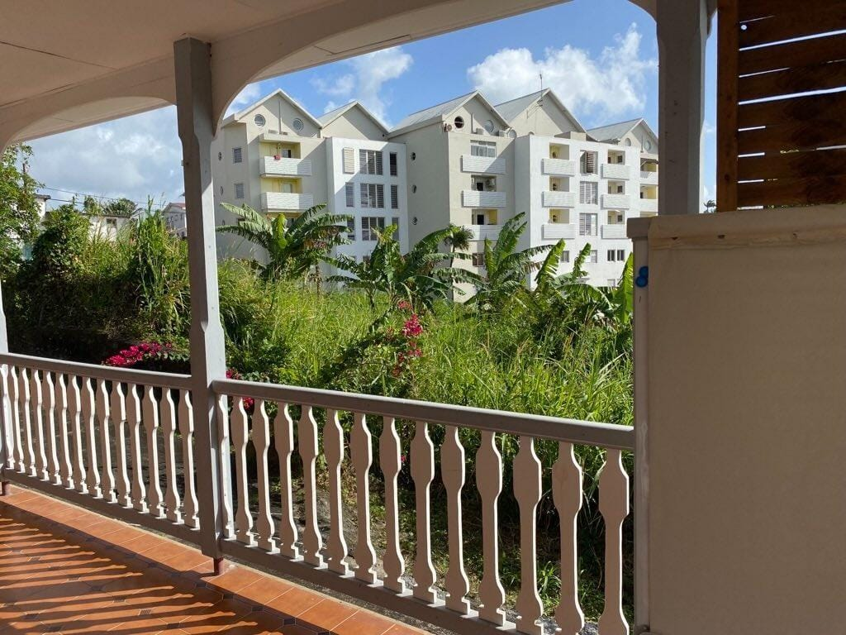
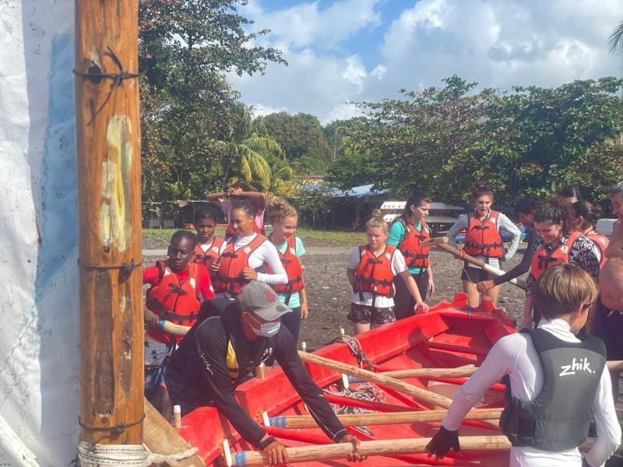

Slide 5
wednesday
We went to the Tombolo
After that, we went to see a strange man with plants
Next, we went and learned how to weave baskets
After that, we ate traditional food and learned a traditional dance called bèlè.
Our opinion
We got a very nice view of Martinique from the tombolo.
The strange man (șaman) was boring and he had a weird house.
The weaving was nice and the bèlè was very funny.
Traditions

Slide 6
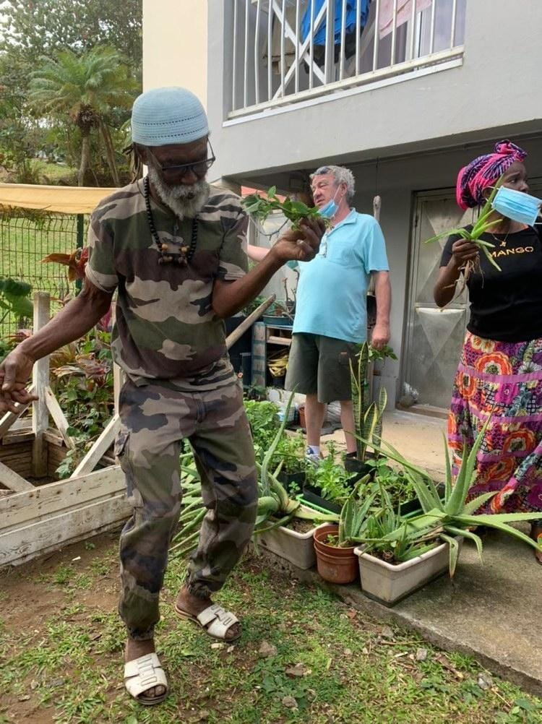
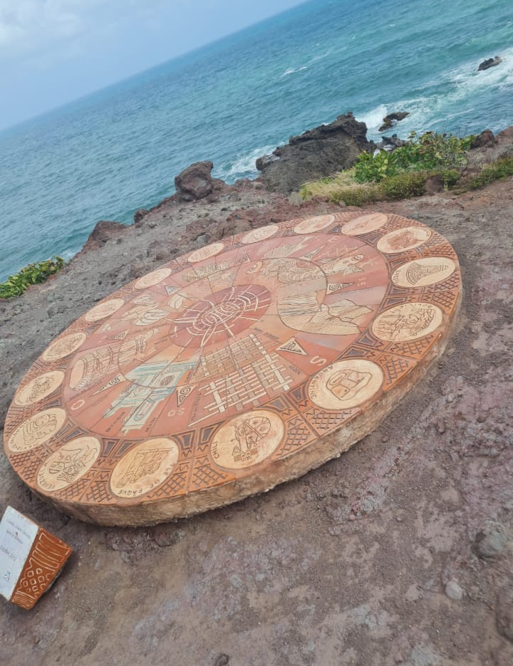

Slide 7
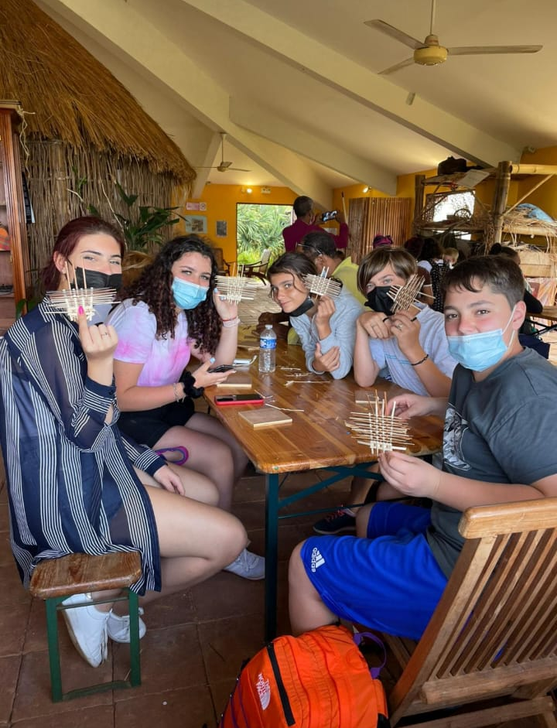

Slide 8
thursday
We were taught how to make cacao and also about slavery here in Martinique.
Then we went and ate in the forest and also made friends with a lizard.
At the and we went to the beach and had lots of fun
Our opinion
Learning how to make cacao is useful and it smelled so good.
We bought nice, expensive things from the pottery village.
At the beach we had lots and lots of fun.
Interesting

Slide 9
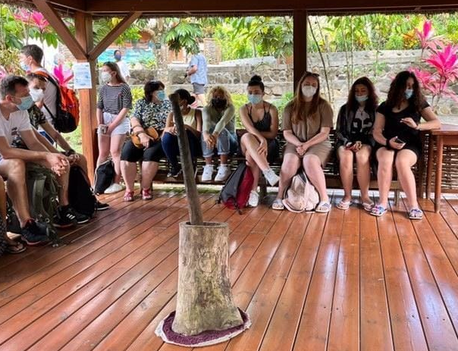
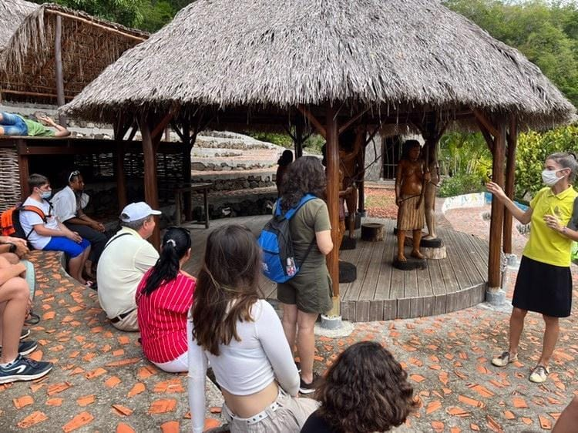

Slide 10
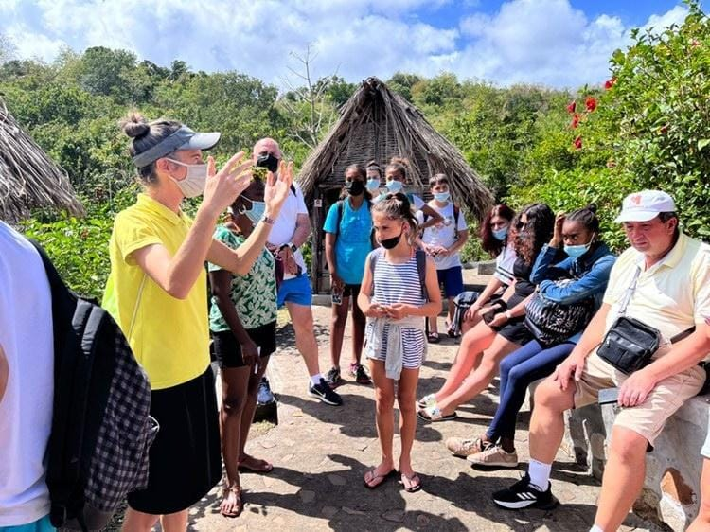
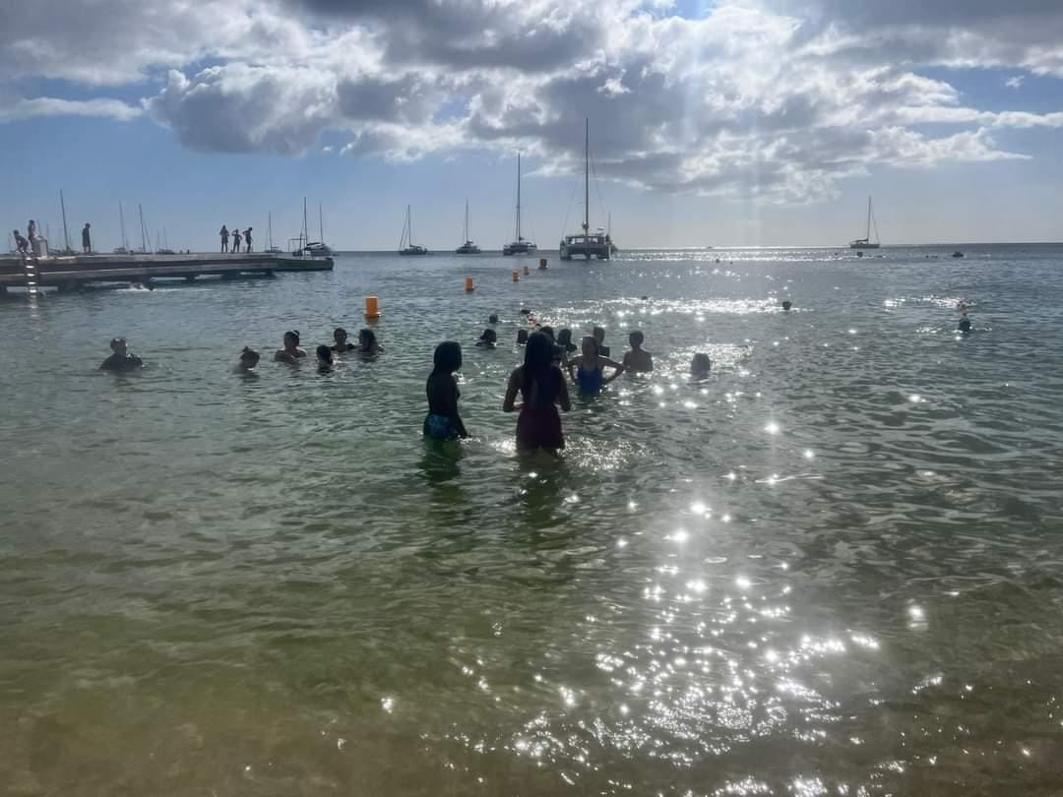
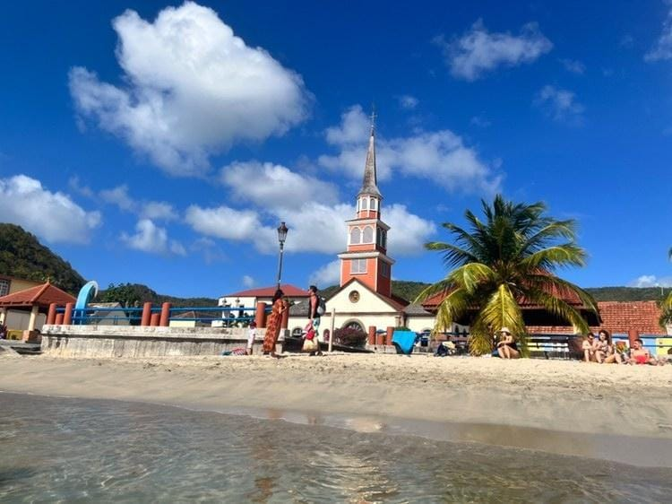

Slide 11
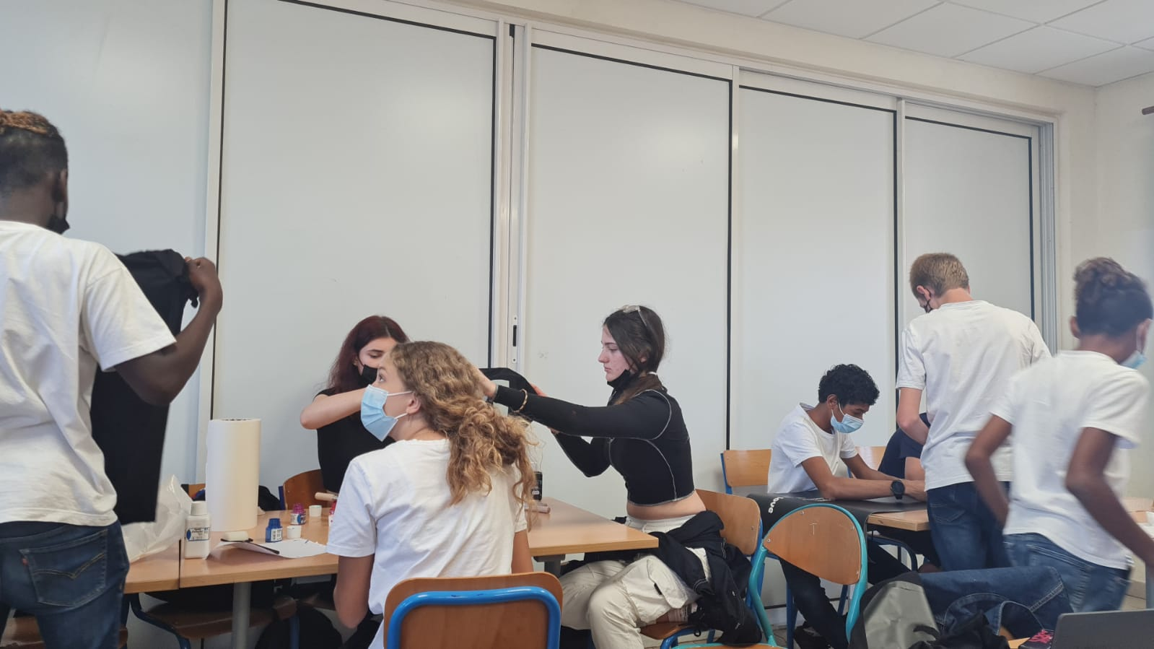
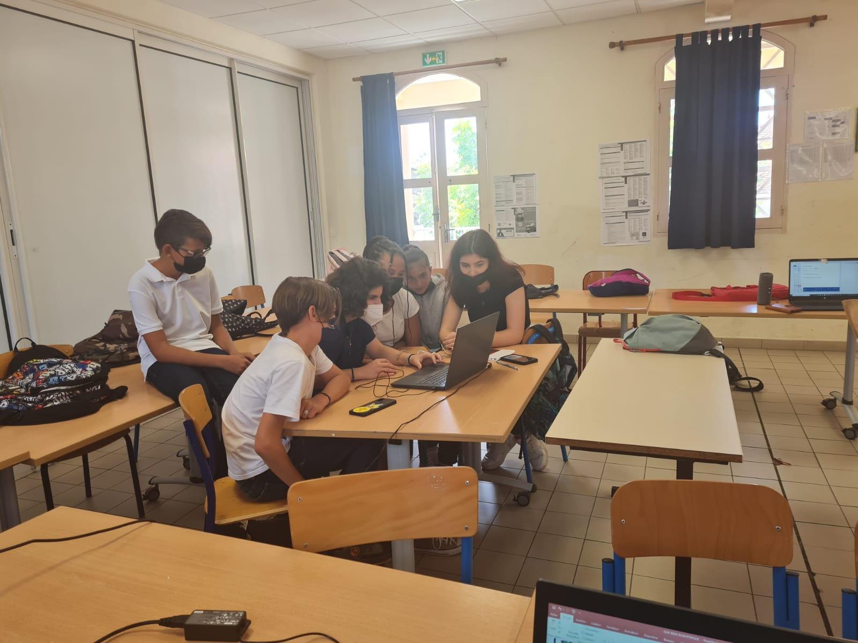
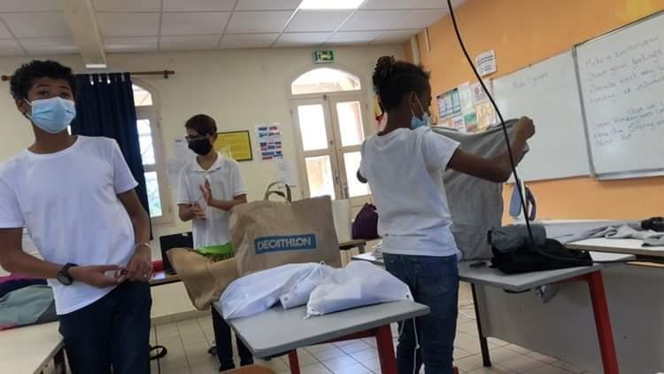
friday
Made projects about our days
We also made t-shirts
Our opinion
We had a lot of fun working together.
We love our t-shirt
Unforgetable

Slide 12
racism
How to fight it?
Monday: Determination
Tuesday: Working together, trusting eachother, encouraging
Wednesday: Sharing, respect, learning from each other
Thursday: Making the future different from the past and not making the same mistakes.
Friday:
Definition
A belief that race is a fundamental determinant of human traits and capacities and that racial differences produce an inherent superiority of a particular race

Slide 13
POEM
Rasism should be stopped once and for all
Lucrand impreuna, lucrand cu familia si prieteni, suntem mai puternici
Todos somos iguales, no debería haber diferencia
Niemand wurde mit Hass geboren
Le racisme est une bataille que l’on ne va jamais arreter de mener

