Slide 1
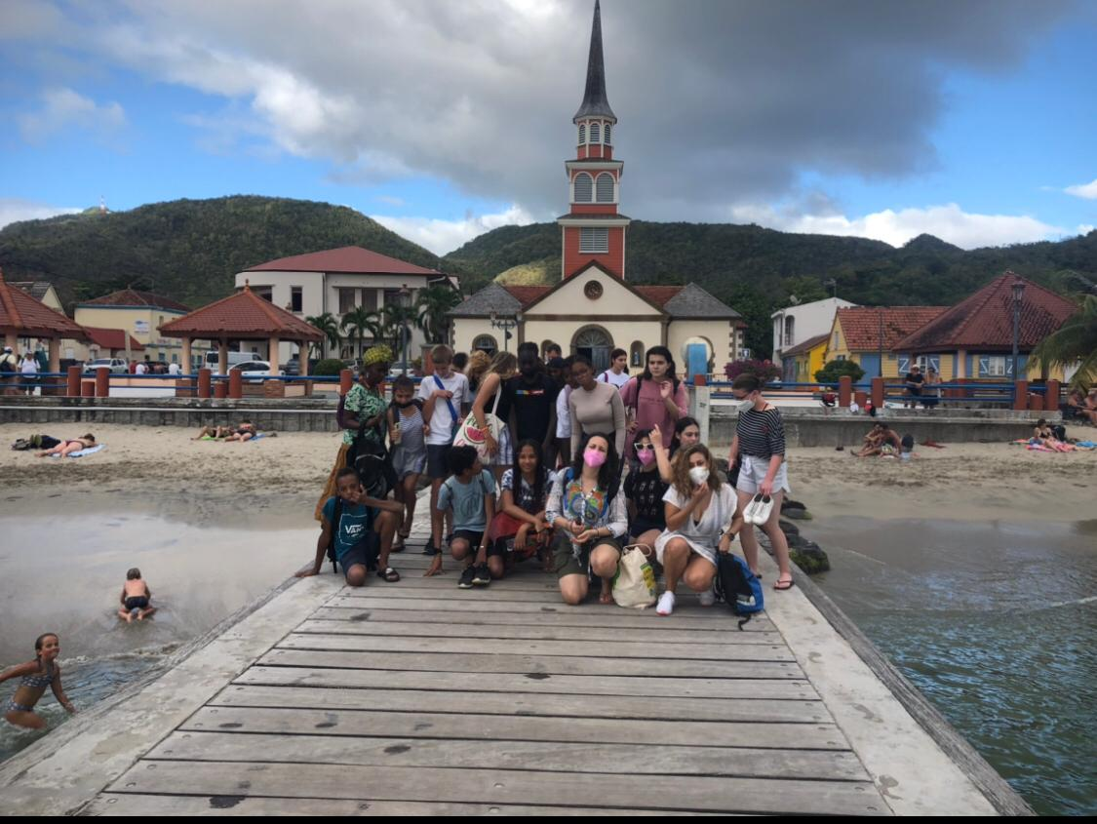
ERASMUS 2022

Slide 2
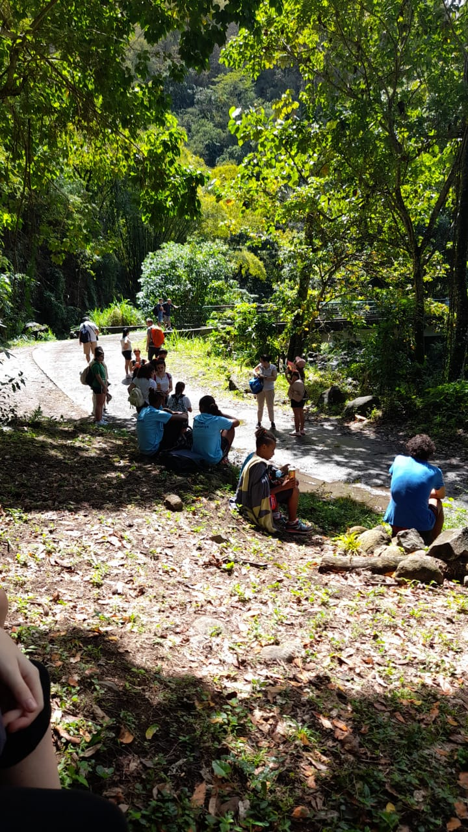
DAY 1:
In the morning we did our presentations
We tried some traditional tasty « pain-au-beurre chocolat » and mont pêlé
We went on a walk to the river
We got very wet in the river when it started raining

Slide 3
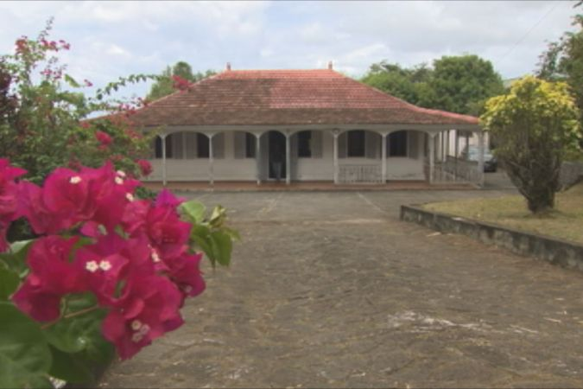
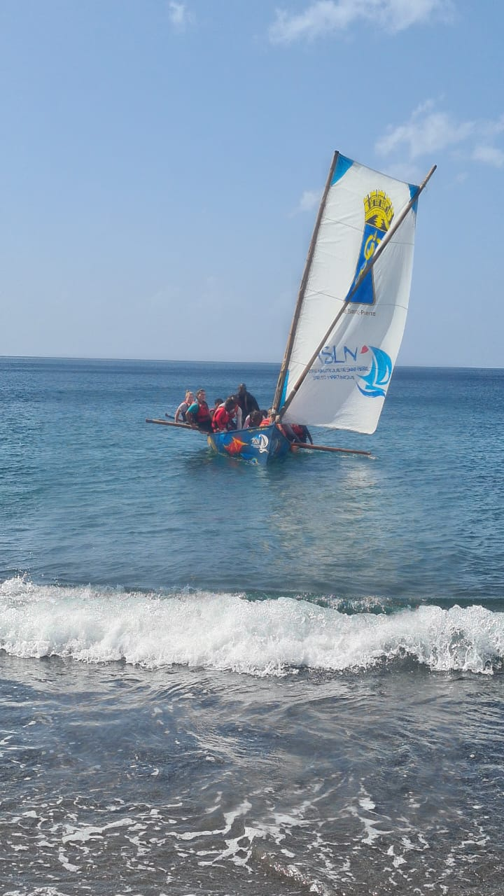
DAY 2:
In the morning we did Yole and used the canoe
It was very very fun
After we went to Aime Cesaire’s house

Slide 4
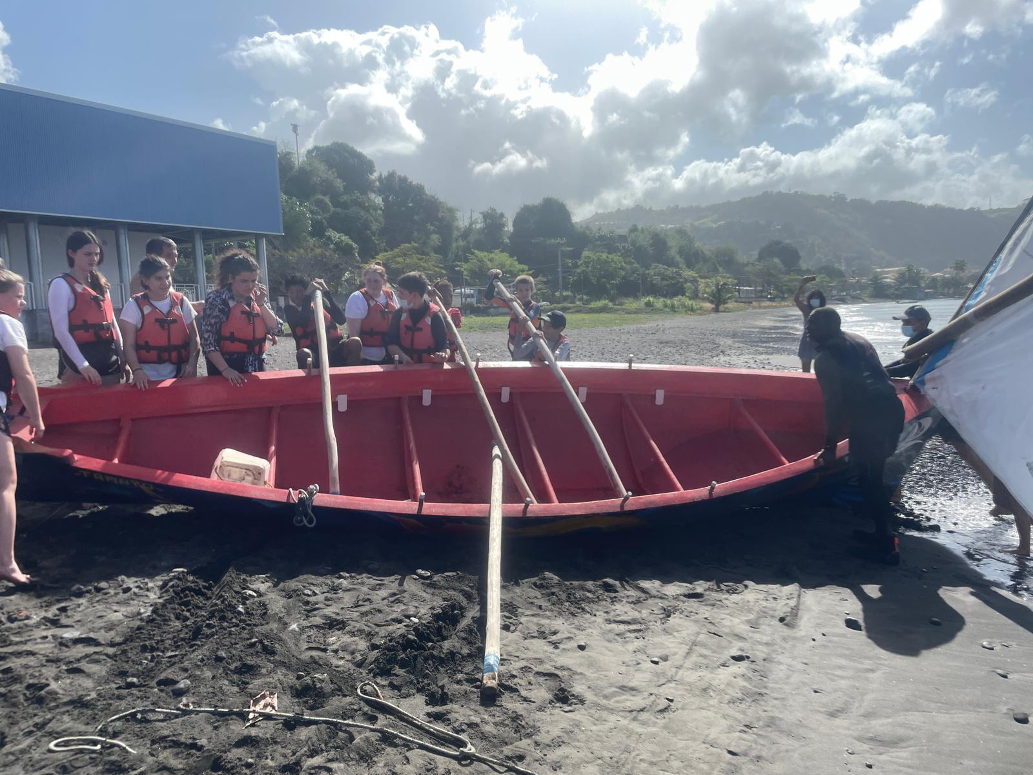

Slide 5
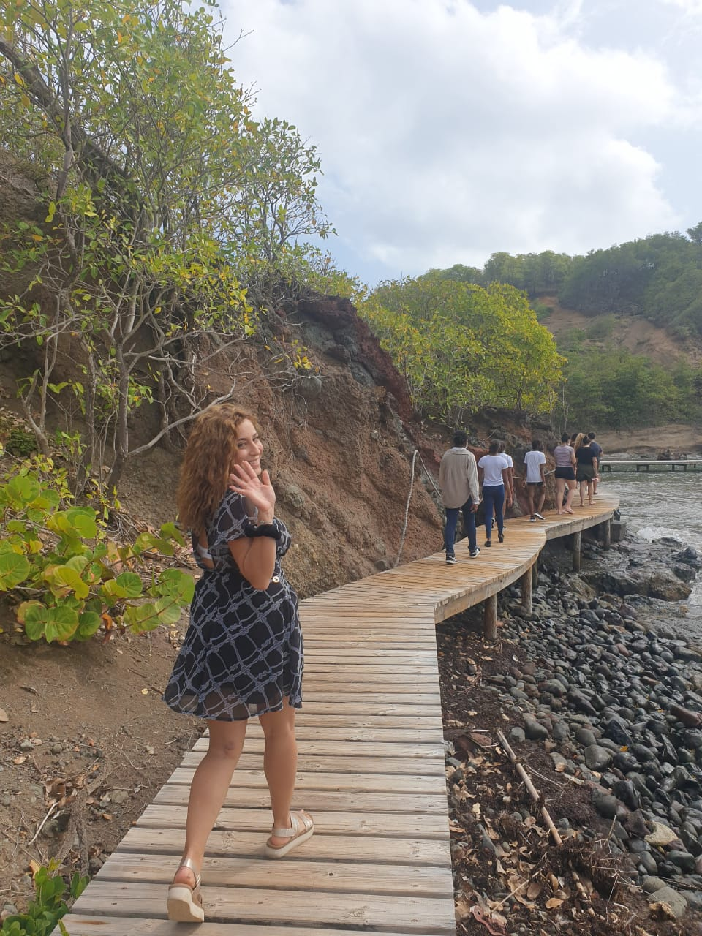
DAY 3:
We went to Tombolo
We got wet again
We saw hermit crabs, crabs and birds
We ate Martniquan food like gratin
We did some weaving
Later, we learnt some cool dances « Bèlè »

Slide 6
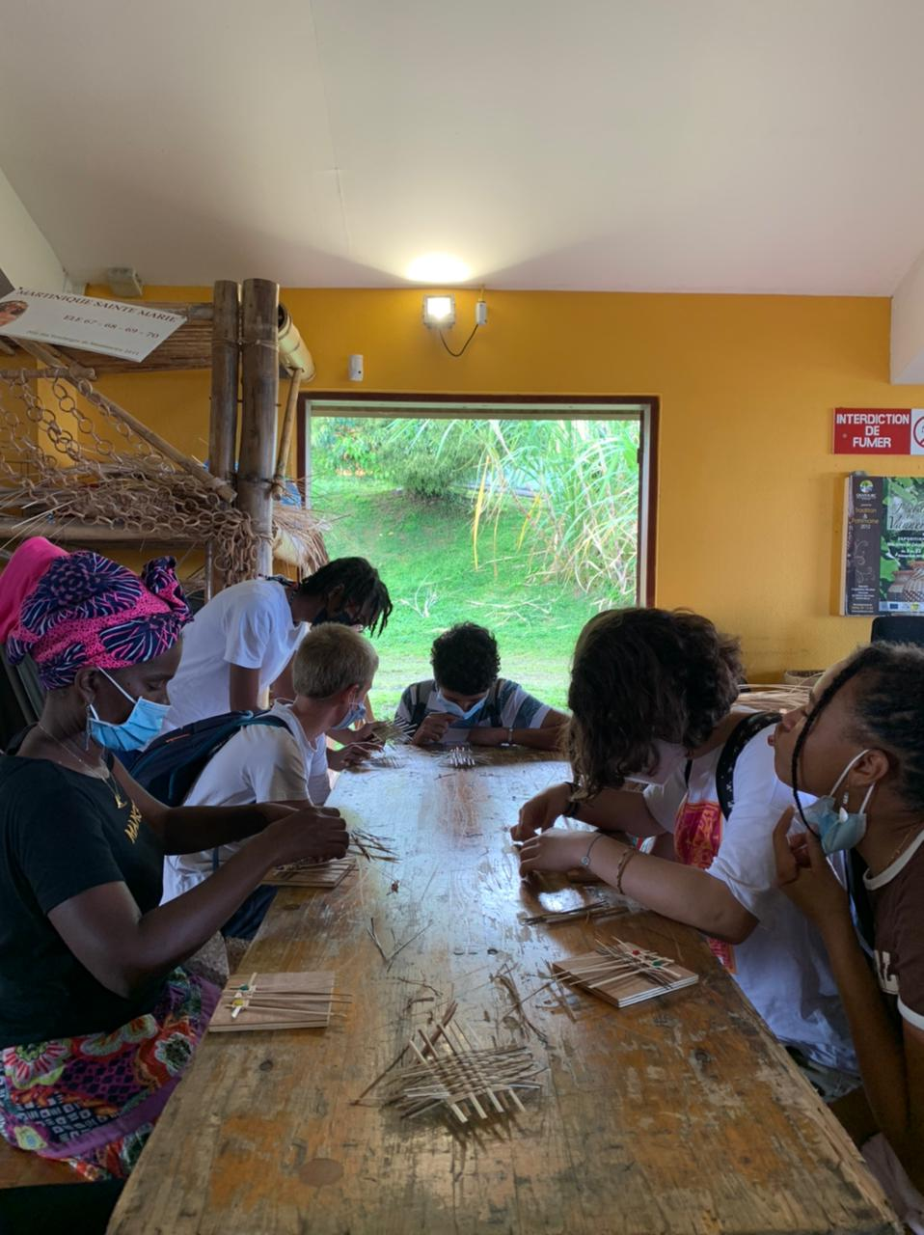
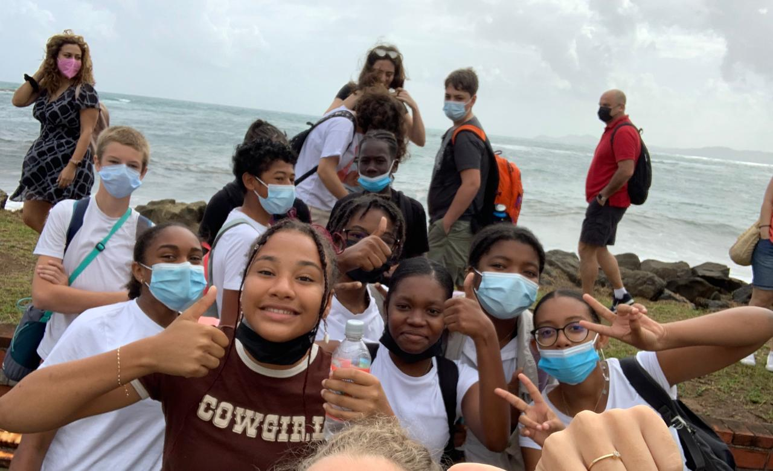

Slide 7
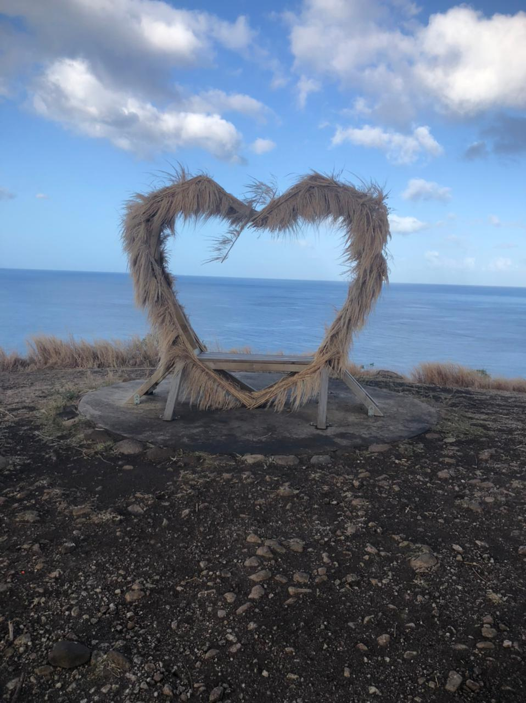
DAY 4:
We went to the heart at the « point de vue » in Carbet and took pictures
We went to « La Savane des Esclaves » and learnt about the hardships of the slaves’ lives and how they lived
We ate in a beautiful forest
After, we went to the beach in Anse d’Arlet

Slide 8
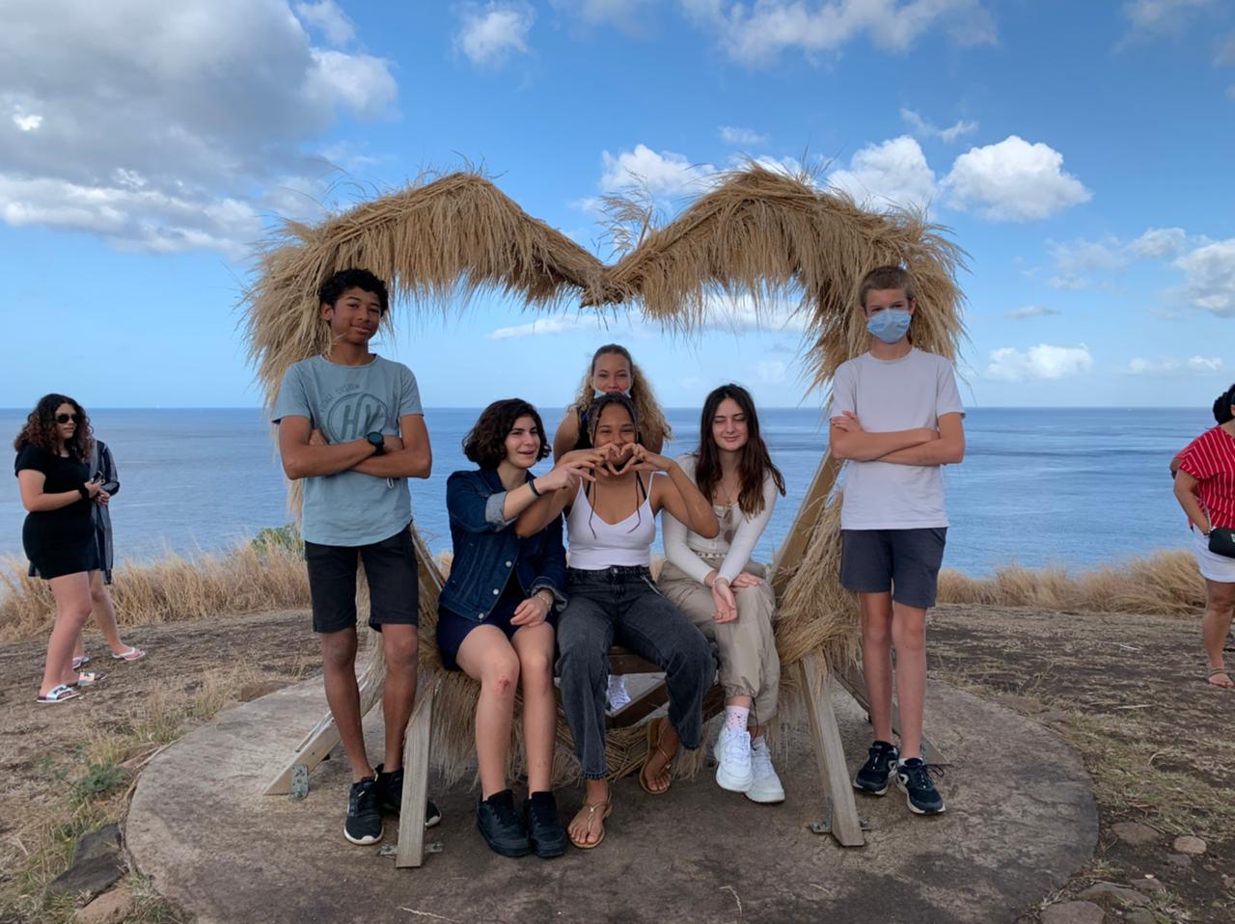
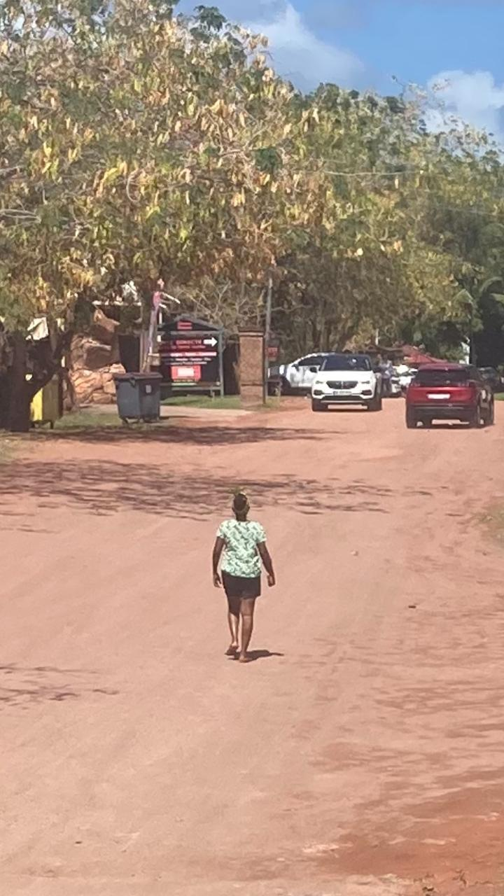
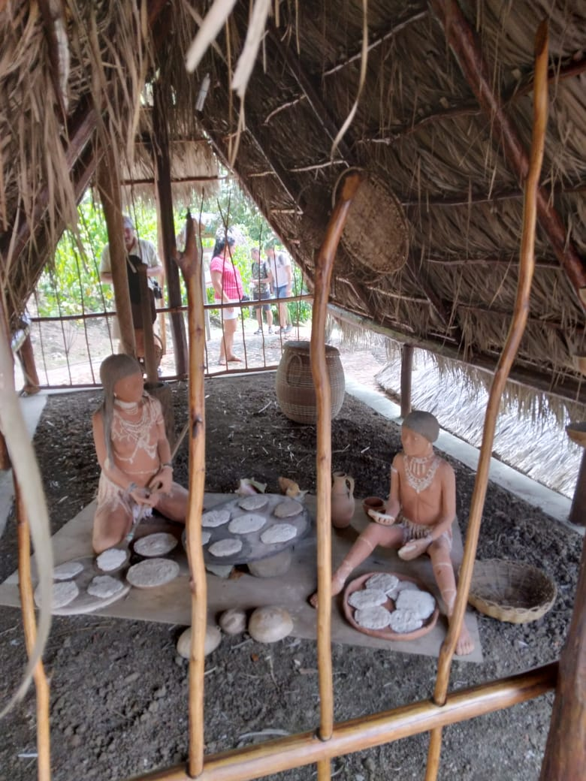
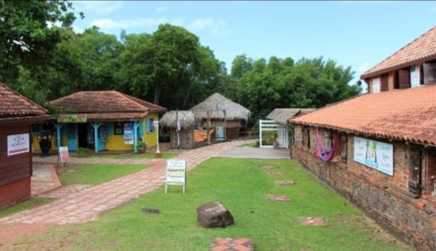
Tatie coco

Slide 9
RACISM
A racist is somebody that hates somebody on the basis of their differences
During this week we accepted our differences – our colour, origins, languages – and worked together
For example: In the Yole, we put our differences aside and worked as a team. We managed to sail far

Slide 10
TO FIGHT RACISM WE NEED TO:
COOPERATE WITH OTHERS
COMMUNICATE
BE UNITED
BE AWARE OF THE DIFFERENT FORMS OF RACISM
LISTEN TO OTHERS
ACCEPT OTHERS’ DIFFERENCES
BE OPEN MINDED

Slide 11
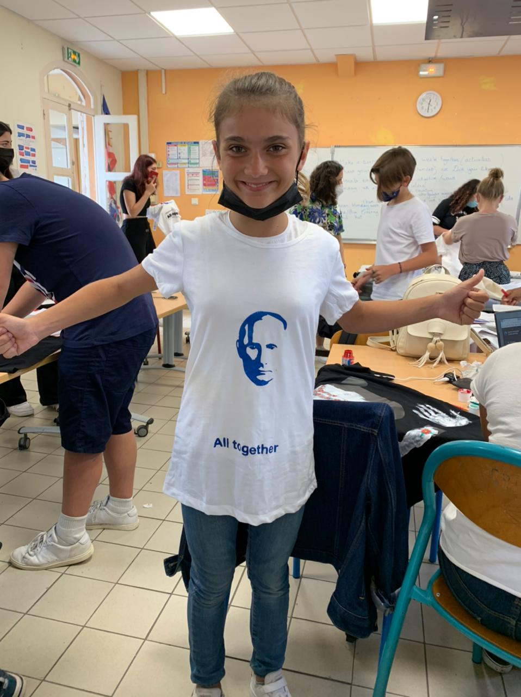
Malgrés nos différences, ON EST PAREIL !
We are the same !
Noi suntem la fel !
Todos somos iguale !
Nou tout mèm mannyè-a !
ΕΙΜΑΣΤΕ ΙΔΙΟΙ !
En travaillant ensemble, ON EST PLUS FORT !
Nou pli fo !
We are stronger !
Suntem mai puternici !
Somos mas fuertes !
ΕΙΜΑΣΤΕ ΠΙΟ ΔΥΝΑΤΟΙ !

Slide 12
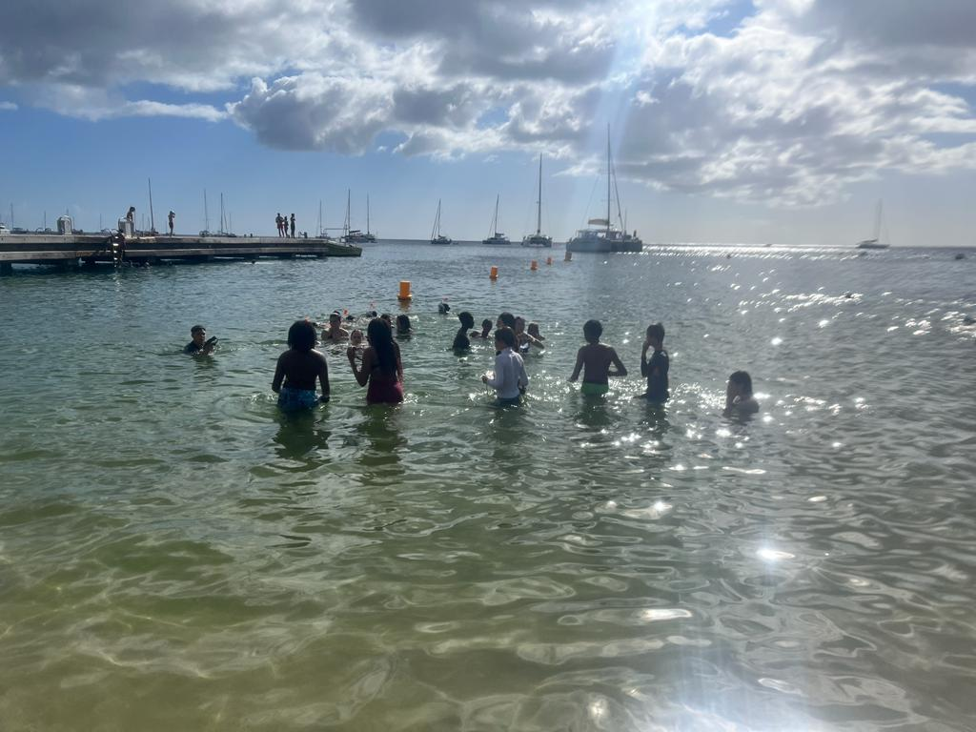
Greek Poem: RACISM
τη και αν είμαστε άλλο χρώμα;
όλοι ένα σώμα,
στην ίδια τη Γη κατοικούμε,
στην ίδια θα πεθάνουμε

