Slide 1
Petar Buchkov
Small forward, Guard

Slide 2
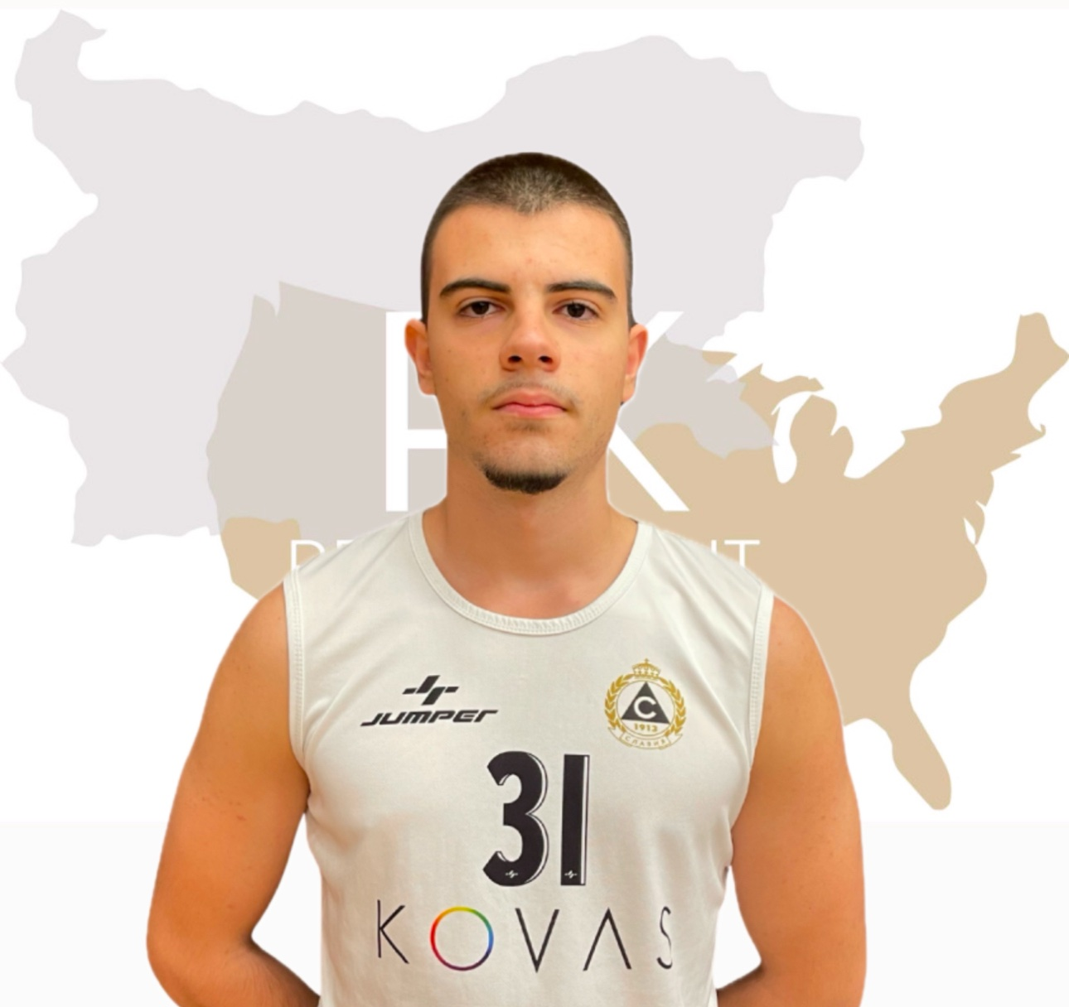
Status: Available Gender: Male Position: Guard/Small Forward Date of Birth: 08. 04. 2006 Graduation Date: June 2025 Club Team: Basketball Club Slavia Sofia

Slide 3
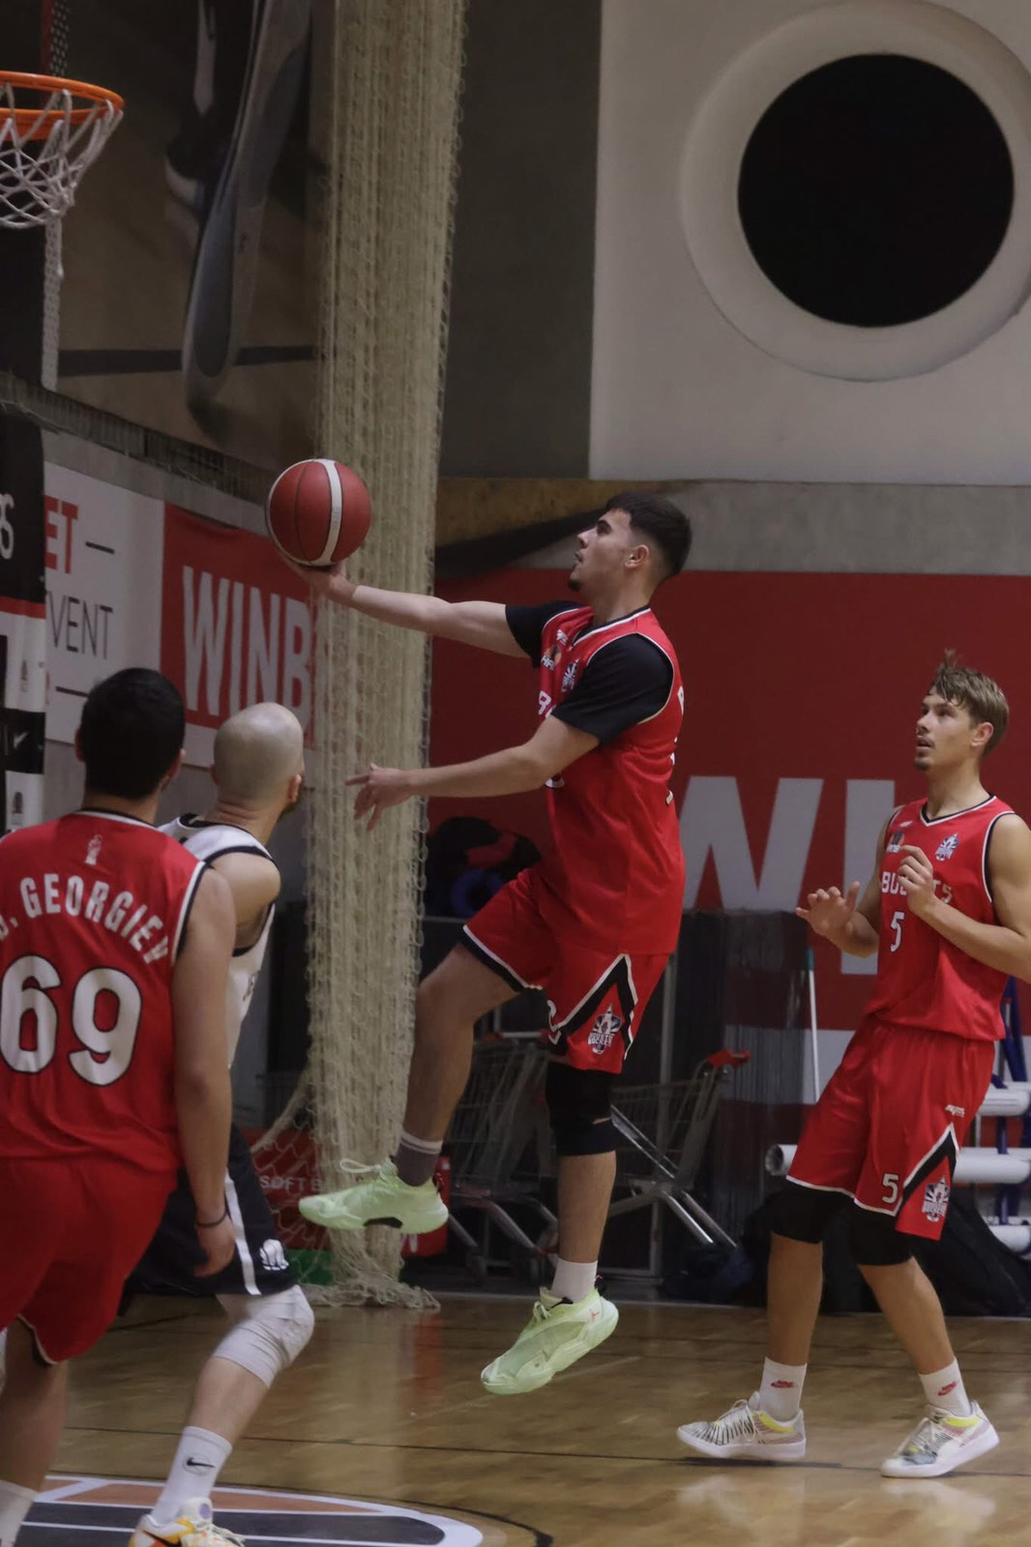
Height: 190cm. Weight: 85kg. Approach High Jump: 320 cm. Standing High Jump: 310 cm. Languages: English, Bulgarian, Hebrew, Spanish, Japanese Desired Degree: Business Management SAT: 1010
ADDITIONAL INFORMATION

Slide 4
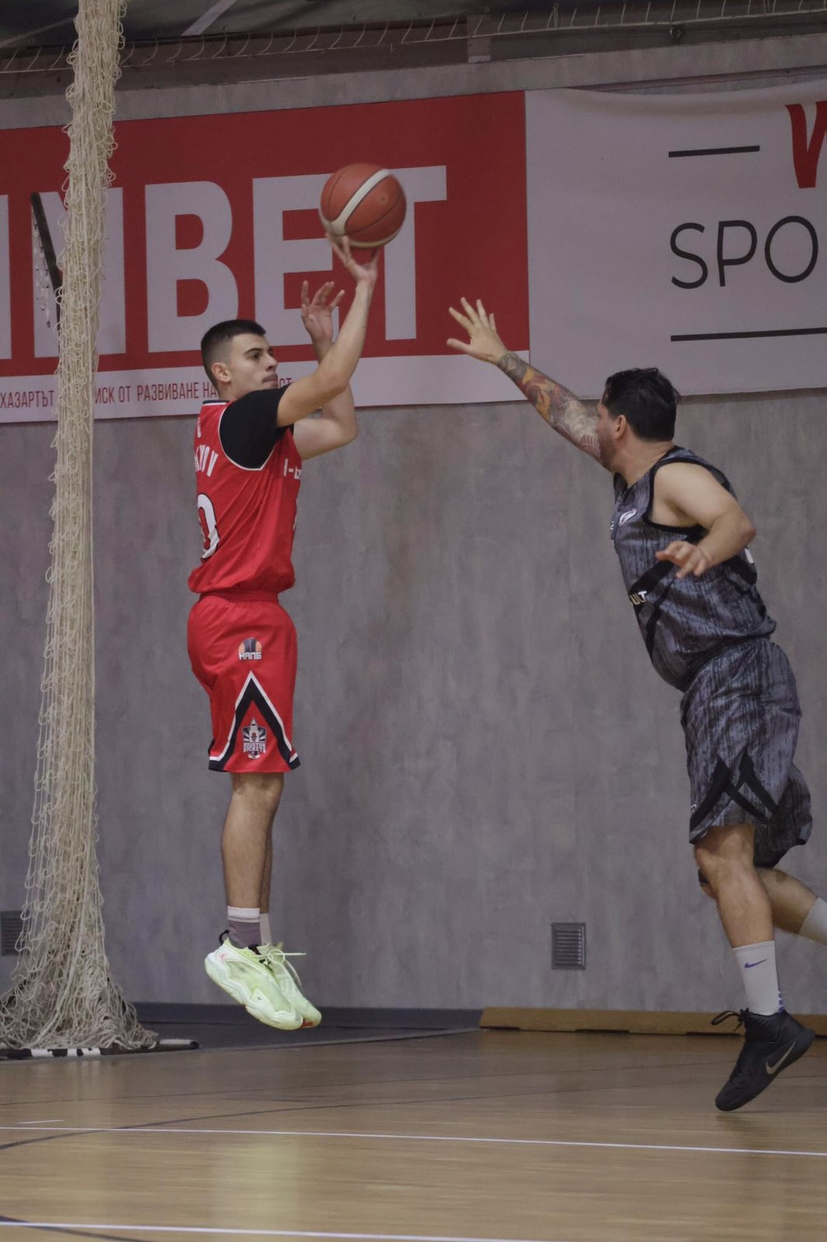
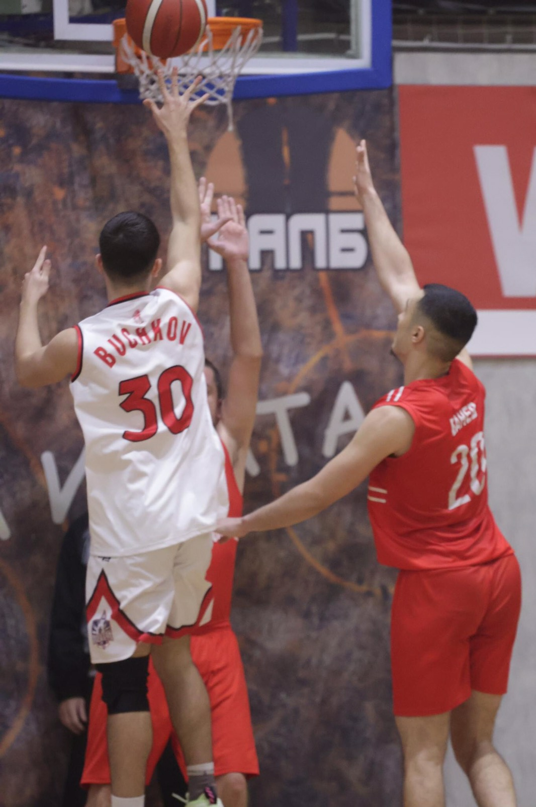

Slide 5
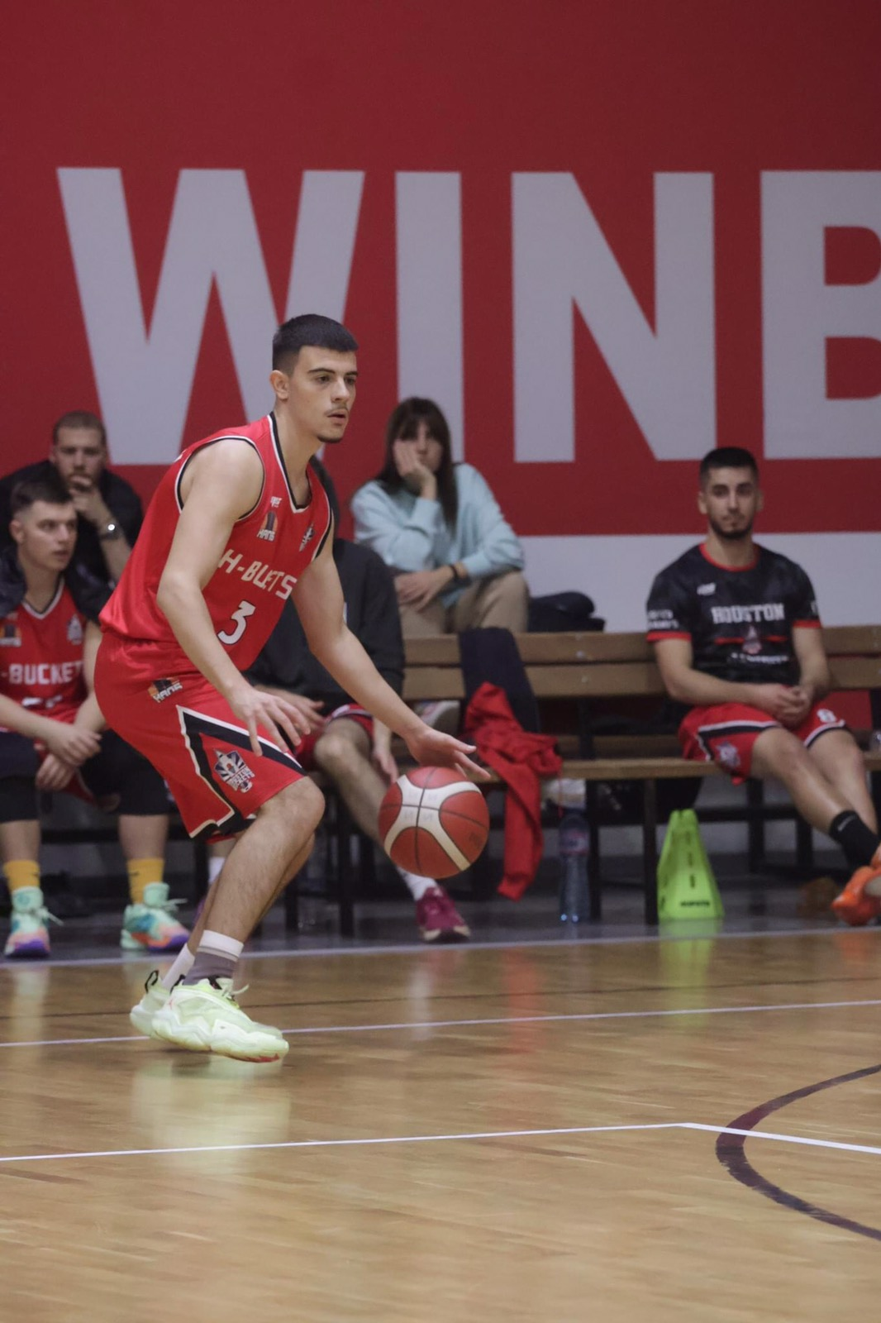
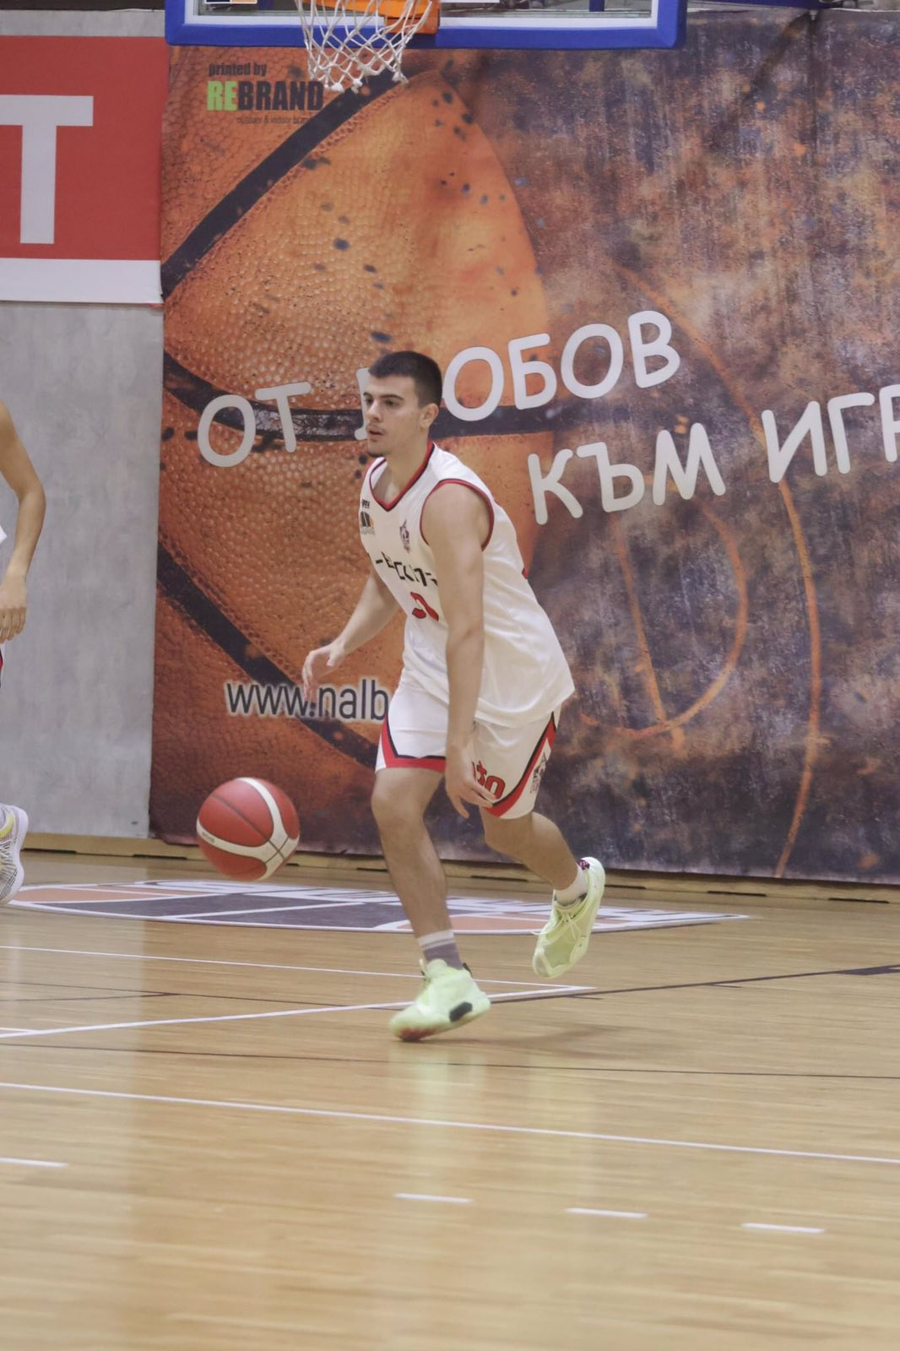

Slide 6
Athletic Achievements:
Club Team:
Participated in the Bulgarian Republican championship and won 5th place, attended Future Stars Basketball Camp (FSB) 2022 in Panagyurishte, Bulgaria featuring Veselin Veselinov, Hoop Talents Camp 2024 in Belgrade, Serbia featuring Deyan Srzic "Susla" and Josko Srzic

Slide 7
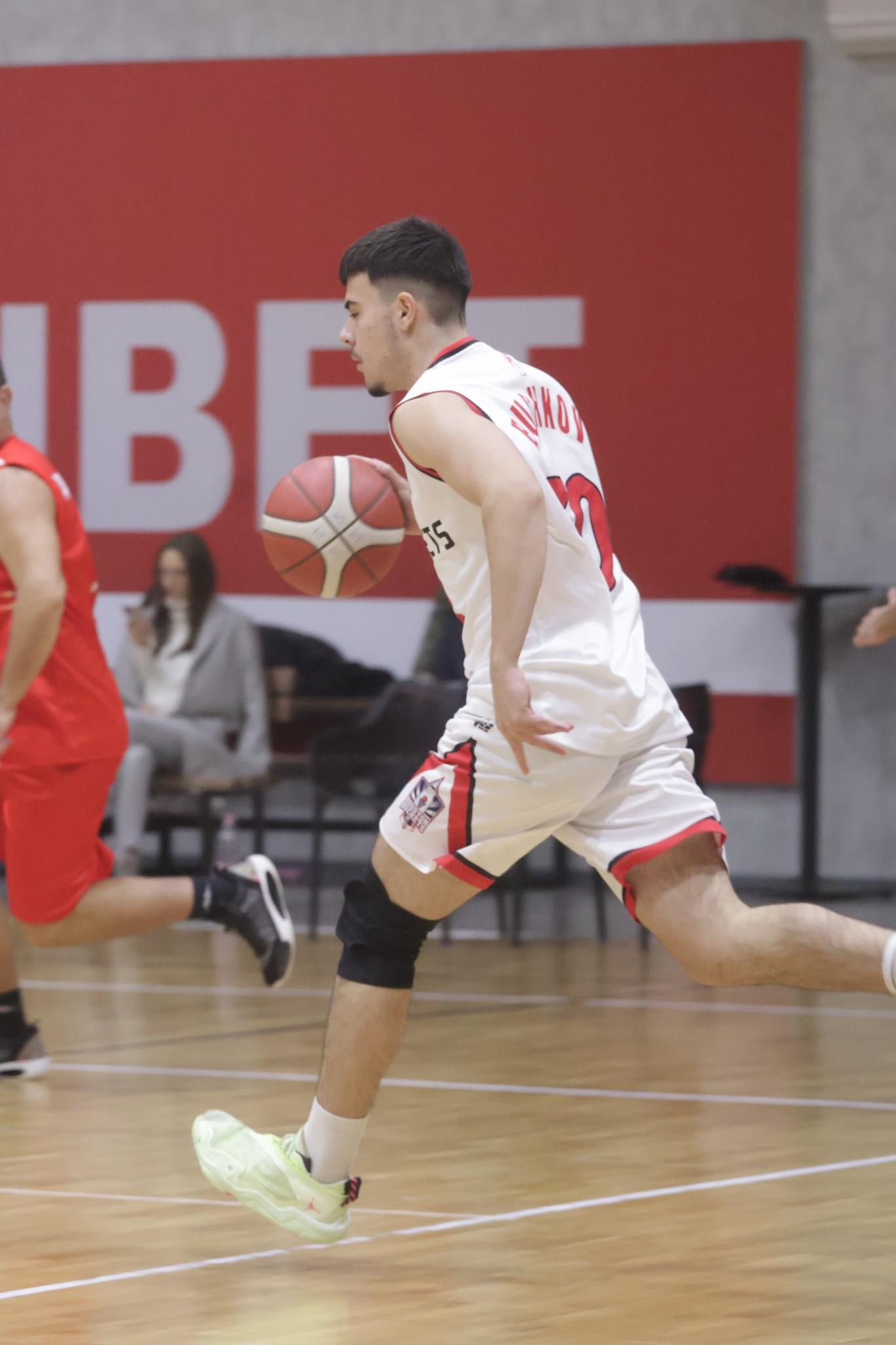
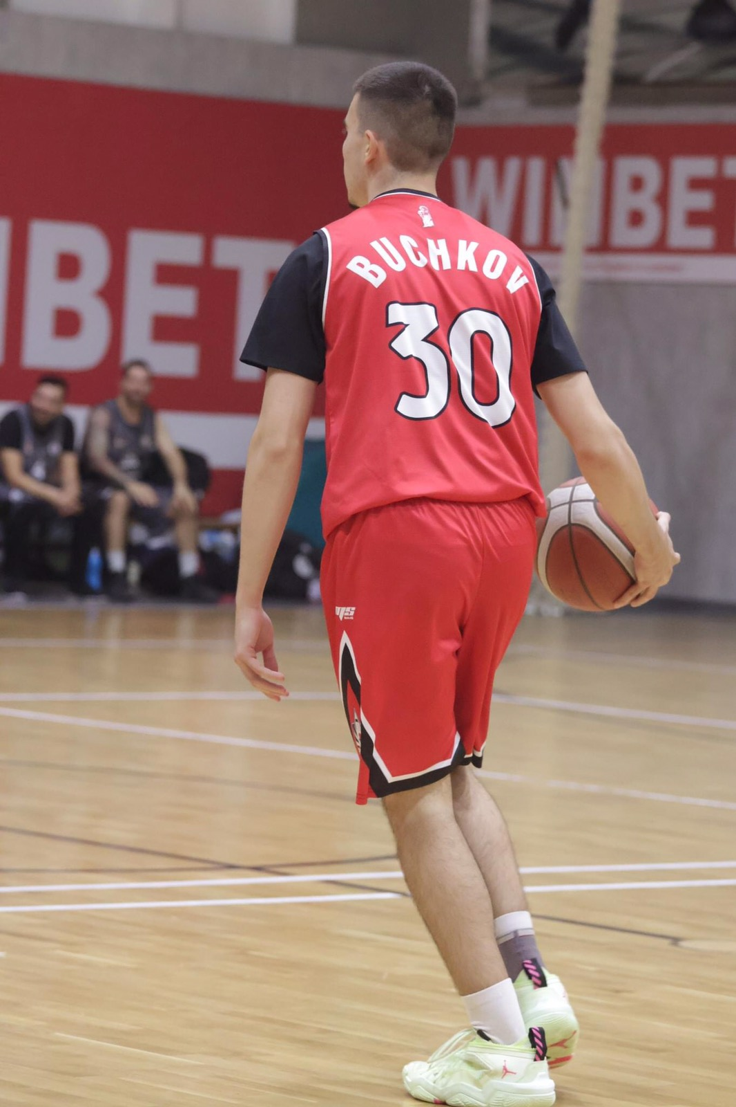

Slide 8
Interview Questions:
Describe yourself with a few sentences.
My name is Petar, and I consider myself disciplined, focused, hard-working and ambitious. My dream since I was a kid is to become professional basketball player. I have always had special connection with the game so much that it has become my lifestyle. I love movement in general. I train in the gym as well. I cannot imagine myself without the game of basketball. Since I was just a little boy, I always knew that one day I will make my dream come true and I will be a professional.
What does volleyball mean to you?
It is a way of living. Sport is not only a physical activity, but a way I look at the world. It teaches me discipline, patience and perseverance. Through sport I learn to set goals and not give up, even when the challenges seem impossible. It motivates me to be a better person – healthier, stronger and more responsible. Every training process reminds me that success comes with effort and dedication, and this makes me not only a better athlete, but also a better person in everyday life.

Slide 9
Interview Questions:
What does your education mean to you?
Education for me is the foundation for personal and professional development. It not only provides knowledge but also builds thinking and communication skills. It is important for a person to be able to clearly express their thoughts, because only in this way can they defend ideas, influence others and solve problems effectively. Through education we broaden our worldview and learn how to be responsible and informed citizens. It is the key to success and a better understanding of the world around us.
What are your main goals as a student-athlete in the USA?
My main goals in short as a student-athlete in the USA are to make my dream of becoming a professional basketball player come true and to be independent. Also I want to the develop skills in the field of business.

Slide 10
Video Analysis
Highlight Videos:
https://youtu.be/EVkqG6kTUfU?si=FpdqvG3hvEYxGeKD
https://youtu.be/H6YMqKMP9rs
Full match:
https://www.youtube.com/live/BHomTF_TwXw?si=yqkfKPjEj4Ya2zwH
(number #55)

