Slide 1
Trip to Holland
10/02/2019 – 15/02/2019

Slide 2
Spain-Holanda
10/02/2019
Today we travel to Holland. When we arrive we meet with the Dutch people. At the beginning we are not all silent observing each one. Then the professor came and told us to talk to the Dutch. After meeting our respective Dutchmen we went to the bus.
When I got home I met the parents of my Dutch and her sister. I had a good dinner. I knew more their traditions and customs and then we saw a movie in Netflix. At the beginning while we are all watching the movie. I had a feeling of not being at home and I felt bad and wanted to go home. but everything happened well and after they asked me again I went to sleep.

Slide 3
First day
11/02/2019
On the second day, we went to the institute, a teacher explained a bit about the institute's program. then we took a walk around the institute and honestly, it's very big and beautiful. Then we had a break and we had to have lunch. There were many Dutch people and one gave me some cookies. Then my Dutchwoman came and gave me a croissant, introduced me to her friends and one of her friends was from Turkey and I made her friend. Afterwards we met the Dutch with the Spaniards and we went to a big boat where we did an orienteering activity. They made groups in which there were three Dutch and three Spanish students. That activity was not the best activity I did in my life. It was the worst because the map they gave us has nothing to do with an orientation map. The Dutches of my group did not know what to do and they spent it talking among themselves in Dutch ignoring us leaving us to do the work alone. We ended up doing the work only my Spanish colleagues and me. I did not like it when the woman came and told us that we could not finish the activity. I got very angry that day, but I thought it was only the first day there will be others better. We returned to the institute I had to wait for my Dutchman along with my Spanish friend to finish private lessons. then a Dutch boy invited us to his house has spend the time. That time that we had was cool, I forgot about the past that morning and I had fun. There were my Spanish friends and some that I did not know but honestly, I had a great time.

Slide 4
Second day
12/02/2019
On the third day being with the Dutch, we went ice skating, at first it was a bit difficult, but I got used to it quickly. I had the opportunity to meet some Germans and the English, I had a fun conversation with an English boy. After skating on ice, they gave us a hot chocolate with cream, I enjoyed it a lot. Then we went to lunch, they gave us some croquettes, but I could not eat them, I ate the chips and I drank the lemonade. The day was fine, until we got to do sports together. It was the worst I could do. the Dutch woman, did not let us do mixed groups, then did not say that the girls had to play hokey and the boys to football, that seemed a little machist, because we can not play with the boys? and the football? I did not like that much when we played the hokey with the Dutch girls and some Germans and other English, the Dutch sat on the small goal and began to speak, the Spanish and the odd Dutch and the other girls began to play, but everything was boring. Some Spanish girls, including me, took a ball and we started to spend one night between us, when the thing got funny a Dutch woman joined us and then another, and another, but the teacher came and told us to play again. When we started to complain that we wanted to play football with the boys, the woman said that the only thing was to try them, but honestly, I did not believe her, the girls could play with the boys at football, so I had a better time. We returned to the institute, and I had to wait for my Dutchman along with my Spanish friend to leave the private classes. Then we went home, I took a shower, we had dinner and went to the jump space, there I forgot what happened in the morning and I had fun jumping with my friends and classmates. After the space jump, we went to a burger and, my Dutchman invited me to an ice cream. My day got better, but I do not want everything related to the project to seem bad or that I feel bad.

Slide 5
Third day
13/02/2019
the third day dawned very well, a little tired by the space jump yesterday, but all good. when wanting to go to the institute, the wheel of the car of the father of my Dutch was spiked, so we did not have how to go, I started to get nervous, because that day we would go to see mastrich and I did not want to lose it. In the end we were able to go to the institute with the help of my Dutch neighbors to take us with their car.
My Dutchman went to his class while I got on the bus to go to Maastricht.
I loved mastrich, it was very calm and cold, we could see many beautiful things, but clearly what I enjoyed the most was the free time we had. We were walking through Maastricht; clearly as normal people do. We went all together to a king burger and ordered our hamburgers, I clearly took one of the fishes, it was very rich. We spent a great time together.
Afterwards I had the misfortune of losing the group I was in, I was looking for them with my eyes but I did not find them, I went back to the place where I lost my group, then I found two girls of my class, I was with them so I would not be alone, but these are walked every two by three in a store, and there are only 5 minutes left for the time we would have to be all together, that bothers me a lot, when I remember a bit of the way forward, but procure that they would follow me because they did not get lost, because they did not know the way.
when returning to Landgraf, I returned to wait for my Dutch to finish his private lessons, that day instead I had a better time with my classmates.
When I got back home, my Dutchman told me we would go to the house of a Dutch woman. There were some Spanish companions of mine, I had a good time with them, because the Dutch spoke in Dutch and they did not speak to us, but when playing the Wi, they played with us.
that day was fine, I think it was the best day of that week

Slide 6
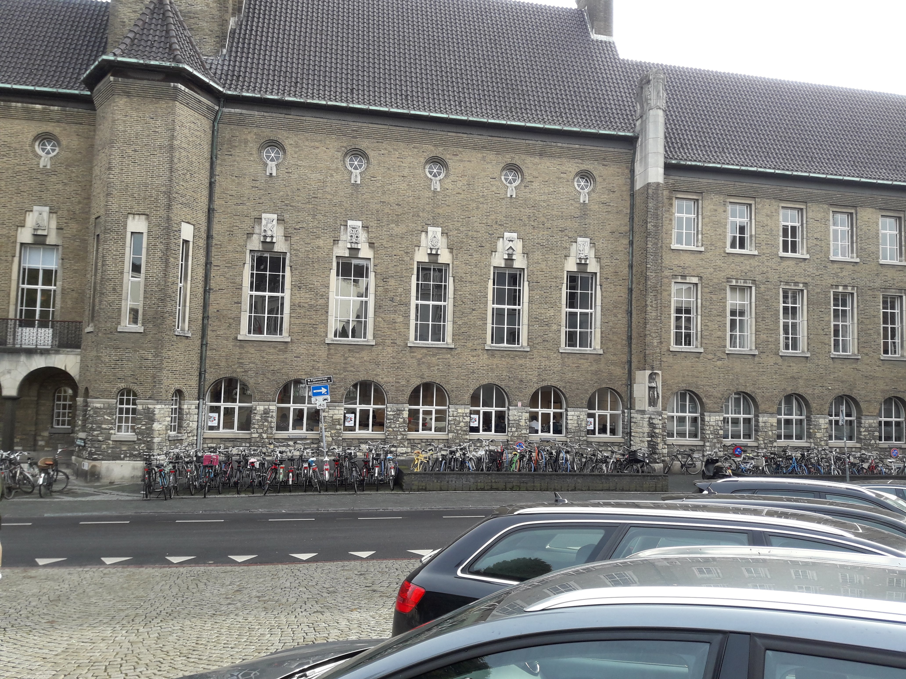
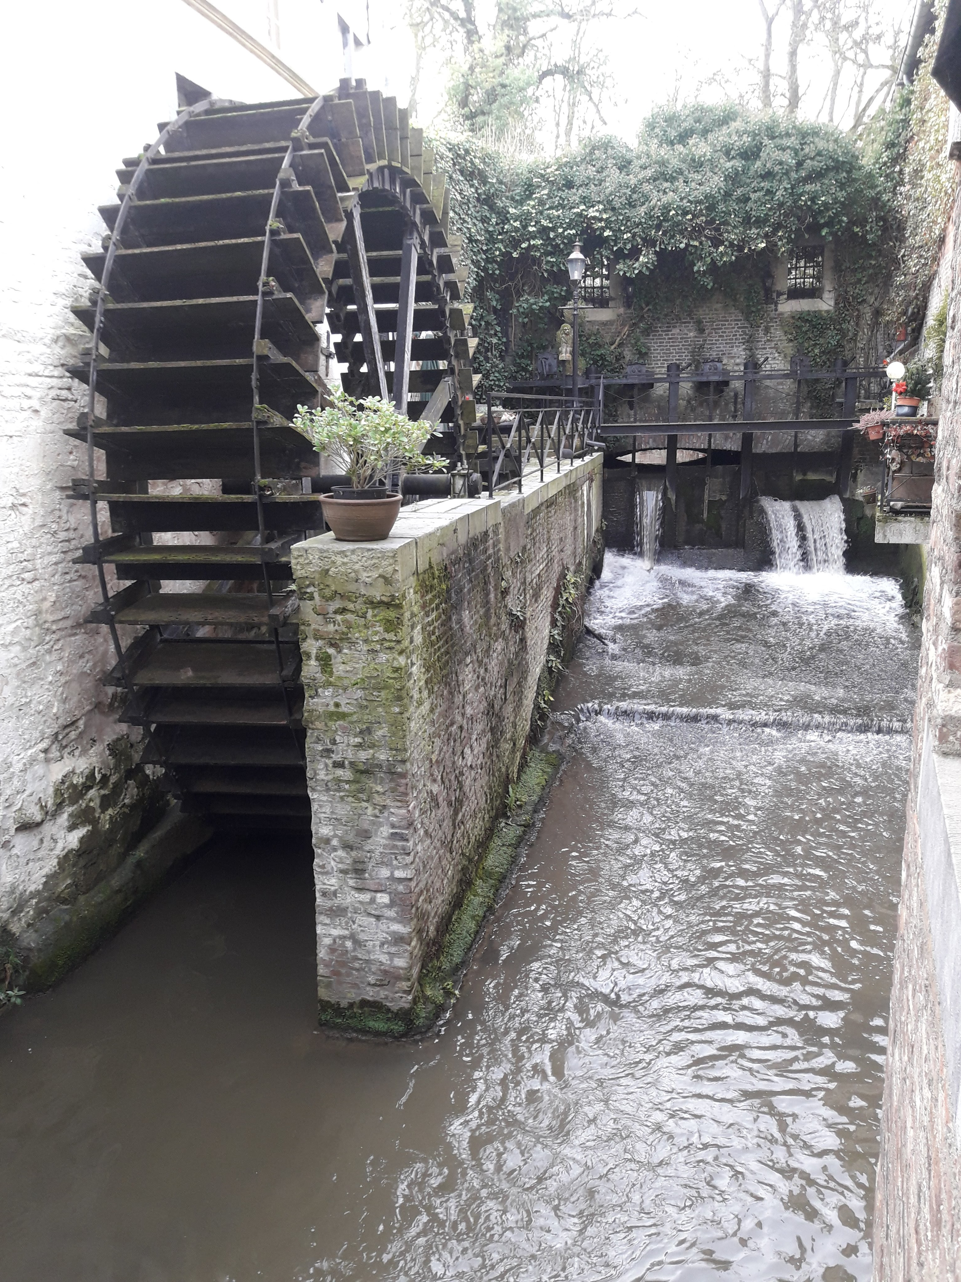
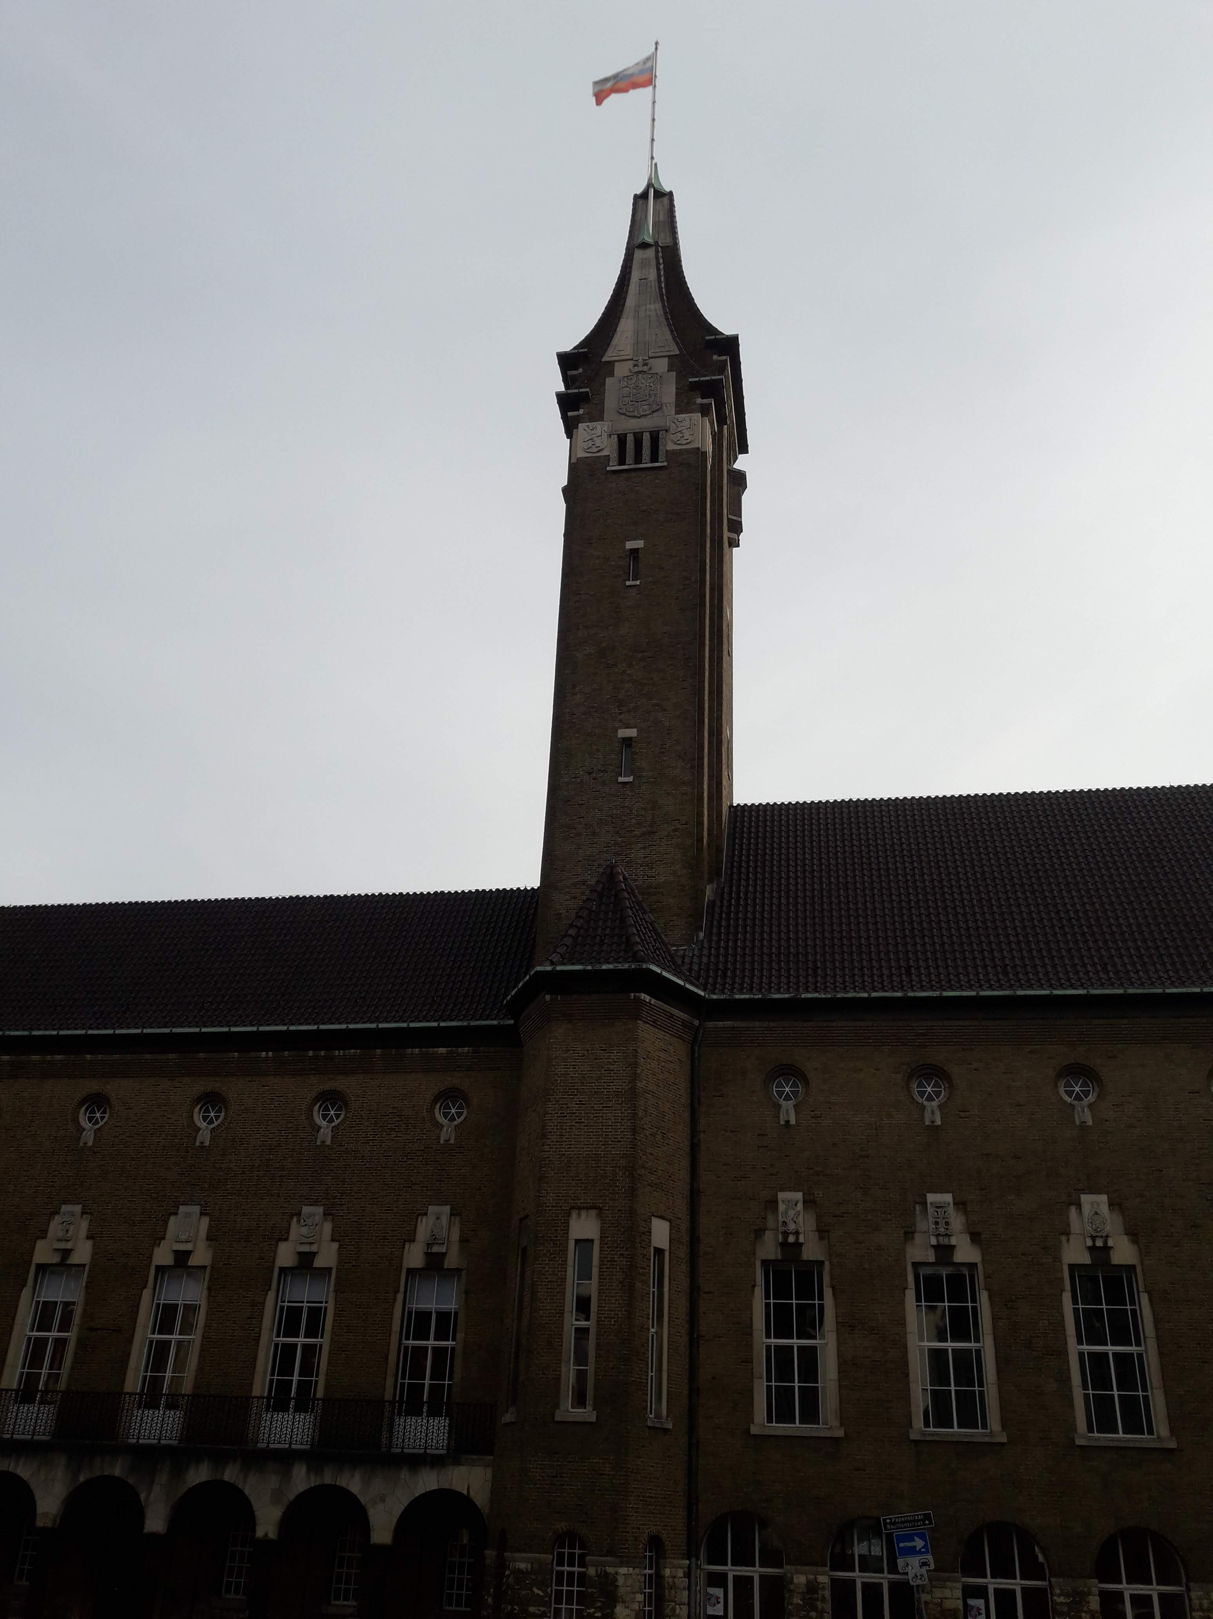
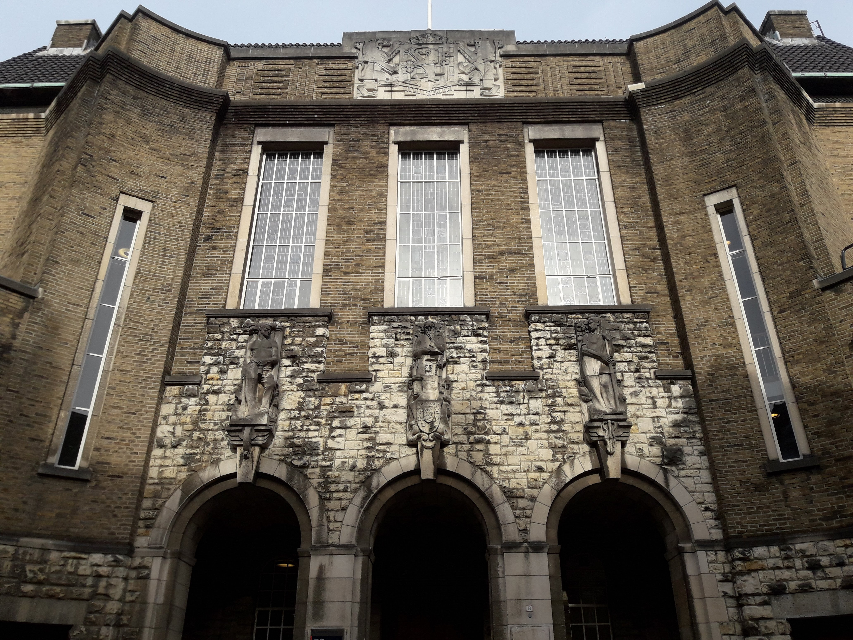
Maastricht

Slide 7
Fourth Day
14/02/2019
On Thursday, February 14, I woke up badly, the little sister of my Dutch bin, and I untie the blanket and I hate that I am attacked, I got up on my feet, but good.
today we went to the border between Holland, Belgium and Germany, I loved everything, I took a picture in a part where there were three flags, I liked it a lot. Then we went up to a tower that showed us a great landscape. I took several pictures and enjoy it a lot.
later they took us to a large sports center. They gave us shirts that I honestly did not like, I always thought that white was a very bland color. there were two specialized in korfball, one very high and the other a little low. the baskets were about 3 meters, I do not remember, but they were very tall. They taught us how to throw and some rules of korfball.
Then we went to the cop's cafeteria and they fed us many sandwiches, but I could not eat any, because I could not, but I ate an apple and a yogurt.
After that they put us in mixed groups, and we had to answer some questions.
We returned to the institute and again I had to wait with my friend to our Dutch to finish private lessons.
a Dutch woman invited us to a party, where everyone was supposed to be invited, but I only invite the most popular, the party was the most boring I could have been in my life. the Dutch spoke to each other in Dutch, and they left us in a corner alone, there was no food, there was only at their table and they ate each other, they did not let us put music and the music they played was sad music not suitable for a party. After a great abruption everyone went to their respective house. tomorrow would be the last day, and I would lie if I said that I did not feel like going to my house

Slide 9
Last day
15/02/2019
Last day, I will miss my Dutch and my family very much, but I also miss my family.
On Friday we started going to the computer room, we finished yesterday's work. After lunch, I had nothing to eat, because my Dutch family did not give me anything for the day.
When we finished, we went to Belgium, I wanted to see Belgium, I was curious. We went to Brussels and had the opportunity to see the atomium, I loved it, it was a great beauty. We went up to the atomium and bought a beautiful atomium magnet.
Then you went to the most beautiful plaza in the world. It was incredible, it was very beautiful. I was able to buy a waffle with the money the teachers gave me when they learned that they did not give me anything to eat all day long. the waffles were very hot, crunchy and tasty with Nutella on top, they were delicious. Then we went to buy something for our families. buy a beret where I put black Brussels for my father, because he likes to wear many visors and had a large collection. I bought my sister and friend a keychain where there were many things.
After the time in Brussels we went to the bus and took us to the airport where we said goodbye to the Dutch.
At the airport the teachers bought us a hamburger, for all those who were hungry and clearly, I had it.
After several hours we arrived at our homes, I was tired, I just wanted to drink a hot glass of tea and eat some bread. Then I went to sleep in my comfortable bed. This trip to the Netherlands was very exciting, I loved it, I used to go back to my house, but everything went well, and I had fun with my colleagues and my new Dutch friends.

Slide 10
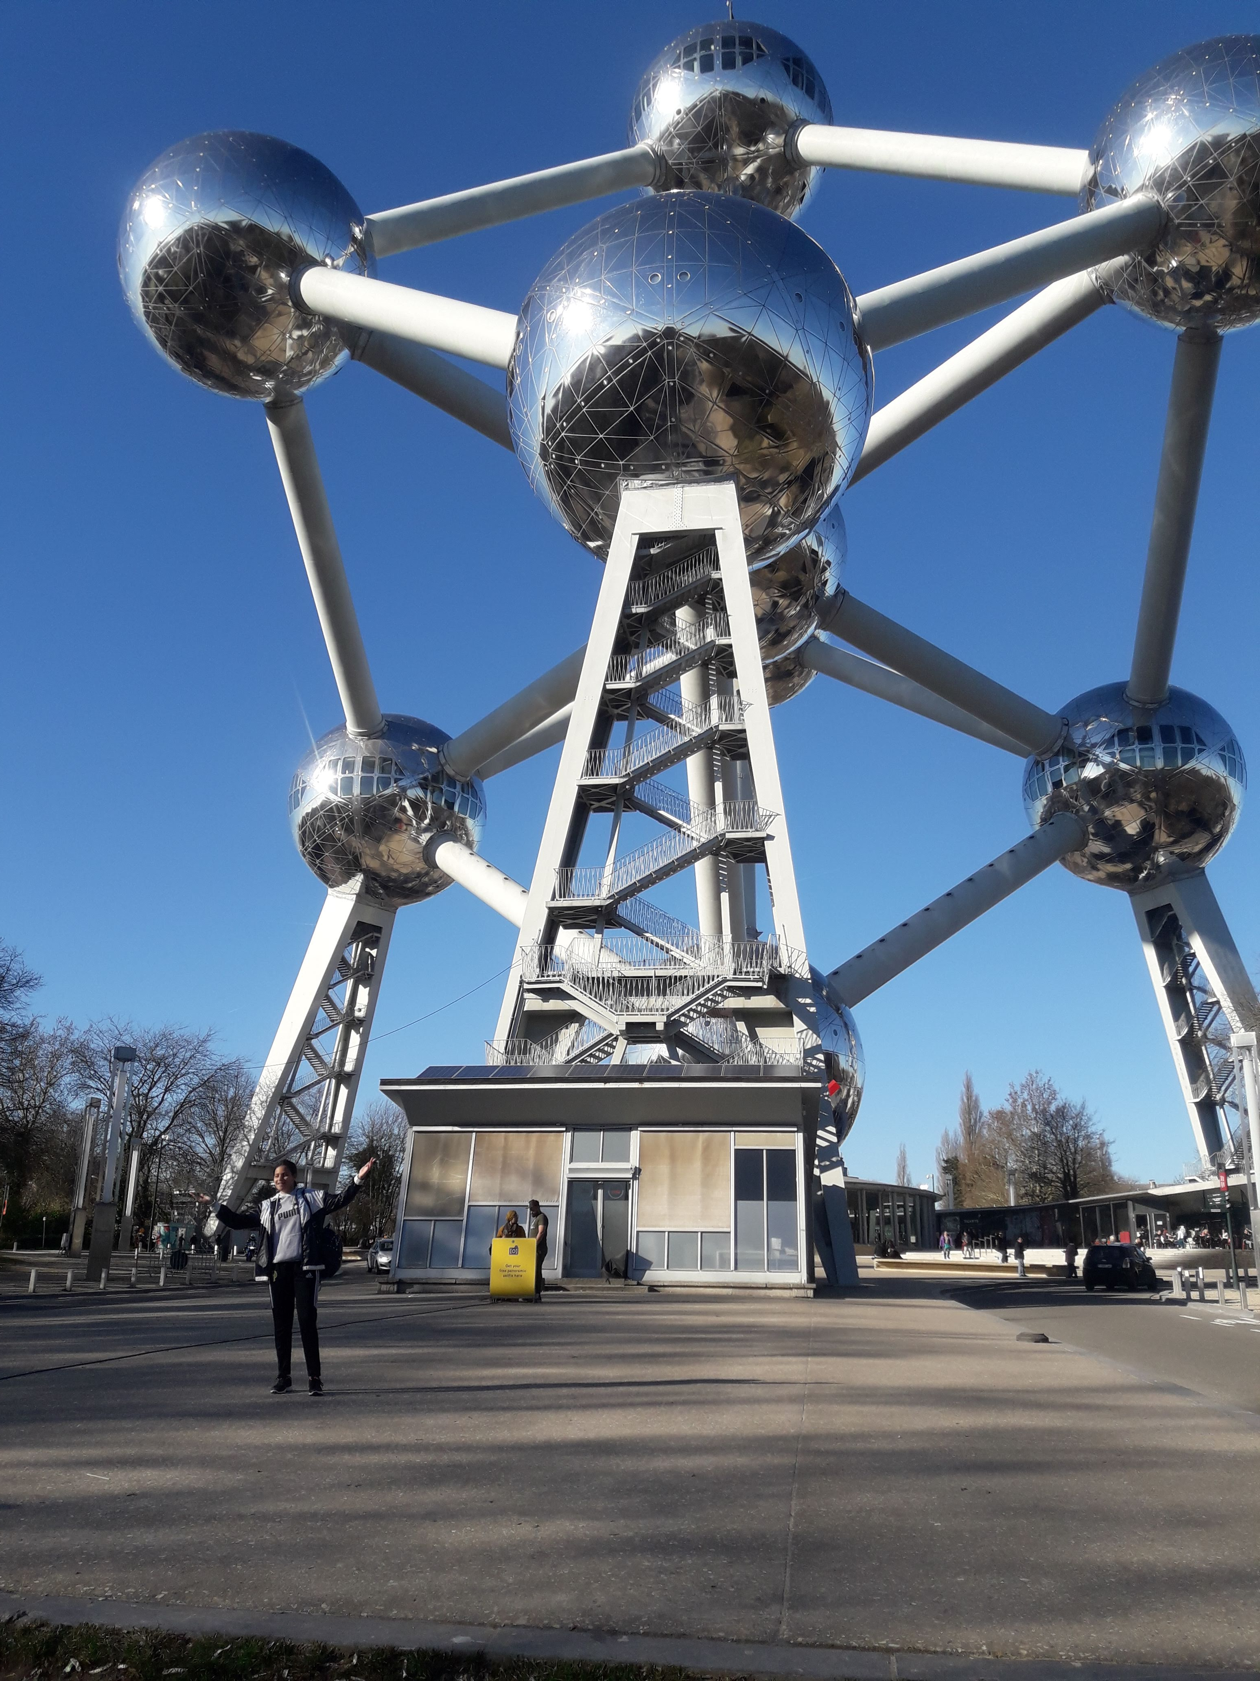
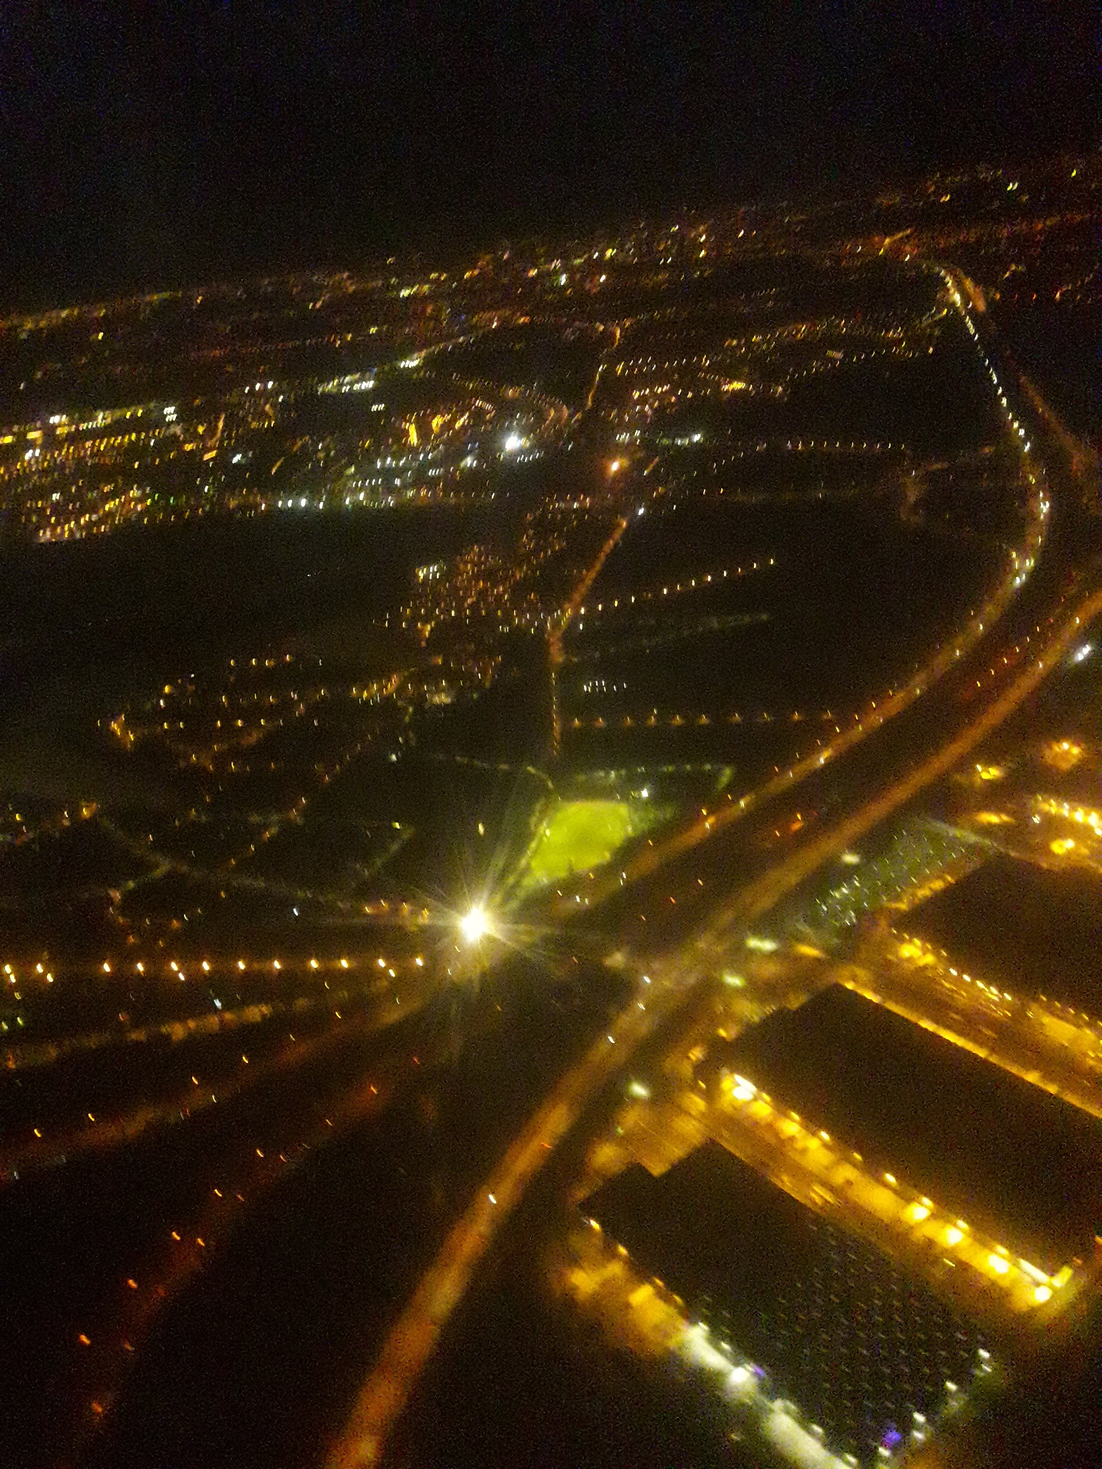
Brussels

Slide 11
The end of my trip

