Slide 2
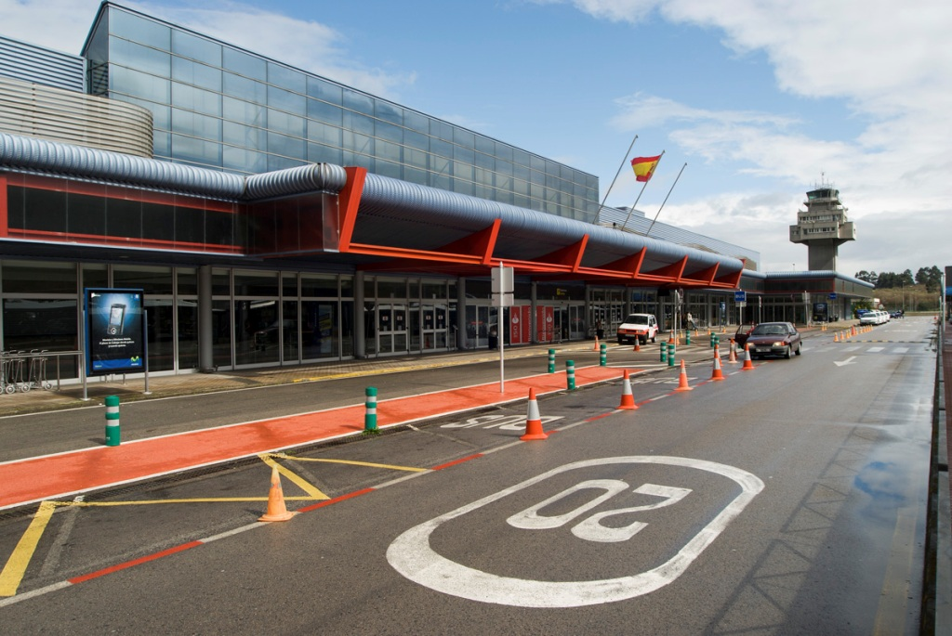
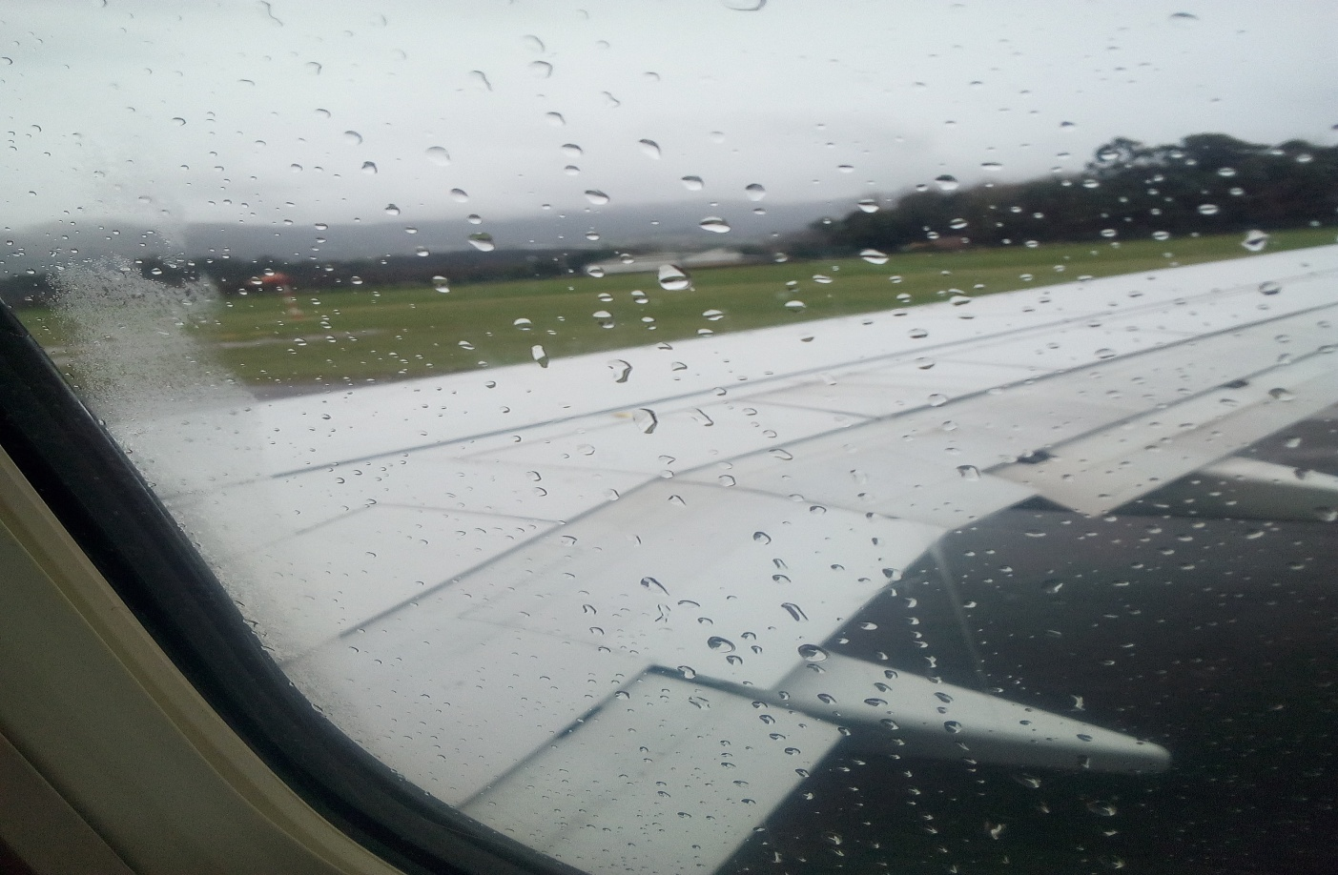
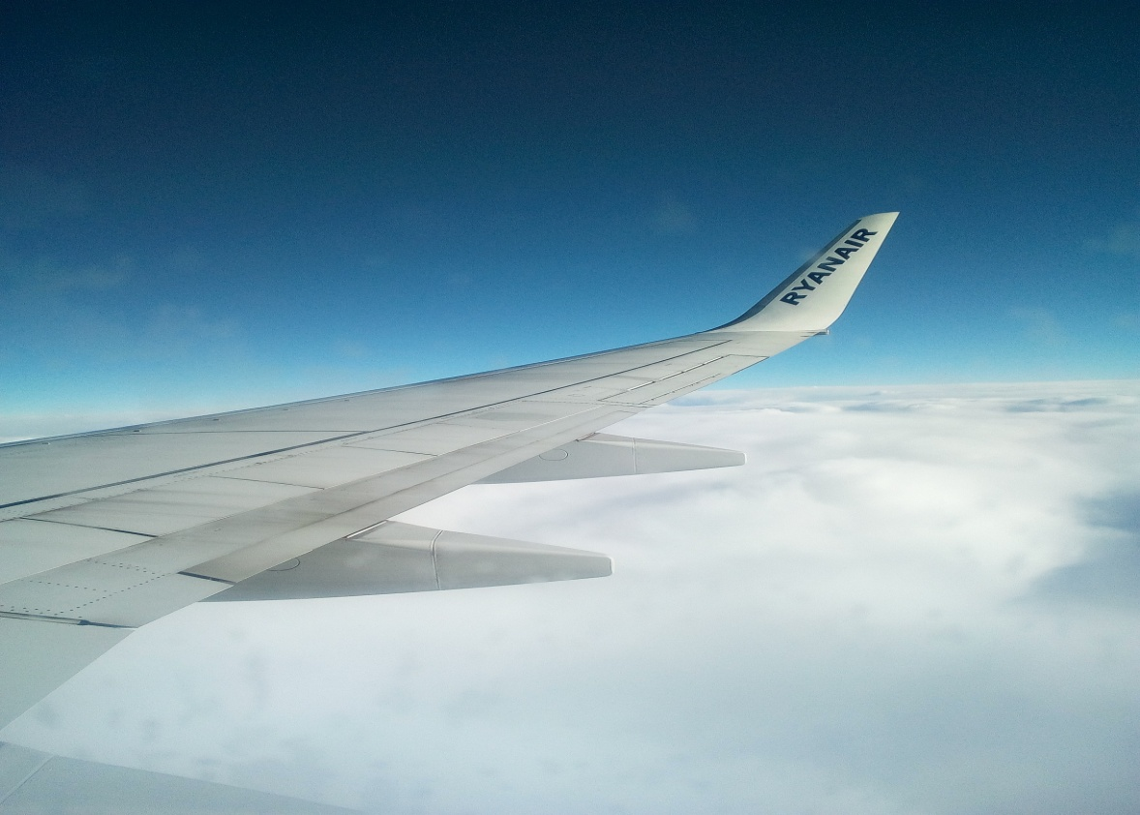
SUNDAY
On Sunday we went at 11:00 to the bus station
I ate the sandwich
We passed the controls and we waited
We ride the plane
We come to charleroi
and the Dutch were waiting for us and later we went by bus to landgraaf
I went for dinner, dinner, talk with the family and I went to bed

Slide 3
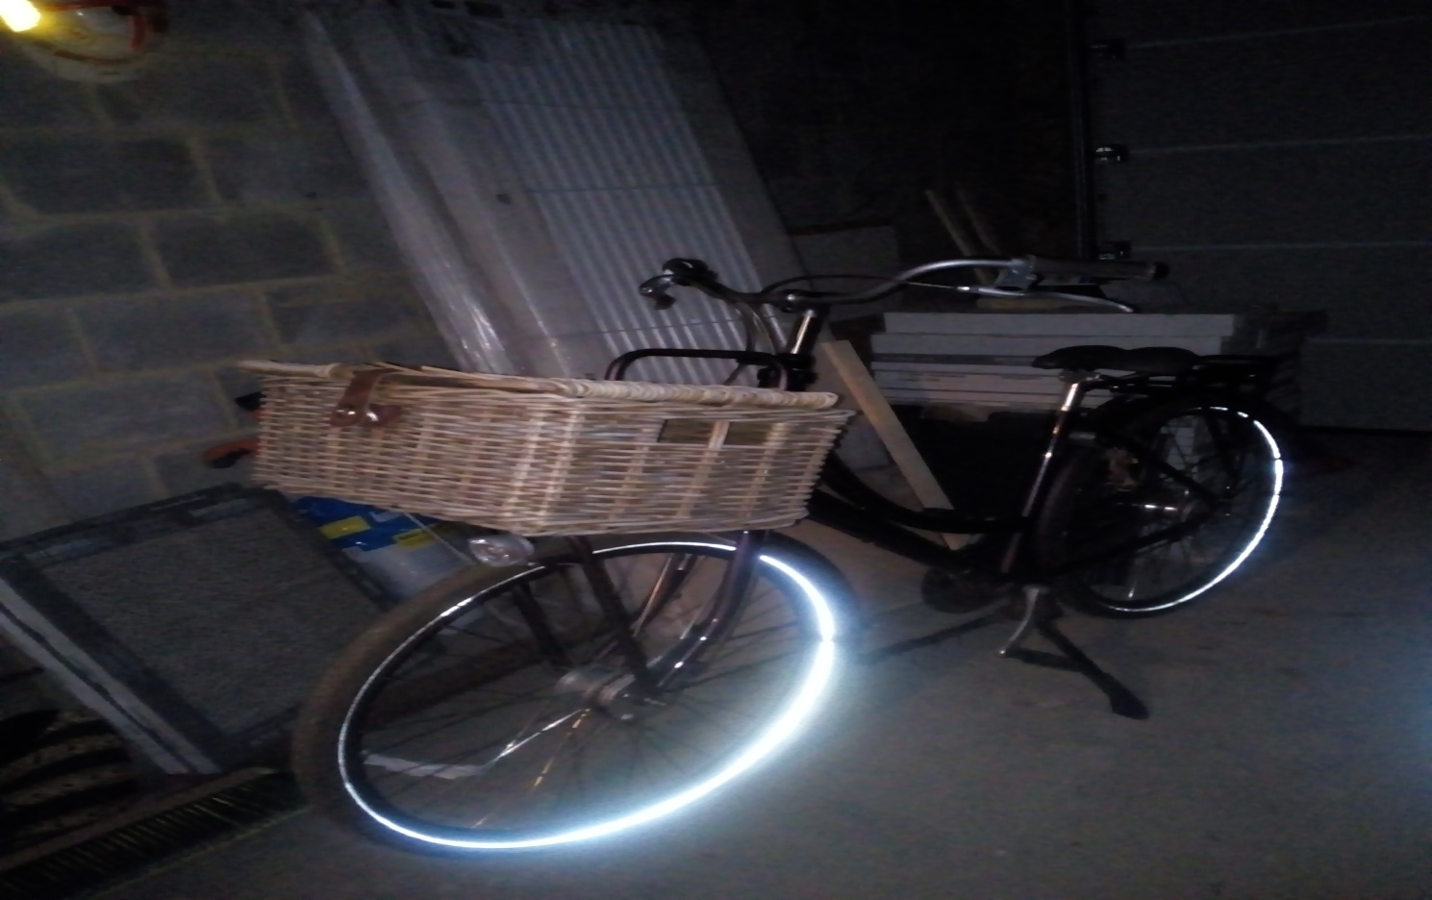
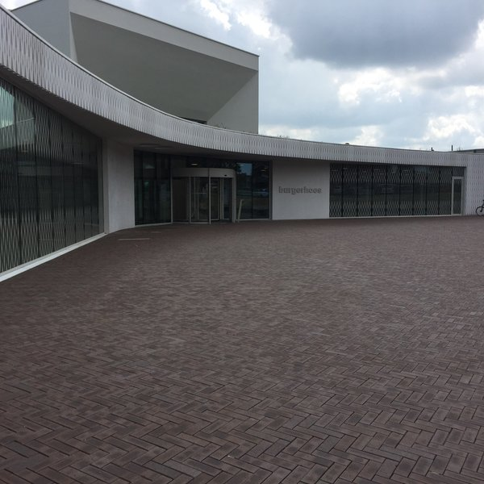
MONDAY
I got up at 7:00,had breakfast and went to school by bike
they gave us a welcome talk
Break
later, we went to the laboratory, where a professor gave us some experiments
later, we went to the laboratory, where a professor gave us some experiments
we went to the town hall , we saw a video of landgraaf and they gave us an appetizer
Break

Slide 4
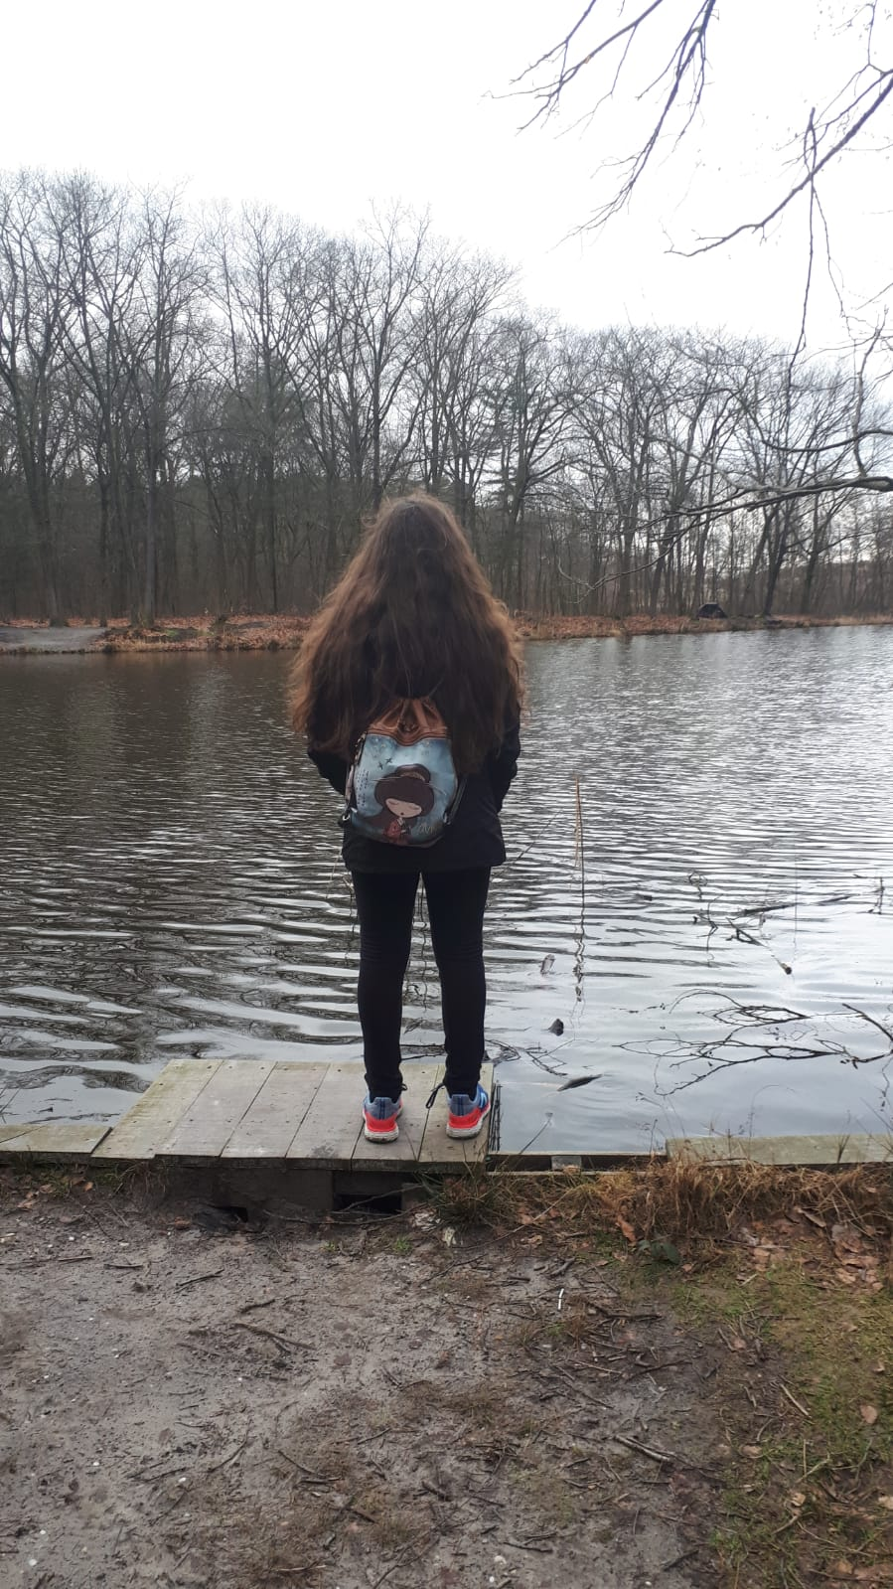
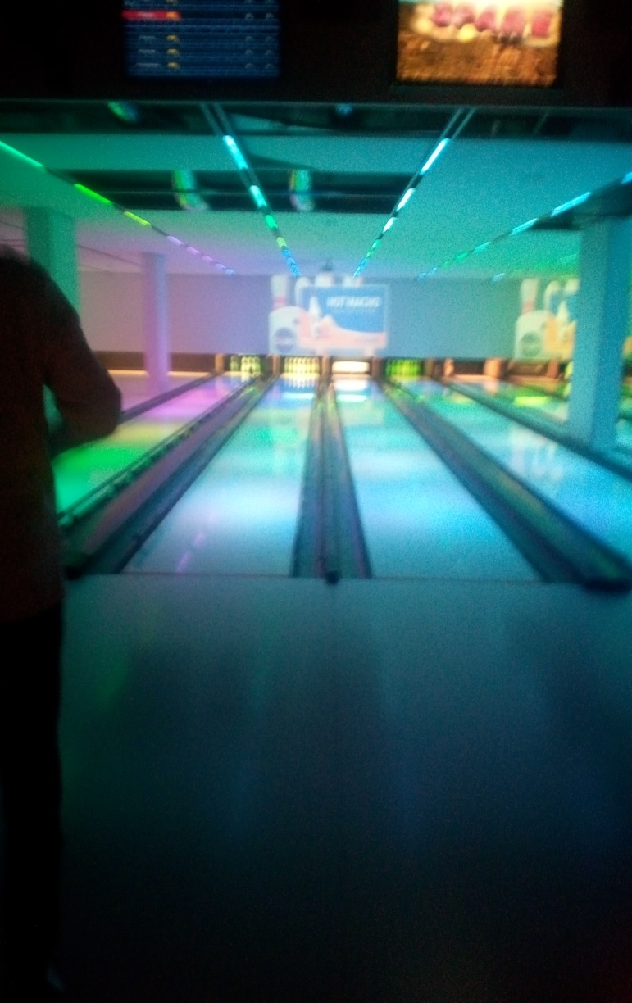
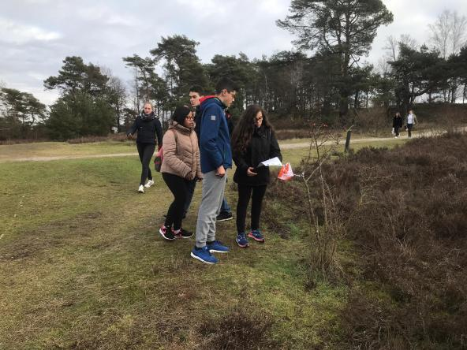
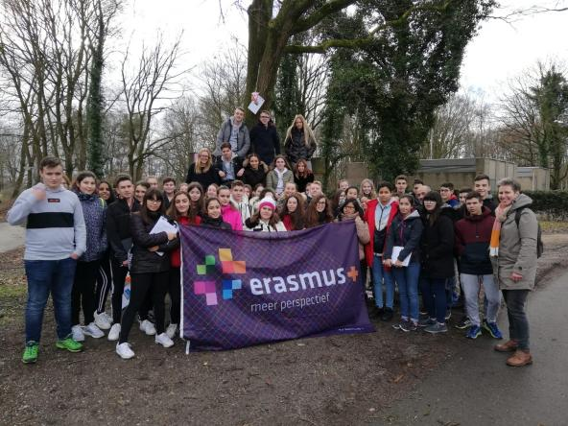
Later we went by bus, we visited Brunssummerheide where we went orienteering in groups of 8 people, the orientation race did not suit me much since they were six kilometers and the Dutch did almost everything, and when they got tired they gave it to us.
The landscape was very beautiful.
We went back and went home by bicycle, I talked to my friends and my family, I had a plate of typical Chinese rice that was very delicious.
Then I went to the bowling alley, there were Emma, David Alonso, Pablo Guerrero, Ines, Cristina, Naiara and their Dutch there we had a great time the bad thing is that as we were divided into 2 Dutch groups by one and Spanish by another
Today, they barely gave me food for morning
I took a shower and talked with my parents and went to sleep

Slide 5
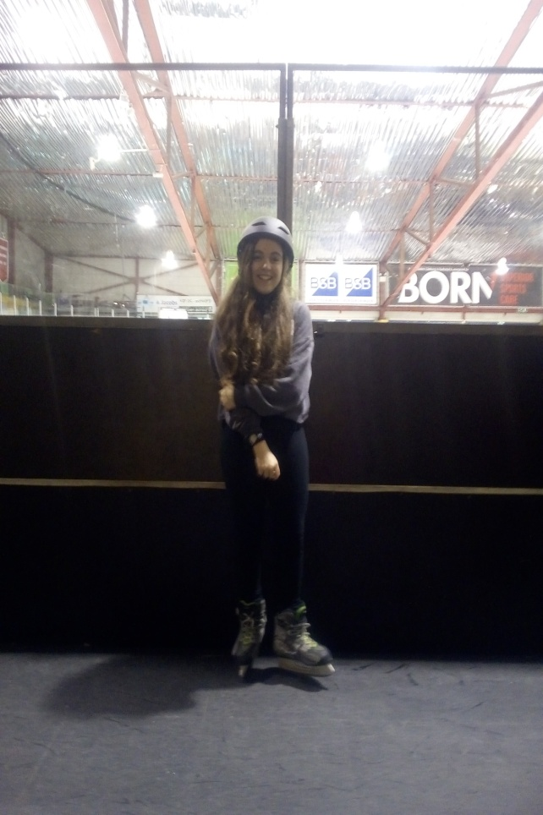
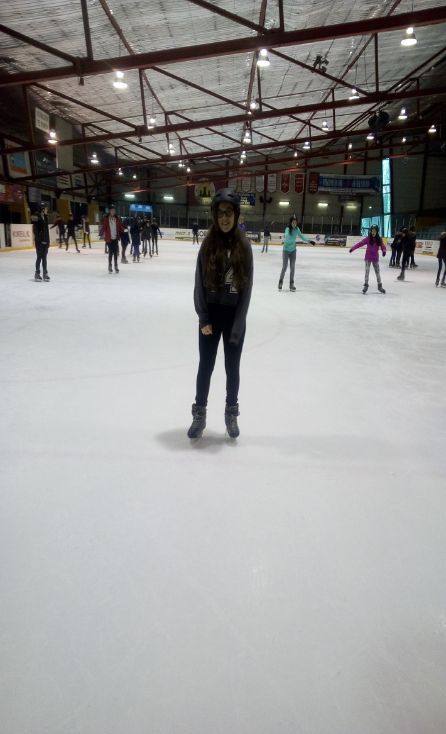
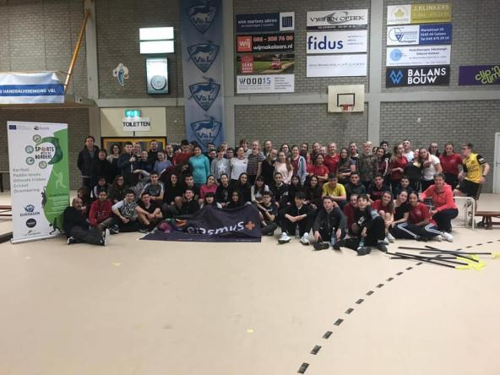
TUESDAY
I got up at 7:00,had breakfast and went to school by bike
Today we went ice skating by bus the track is called Laco Glanerbrook-Geleen...
We skated on ice for an hour with the teachers who played us, then we had one free hour to skate
Lunch
We played the floorball the girls and the boys to the soccer many girls complained because they wanted to play soccer, at the end we did one hour soccer boys and another girls floorball, then we mixed

Slide 6
We went to school and went home by bike with friends of the Dutch
talk to my friends and my family
Dine a taco
later we went to SPACE JAM, I loved it, it was a place full of mats
I took a shower and talked with my parents and went to sleep

Slide 7
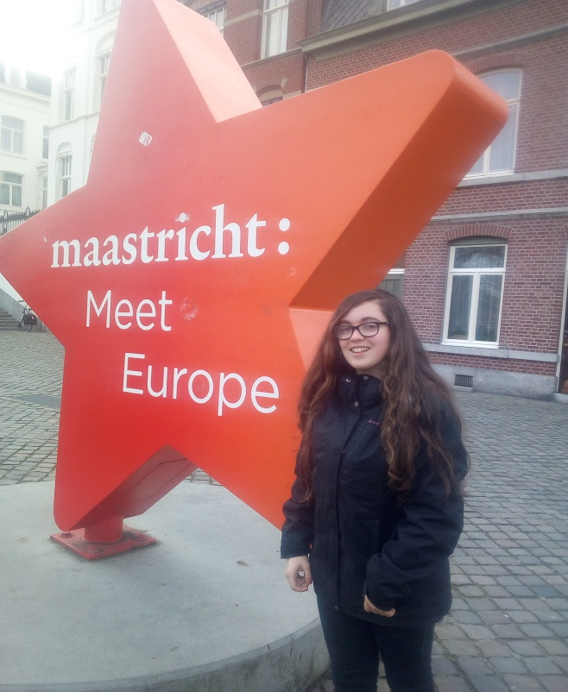
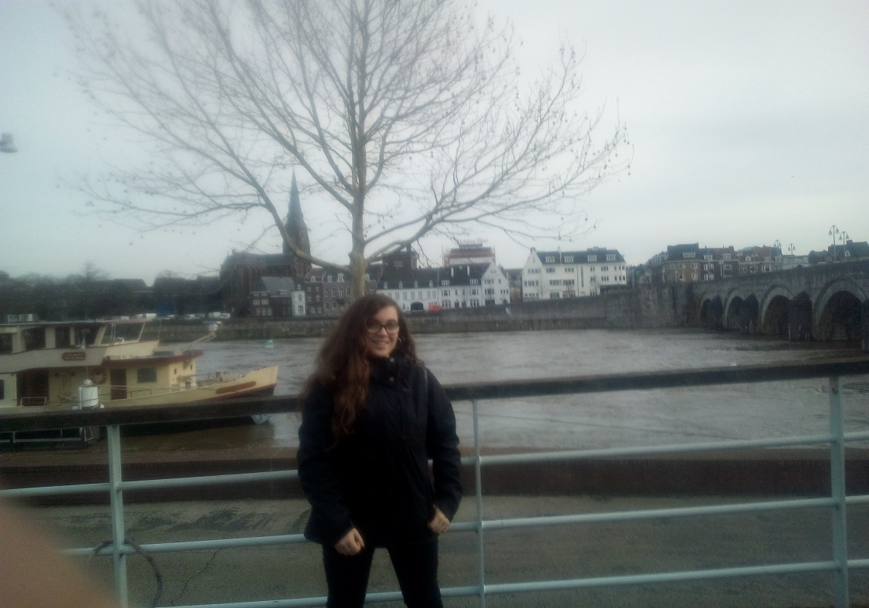
WEDNESDAY
I get up at 7:00,have breakfast and going to school ride a bike
they told us the story that a professor had in Salamanca when he was young
we went to Maastricht only Spanish students, We visited Maastricht, it is very beautiful and big
Free time went to shopping and ate in the burger king

Slide 8
We went to school and the Dutch were waiting for us, we went by bike to home, Pablo, Naiara, Ines and his Dutch came to my house and we ate some pizzas. I talked to my friends and my family
We cycled home and came Naiara, Pablo, Ines to my house with his Dutch, we ate pizza
talk to my friends and my family
About half past seven I went to the home of Paul's Dutch (Luc), also Cristina, Ines, Naiara. There was also the twin brother of luc, we were playing cards.
We left about ten
I took a shower, I braided myself while talking with my parents and my brother, I dried my hair and went to bed very late.

Slide 9
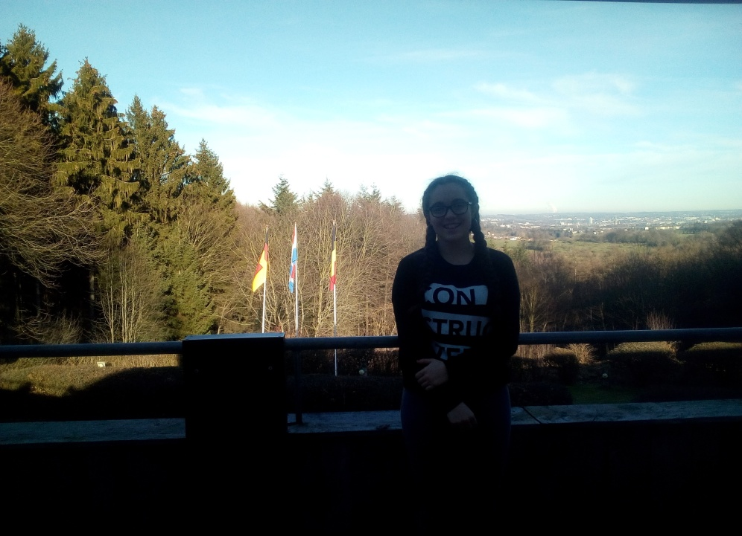
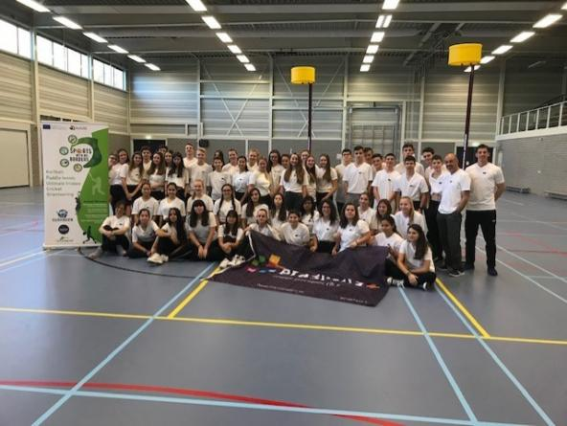
THURSDAY
I get up at 7:00,have breakfast and going to school ride a bike
a teacher gave us a talk about a clown
we went to a sports center to do korfball with two men from the Dutch korfball team
Lunch
we work in small groups on the korfball
We visited the Three Country Points
We went to school and went home by bike with friends of the Dutch
talk to my friends and my family
Dine Spaghetti Bolognese
We went to the home of Demi the Dutchman from Cristina where they had a party, where we danced, played a bottle, listened to a lot of music and ate some hamburgers
I took a shower and talked with my parents and went to sleep

Slide 10
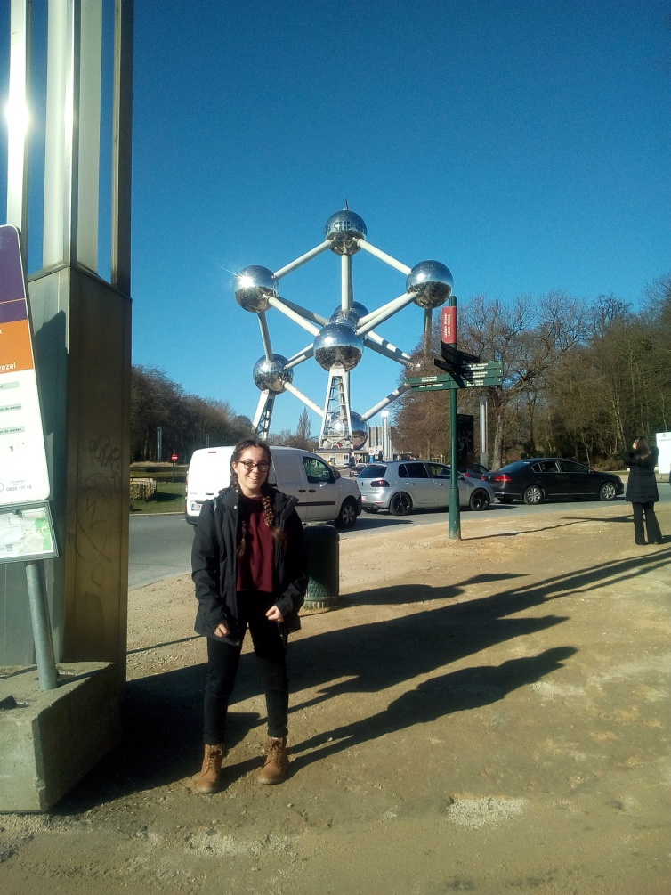
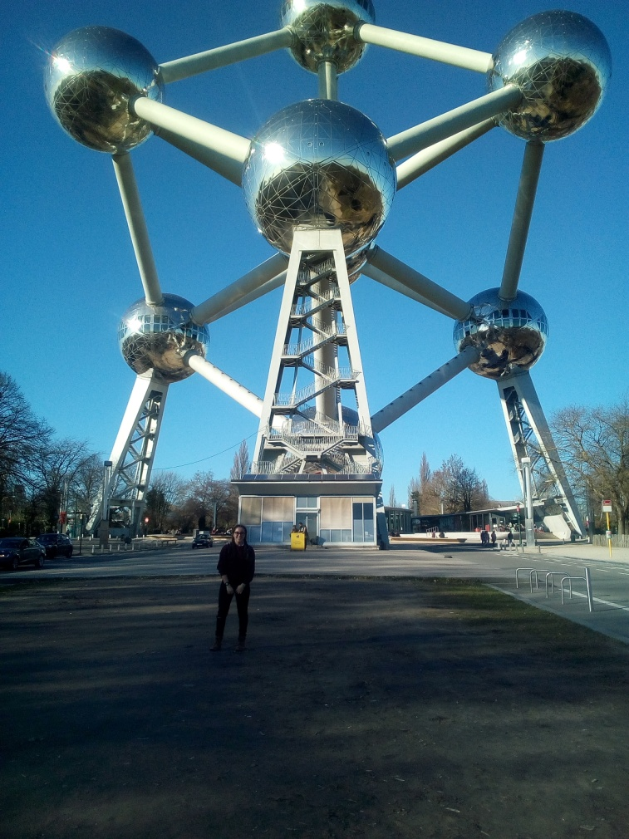
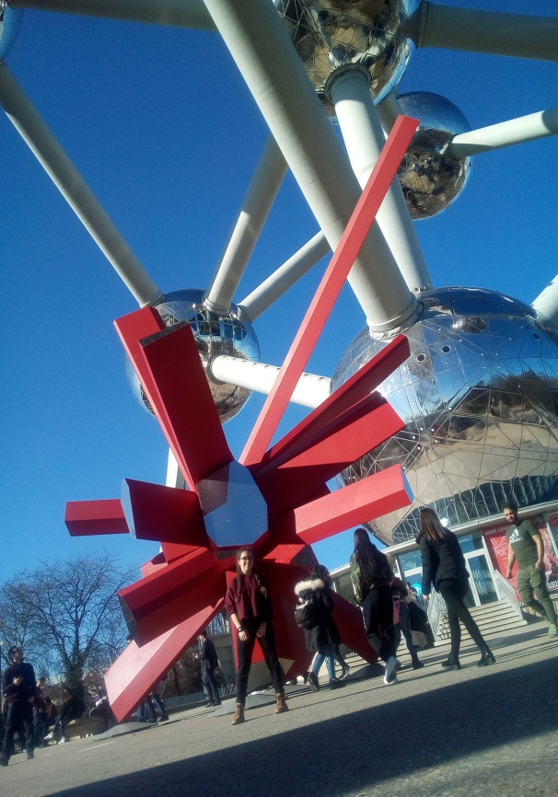
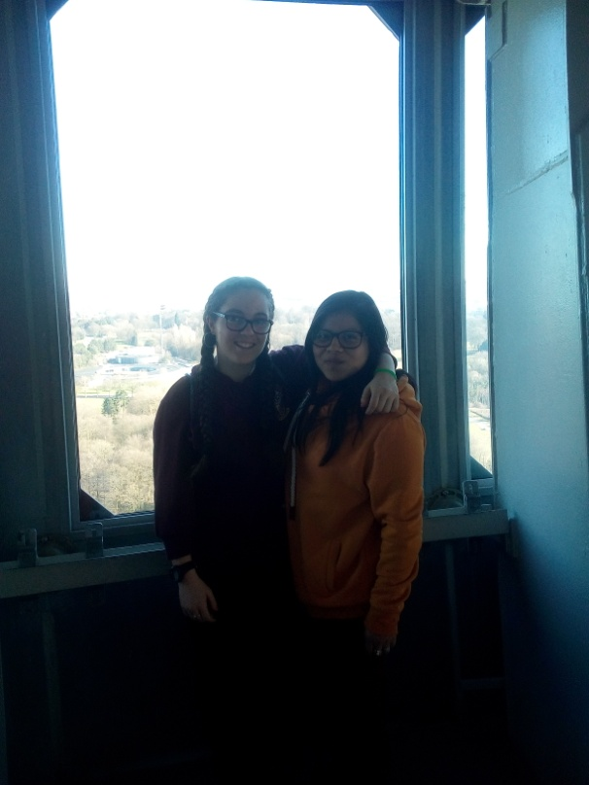
FRIDAY
I got up at 7:00,had breakfast and went to school on foot
We finished our work in smalls groups
We went to Brussels bybus
We visited the Atomium

Slide 11
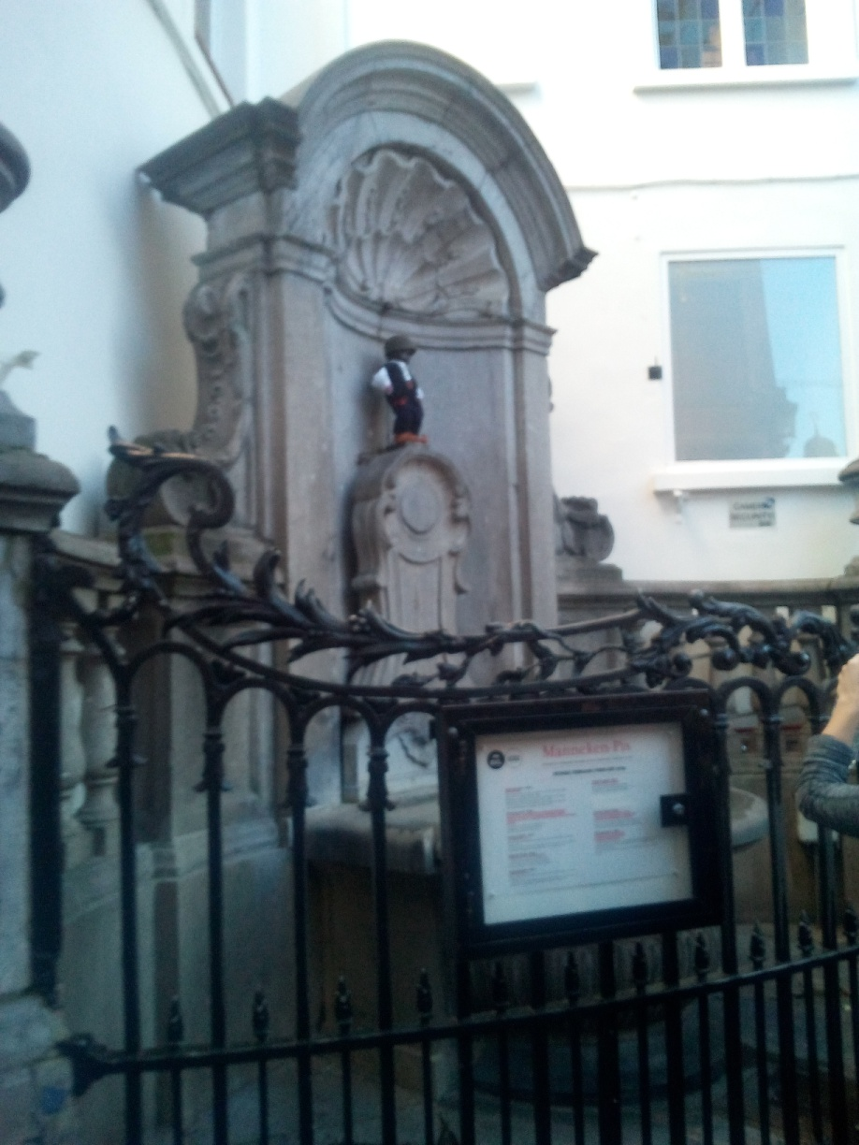
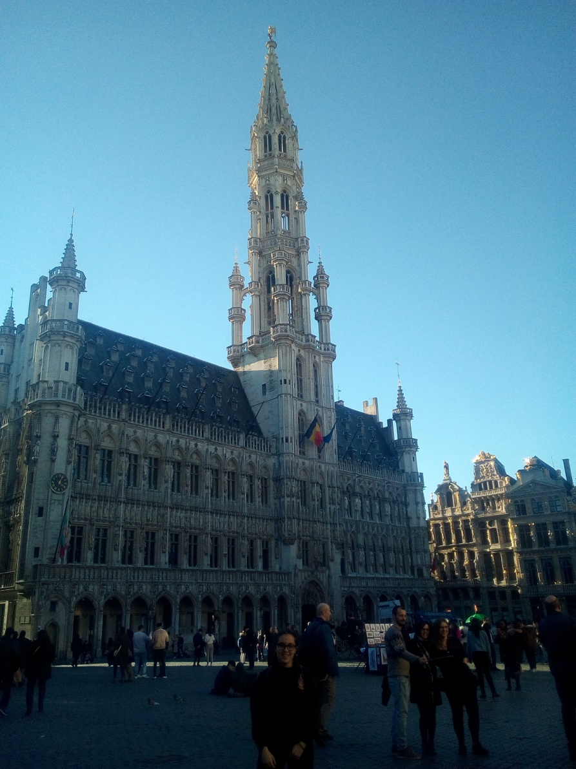
Later we went to the Brussels square, it was full of people and it was super nice
We had free time and we all ate a waffle and went shopping
Later we went to the airport where we had to ask for holnadeses and it was a bit sad because many cried, there were many hugs and I really want them to come to Spain
At the airport we loaded the mobiles we had dinner at Burger King and we went almost all the airport
We ride the plane, on the plane I listen to music and I fall asleep
When we arrived in Spain, the bus was waiting for us
in the bus we played the fool, we played, we talked and we listened to music
When my parents arrived they were waiting for me and I came home and we talked
I liked the trip a lot and I would like to do another one

Slide 12
ELENA POZA LAGUNILLA
THE END

