Slide 1
Madlen Mladenova Outside Hitter/ Opposite Hitter

Slide 2
Status: Available
Gender: Female
Position: Outside Hitter/ Opposite
Date of Birth: 12.05.2004
Graduation date: June, 2023
Club team: Levski, Sofia
Bulgarian National Team u19

Slide 3
Additional information
Height: 185 cm.
Weight: 75 kg.
Reach: 238 cm.
Approach high jump: 296 cm.
Standing block jump: 285 cm.
High school: 166 Sports High School “Vasil Levski”
Languages: Bulgarian, English
Desired degree: Kinesiology, Exercise Science
SAT grade/date: TBA
TOEFL grade/date: TBA

Slide 4
Volleyball Achievements
2019 High school tournament 2nd place - MVP
2019 National volleyball team training camp u16
2020 National volleyball team training camp u17
2020 Pleven cup tournament - 1st place
2021 Bulgarian republic championship - 5th place
2021 National volleyball team training camp u18
2022 Bulgarian republic championship - 5th place
2022 National volleyball team training camp u19

Slide 6
Video Analysis
Highlight Video:
https://www.youtube.com/watch?v=6ZjiUDBCeDQ&feature=youtu.be

Slide 7
Interview questions
Describe yourself with a few sentences:
I read a good number of books when I have free time and I'm always supporting and being there for my friends. I will always ask for help when needed, but mostly I like working things out on my own. I’m consistent of what I do, and my motto is to work step by step and never live without goals, because goals are what keep us motivated to get better every day. I like receiving constructive feedback because it helps me grow to being a better person and an athlete. I’m always working on improving my volleyball skills, as well as my knowledge. My main goal is my hobby to be my career (to be a pro volleyball player) when I’m done studying and improving in the USA and when I’m retired from the sport, I can find my second favorite thing to do and have a career with it. That’s why I know going to the USA will be one of the best choices I make, because it will allow me to balance education and sport the best way.

Slide 8
What does volleyball mean to you?
Volleyball is being part of my life for a very long time now. It helps me be more hardworking, focused, driven and most importantly – happy. It is an opportunity to meet a lot of people and make contacts around the country and even the world. I love playing, because I feel motivated to do better than the day before and I’m always working toward progressing my game every season.
What does your education mean to you?
My education is as important to me as is the sport. It helps the development of mental activity, which in turn contributes to playing smarter. My education is like a plan B in life, because when you are retired from the sport, you can work on building a career of your choice. You can always learn more and more because knowledge and health are the most valuable things a person can have.

Slide 9
What are your main goals as a student-athlete in the USA?
My first goal is to improve in volleyball as much as I can, to push myself to the limits and always stay positive through the end. My second goal is to have the best education and the most knowledge I can receive, so I can have choices of what to do in the future.

Slide 10
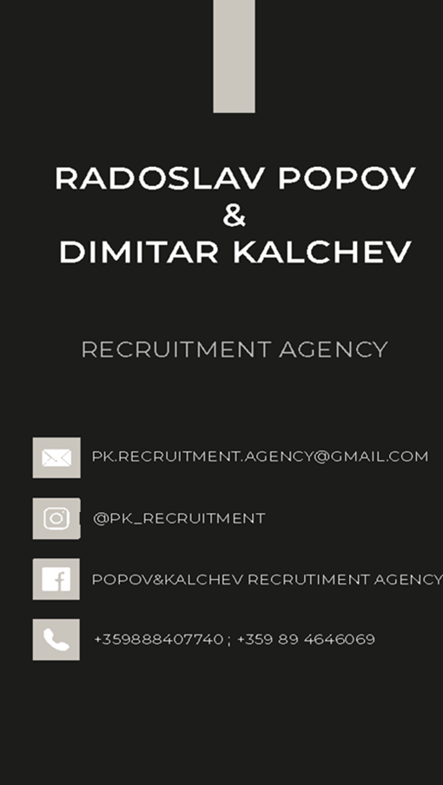
The presentation provides all the basic information for the student-athlete. More details and video can be provided if needed. Contact us.

