Slide 1
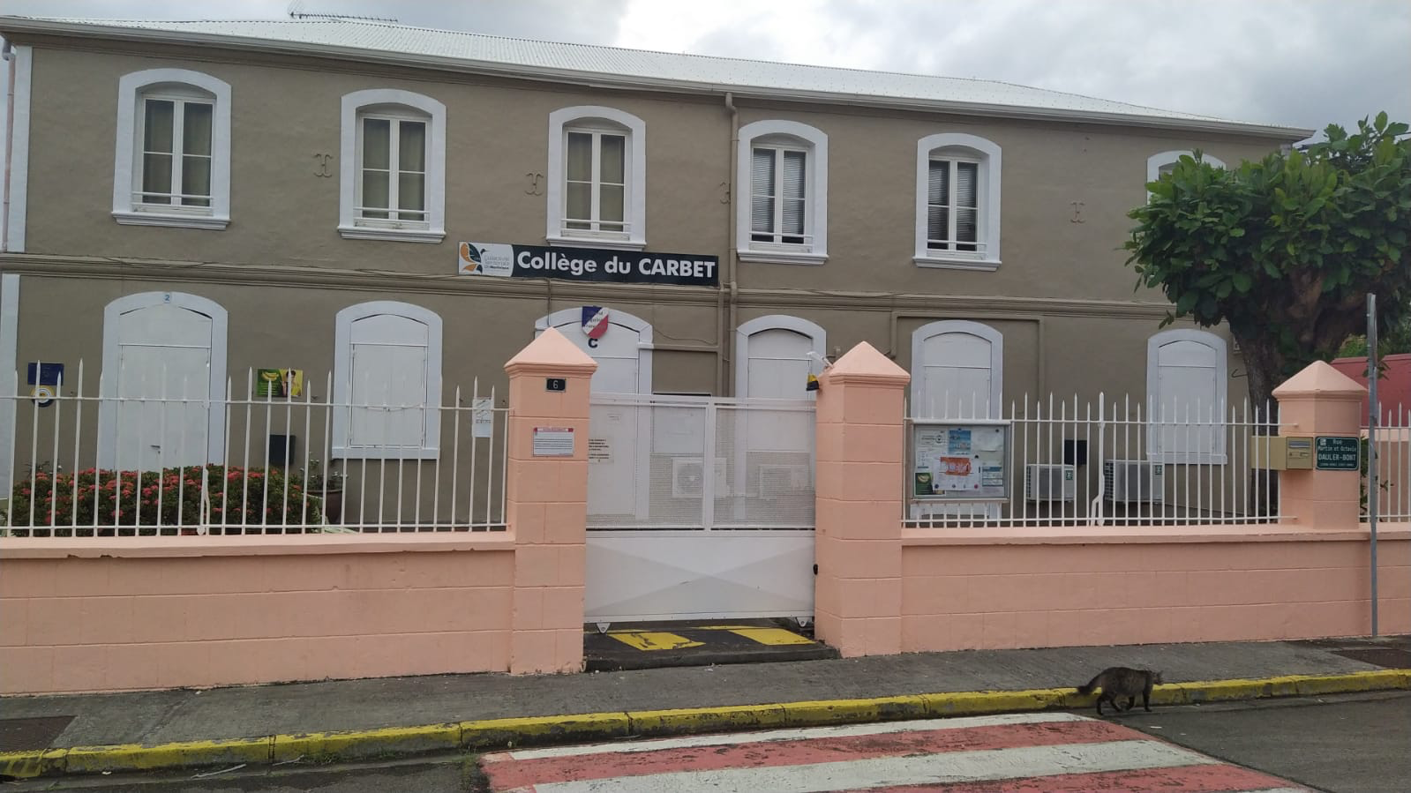
Equity and equality Europe let’s stay together last mobility

Slide 2
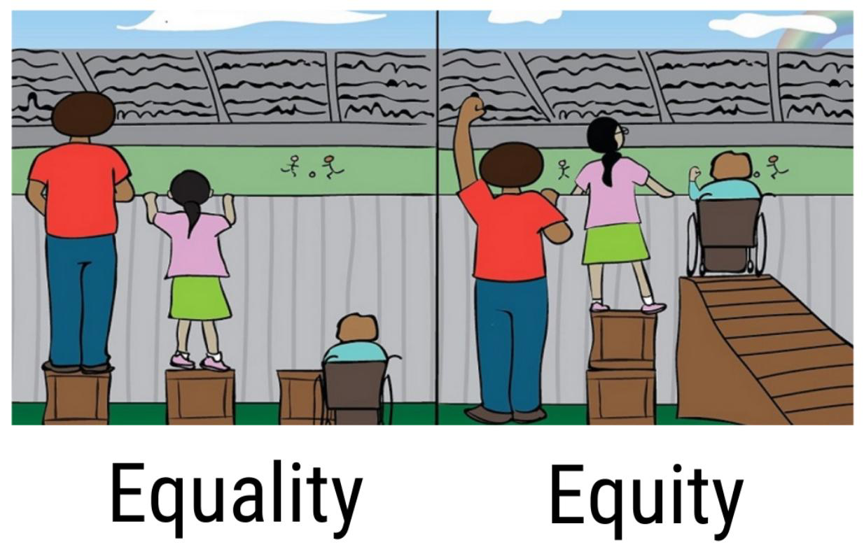
For this last mobility which takes place in Romania from May 2 to 6
In the Onisifor Ghibu High-school,in Sibiu on the topic: From equality to equity we are unfortunately unable to attend it.But we are delighted to participate remotely in the various workshops.Today we will tell you about what we can observe about this topic in our secondary school : The Secondary school of Carbet; that some of you have had the chance to discover.

Slide 3
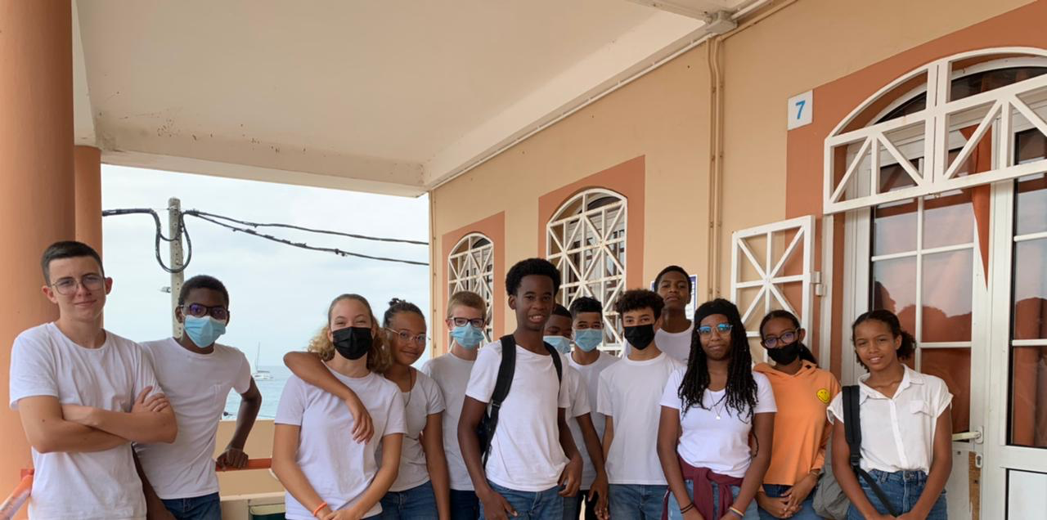
Equality in our school
Our school welcomes all kind of students from different origins, so we’ve got black and white students (…),we try to work together.With the teachers we fight against racism and bullying through workshops etc… because it’s important to feel happy, comfortable and included to come and learn in our school: all together.

Slide 4
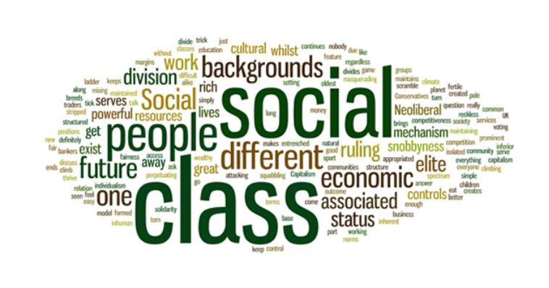
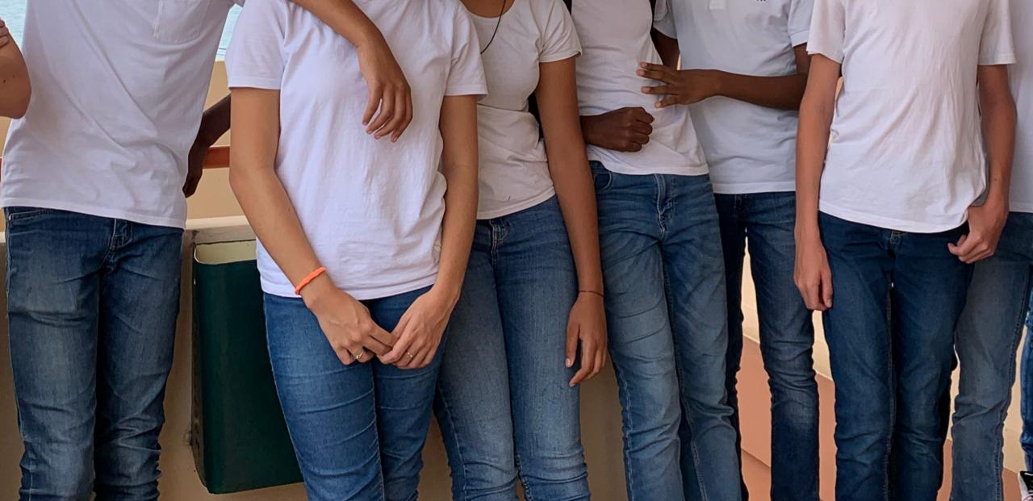
Social equality
Our school accepts students from different social backgrounds. We wear a plain uniform (white tee-shirt and blue jeans) so students who haven’t got a lot of money don’t feel different and rejected.

Slide 5
The solutions and help provided
Thanks to the library, our school provides students with computers and books. Although it is not a rich school, there are social funds to help the poorest when we can. For instance, we try to send abroad, pupils who can’t afford travelling ( thanks to projects like our Erasmus project).

Slide 6
Equity in our school
Our school has started to implement equity. Teachers try to give the same opportunities to girls and boys. Indeed whatever our gender, all students can succeed and do what they want. A girl can be a mechanic , a pilot or a manager; not just a cook or a secretary. It’s the same for boys. Both our science teacher and nurse have organized sessions to talk about the dangers of social networks because of the sexism they spread. We have to be aware and careful.

Slide 7
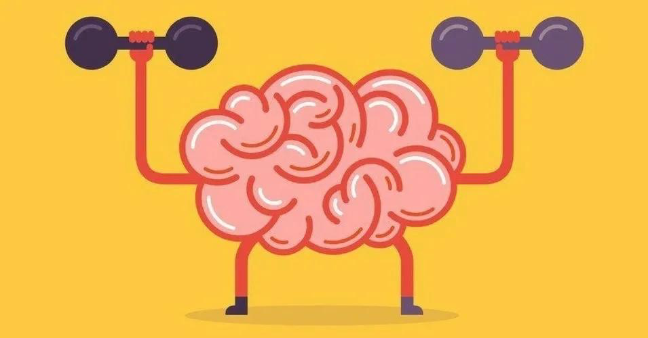
Consideration of individual differences
For children who have special needs all teachers adapt their teaching (lessons, tests).They try to take into account each student’s specificity.They don’t insist on our weakness but they value our strength to highlight it. Thanks to that we feel confident, we improve our skills,our results. And finally we succeed.

Slide 8
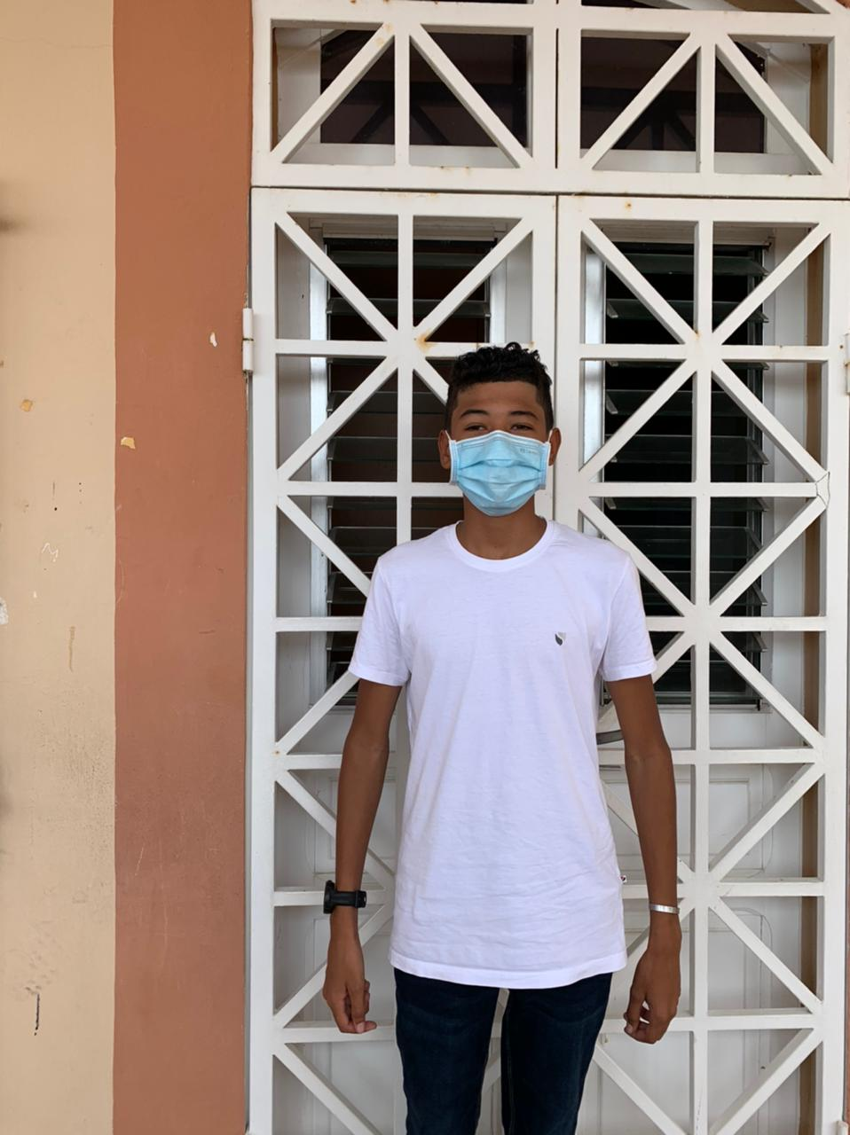

Slide 9
Conclusion
We believe that schools are the right places to experience and to work on equity and equality. It allows us to open our minds to the world and to the people around us, to take into account everyone’s differences, to broaden our choices to become ambitious and confident.

Slide 10
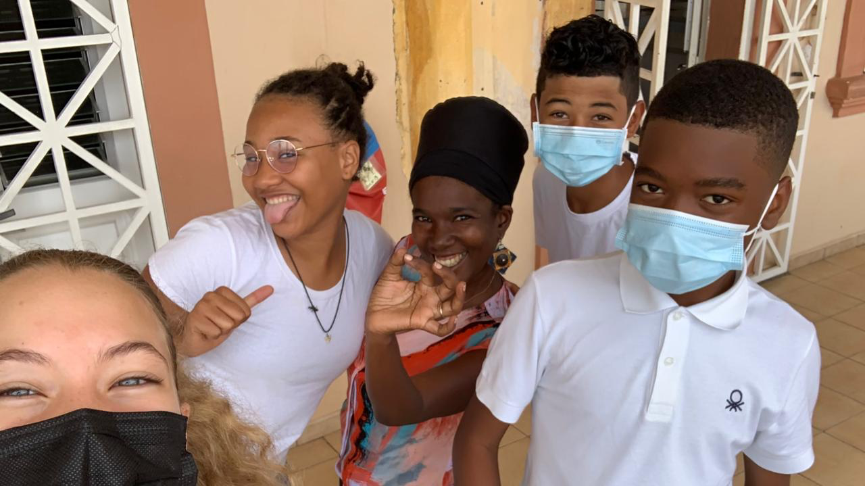
Thank you for your attention !We wish you a wonderful week in Romania with a ton of discoveries and a lot of fun!
Enjoy!

