Slide 1
Elitsa Peneva SETTER

Slide 2
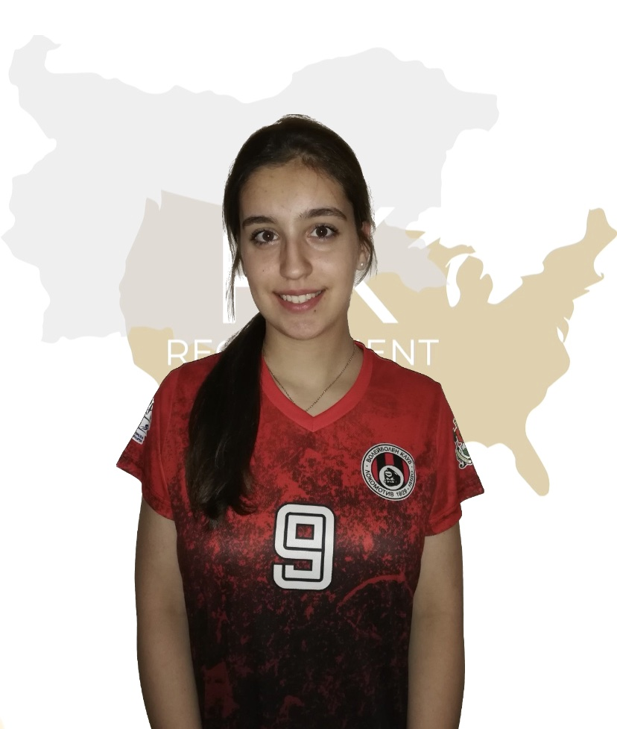
Status: Available
Gender: Female
Position: Setter
Date of Birth: 07.03.2004
Graduation date: June, 2023
Club team: Lokomotiv Sofia, Sofia

Slide 3
Additional information
Height: 175 cm.
Weight: 63 kg.
Reach: 225 cm.
Approach high jump: 275 cm.
Standing block jump: 255 cm.
High school: „William Gladstone“ Sofia
Languages: Bulgarian, English, German
Desired degree: Economics, Sports Journalism, Digital marketing
SAT grade/date: TBA IELTS: Overall band score: 6.5
TOEFL grade/date: TBA

Slide 4
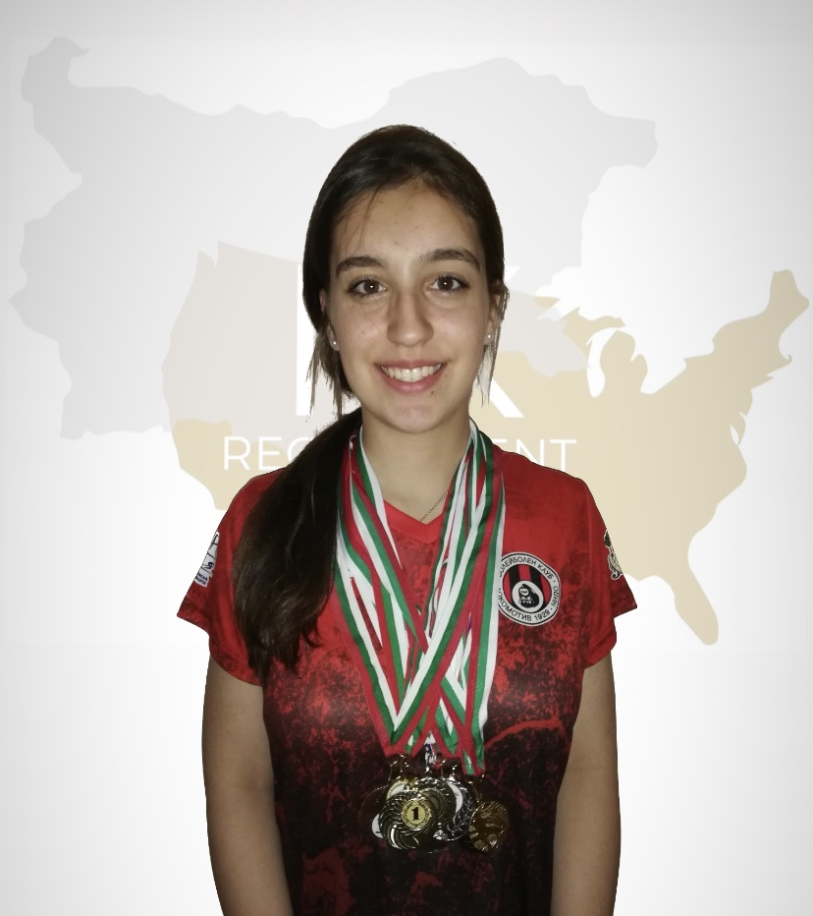
Volleyball Achievements
2022- U19 National Championship - 4th place;
2 International Tournaments in Serbia-1st and 2nd place;
Summer Tournament in Kiten, Bulgaria „Golden Spike“- 1st place
Annual pre-season tournaments in Sofia- two 1st places;

Slide 6
Video Analysis
Highlight Video:
https://youtu.be/zK6zPZb-sPo
Full Match:

Slide 8
Interview questions
Describe yourself with a few sentences:
I am a very persistent, responsible, patient and a positive person. I work well in a team and quickly adapt to new challenges. For me, education is extremely important. I am a diligent person and I like to do my work on time. I always attend the training sessions with a lot of enthusiasm and desire. In my free time, I like to hang out with friends, read, listen to music, walk in nature, watch movies or series.
What does volleyball mean to you?
For me, volleyball is the thing that I do with the greatest dedication and pleasure. When I play volleyball I have fun, I feel satisfied and I do everything with a lot of passion.

Slide 9
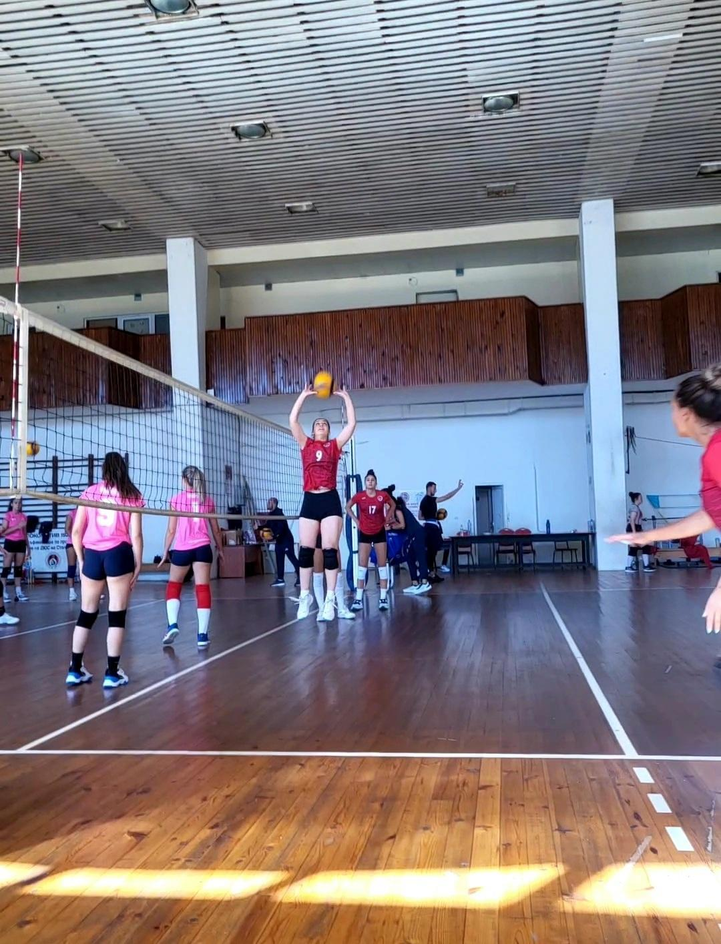

Slide 10
What does your education mean to you?
My education has always been significant to me. I always take my lessons and
homework seriously. For me it is very important to be prepared in class, on tests and
exams. Therefore, I spend almost all my free time for my assignments and never leave
them to the last moment. Higher education is really important to me because I believe it
will help me reach my goals successfully, open a lot of new doors and I will learn many
new things.

Slide 11
What are your main goals as a student-athlete in the USA?
For me, to be a student- athlete in the USA is a great opportunity to combine studies and sports. My main goals are to find the university, where I will feel welcomed, to study the desired degree and to get a great education. Furthermore, to find the most suitable team for me, to continue my sports development and to achieve many successes with my team. I am looking for the best combination between studying and playing volleyball, so I believe I will find it in the USA.

Slide 12
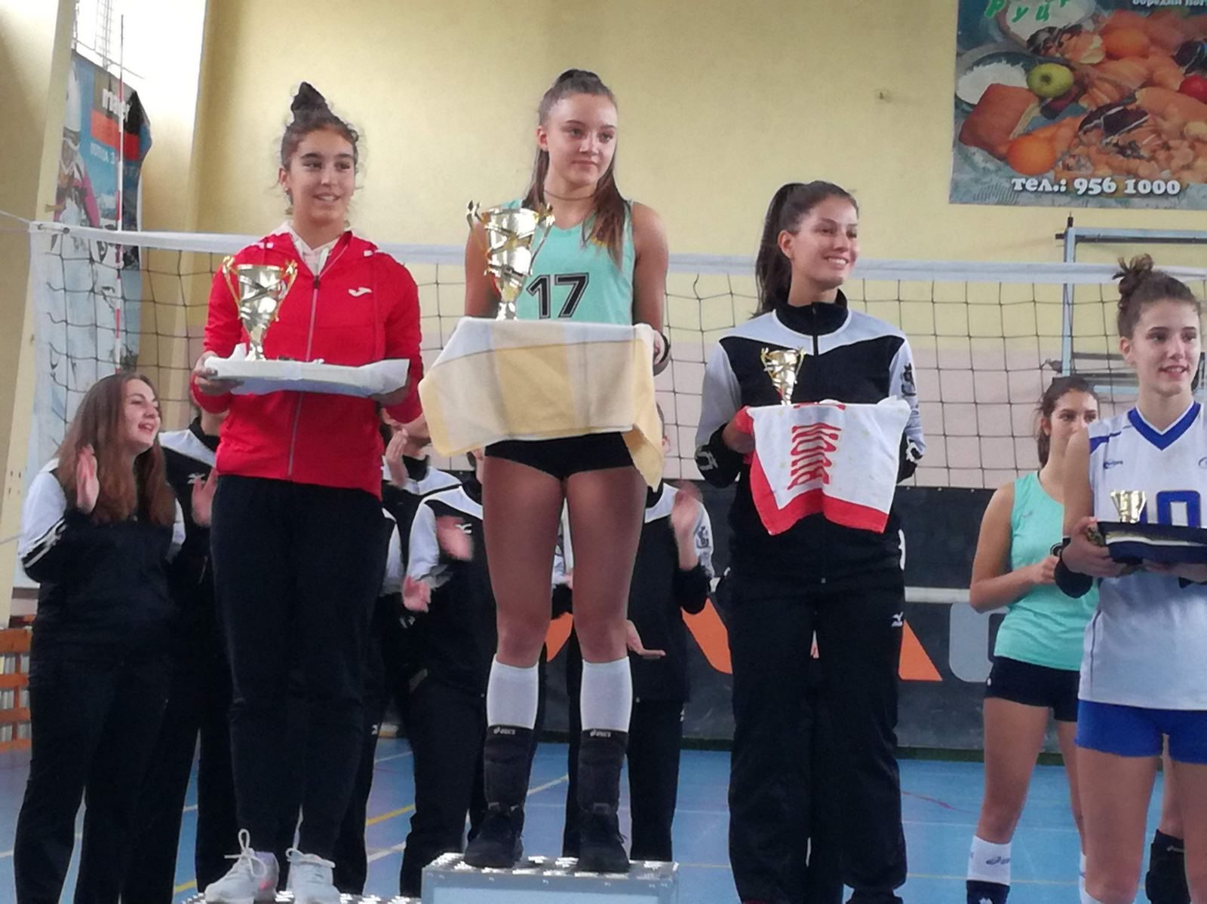

Slide 13
The presentation provides all the basic information for the student-athlete. More details and video can be provided if needed. Contact us.

